Slide 1
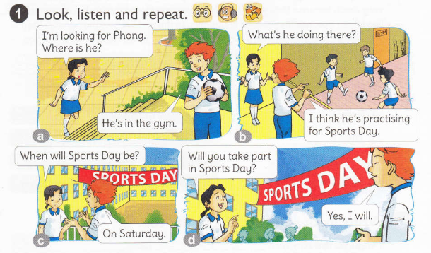
Unit10: When will sports Day be?

