Slide 1
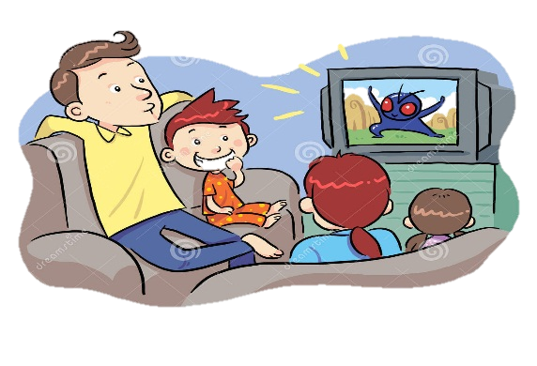
1
2
3
4
8
in the countryside
at the beach
6
7
5
at school
at home
Notes:
In the countryside 7
At school 6
At home 5
At the beach 8

Slide 2
Monday, October 2th, 2018
UNIT 5: WHERE WILL YOU BE THIS WEEKEND?
Lesson 2: parts 1,2,3 (p.32)
Objective:
In the end of the lesson, students will be able to ask and answer questions about what someone will do.
Mục tiêu:
Kết thúc bài học, học sinh có thể hỏi và trả lời về ai đó sẽ làm gì.

Slide 3
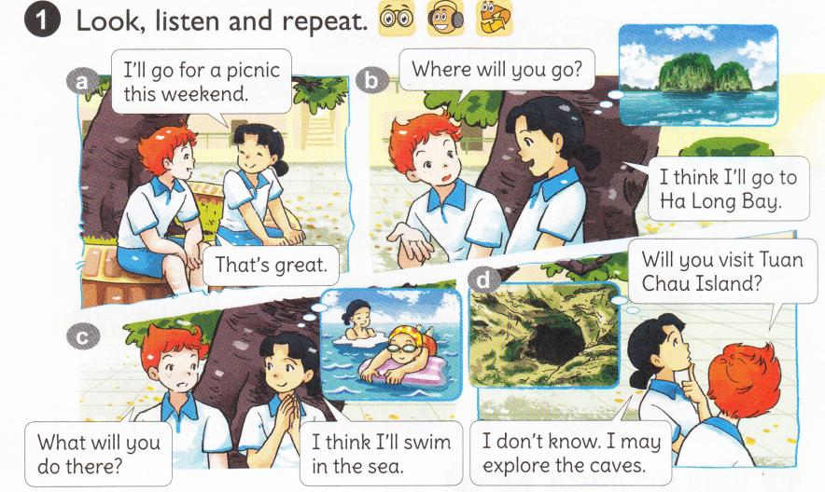

Slide 4
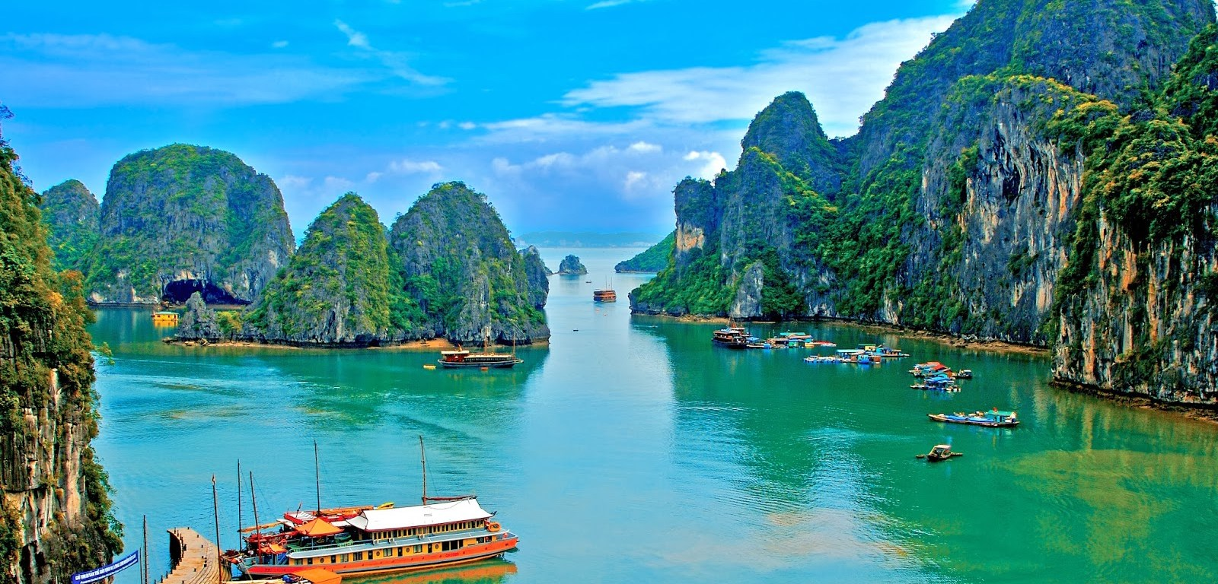
Ha Long Bay

Slide 5
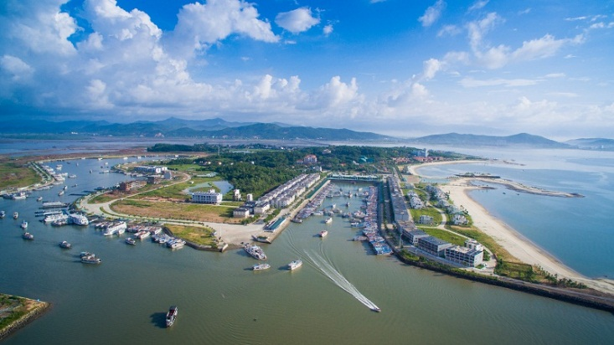
Tuan Chau Island

Slide 6
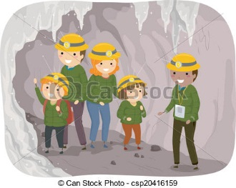
explore the
caves

Slide 7
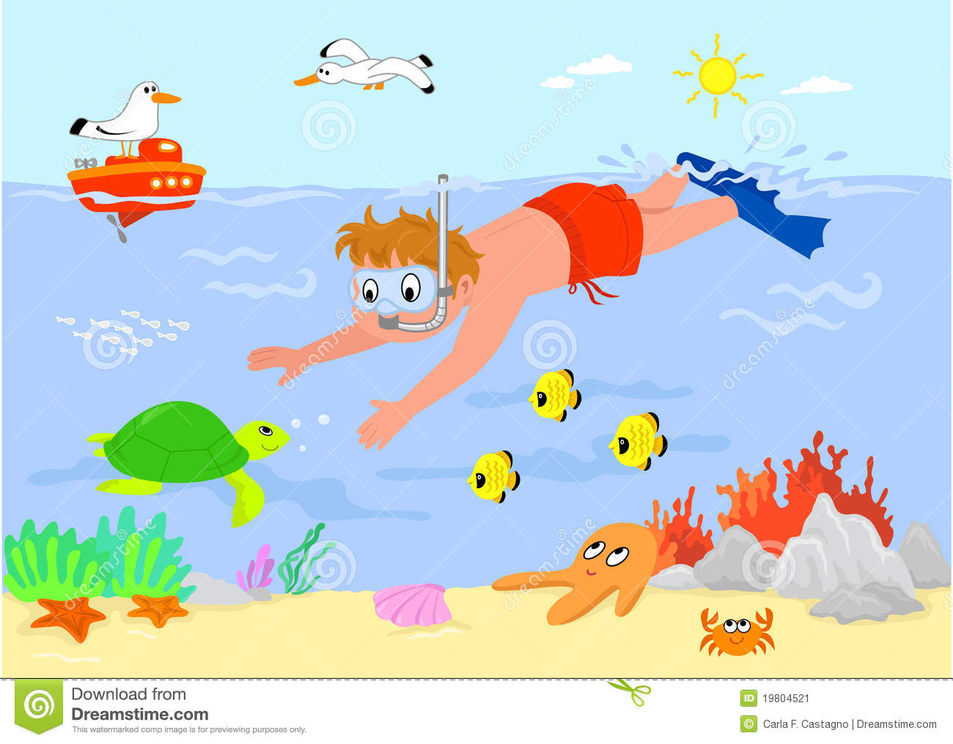
swim in the sea

Slide 10
What will you do at Ha Long Bay?
I think I’ll swim in the sea.
I don’t know. I may explore the caves.

Slide 11
take a boat trip around the islands

Slide 12
build sandcastles on the beach

Slide 13
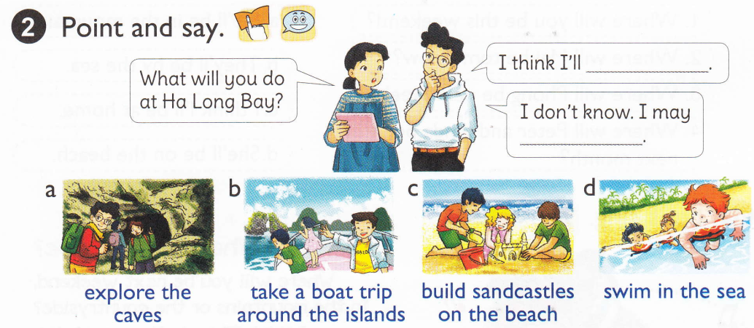

Slide 14
3. Let’s talk:
* Where will you be next week?
I think I’ll in the countryside.
*What will you do?
I don’t know. I may have a picnic.
I think I’ll play with my grandparents.

Slide 15
Monday, October 2th, 2018
UNIT 5: WHERE WILL YOU BE THIS WEEKEND?
Lesson 2: parts 1,2,3 (p.32)
1. Look, listen and repeat:
Swim in the sea
Explore the caves
2. Point and say:
- take a boat trip around the islands
- build sandcastles on the beach
3. Let’s talk:
*Homework:
- Learn by heart the vocabulary and the sentence patterns.

