Slide 1
Welcome to our class 5 A
Teacher: Tran Dang KhanhNhung

Slide 2
UNIT 3
Where didyou go on holiday?
Lesson 2

Slide 3
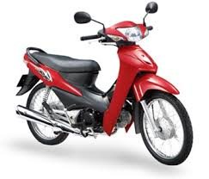
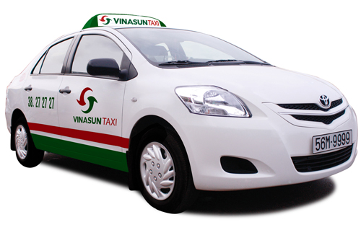
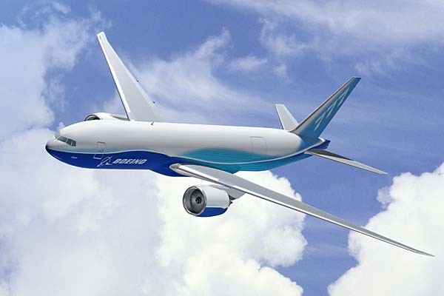
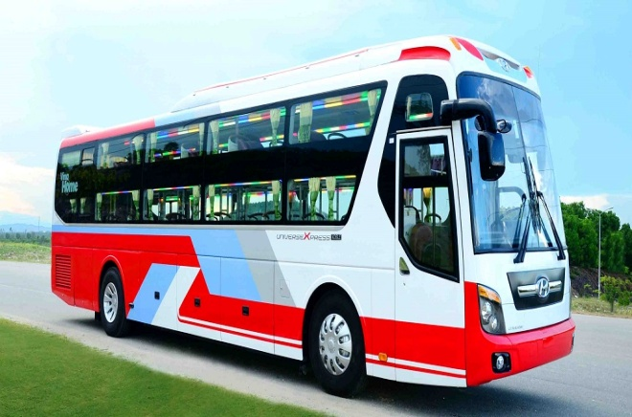
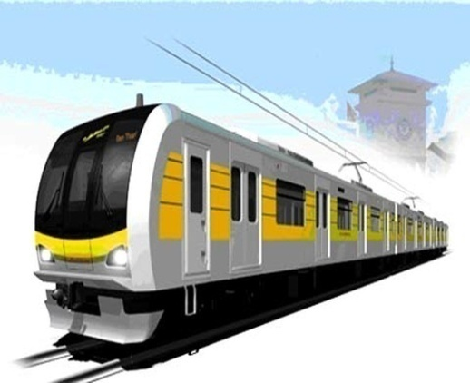
vocabulary
plane
motorbike
taxi
train
underground
coach

Slide 4
Model sentences:
A :How did you get there?
B: I went by coach.

Slide 5
Model sentences:
A: How did you get there?
B: I went by .

Slide 6
Model sentences:
A: How did you get there?
B: I went by .

Slide 7
Model sentences:
A: How did you get there?
B: I went by.

Slide 8
Model sentences:
A: How did you get there?
B: I went by.

Slide 9
Model sentences:
A: How did you get there?
B: I went by .

Slide 10
A: How did you get there?
B: I went by ………….
plane
motorbike
taxi
train
underground
coach

Slide 11
CHÚC CÁC EM HỌC TỐT

