Slide 1
Welcome to
our class

Slide 2
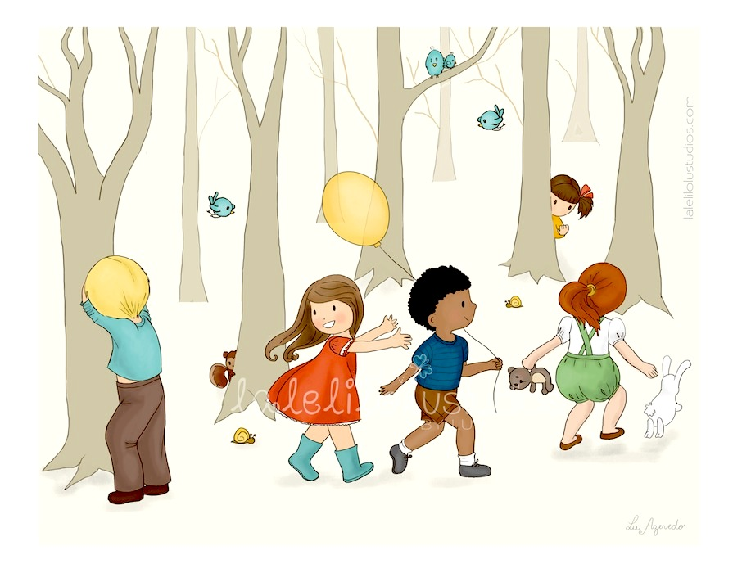
Dance
Play hide-and-seek

Slide 3
Chat with friends

Slide 4
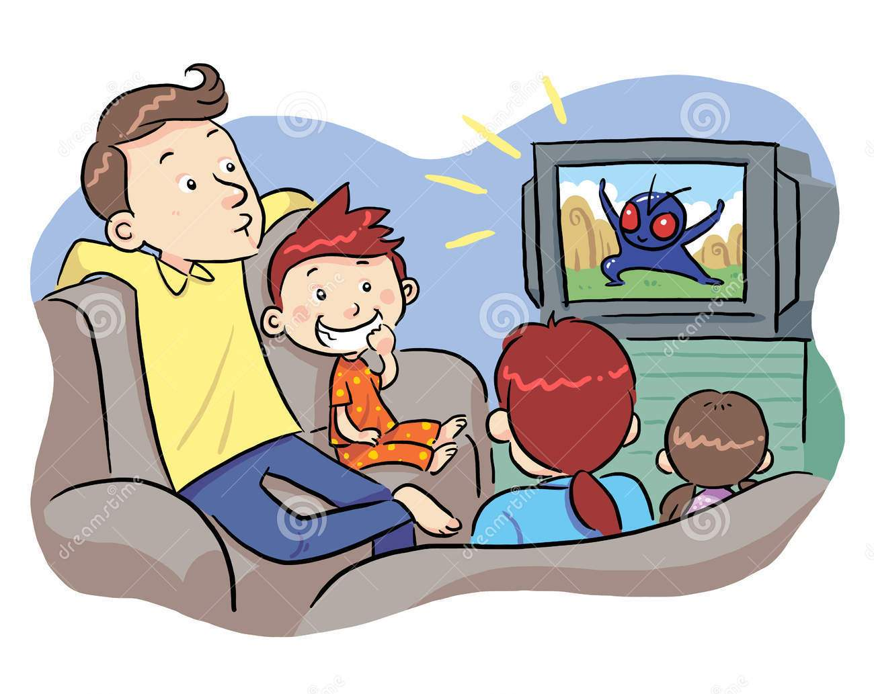
Watch a cartoon

Slide 5
1. Look, listen and repeat
Wednesday, September 30th 2015.
Unit 3. A birthday party
Lesson 3. Part 1, 2
2. Point, ask and answer

Slide 6
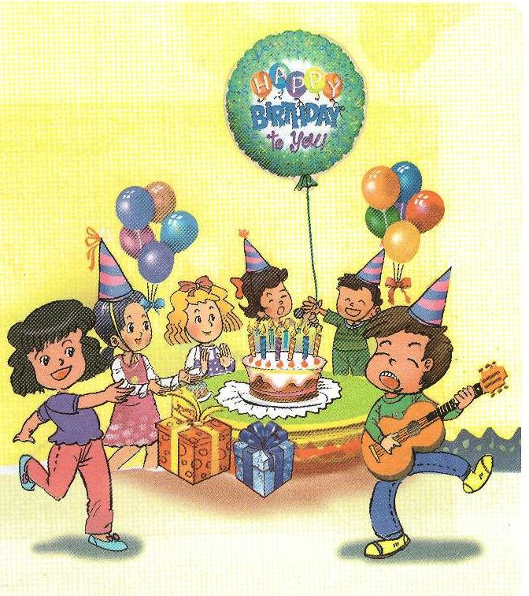
Last night
1. Look, listen and repeat
Tony’s birthday party

Slide 7
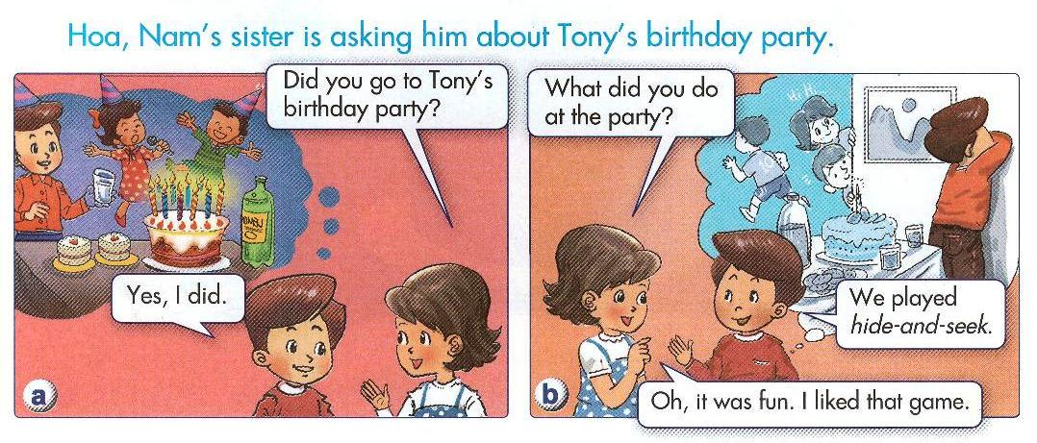

Slide 8
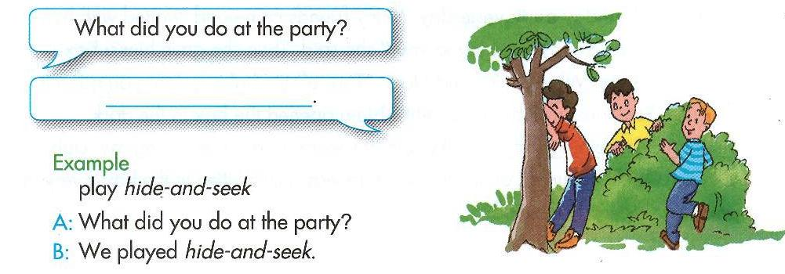
Imagine you were at Tony’s birthday party last night
2. Point, ask and answer

Slide 9
40
35
45
4
1
50
10
2
5
30
1
3
25
5
6
20
15

Slide 10
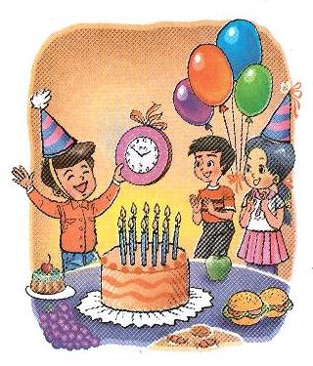
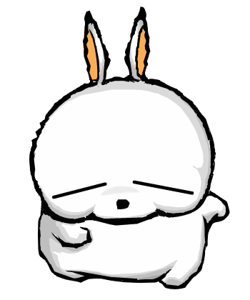
What present did you give Tony?
A pink clock.

Slide 11
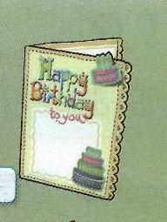
What did Mai give Tony?
A birthday card.

Slide 12
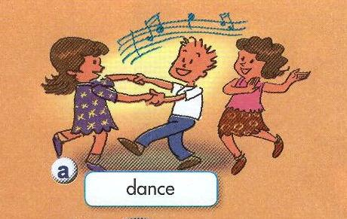
What did you do at the party?
We danced.

Slide 13
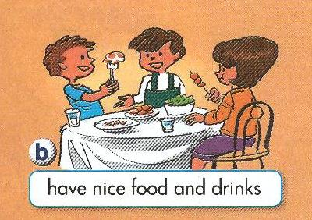
What did you do at the party?
We had nice food and drinks.

Slide 14
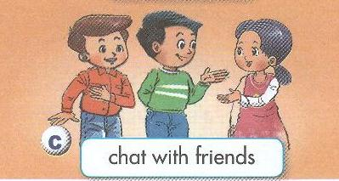
What did you do at the party?
We chatted with friends.

Slide 15
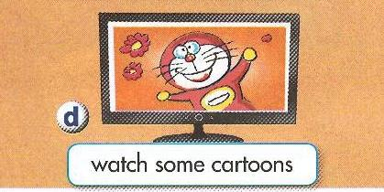
What did you do at the party?
We watched some cartoons.

Slide 16
Miming activities
What did he/ she do at the party?

Slide 17
Home link:
- Read again the dialogue
- Prepare for the next lesson.

Slide 18
Thanks for your attention

