Slide 1
SỞ GIÁO DỤC VÀ ĐÀO TẠO VĨNH PHÚC
Cuộc thi Thiết kế bài giảng E – Learning năm học 2017 - 2018
---------------------------------------------
Unit 2: I always get up early. How about you?
Lesson 1 (1, 2, 3)
Môn: Tiếng Anh lớp 5
Giáo viên:
Email:
Điện thoại:
Thành phố Vĩnh Yên, Tỉnh Vĩnh Phúc
Tháng 4/2018

Slide 2
Video giới thiệu

Slide 3
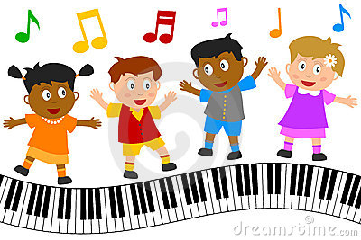
Let’s sing a song and dance

Slide 4
“Hello Song”

Slide 5
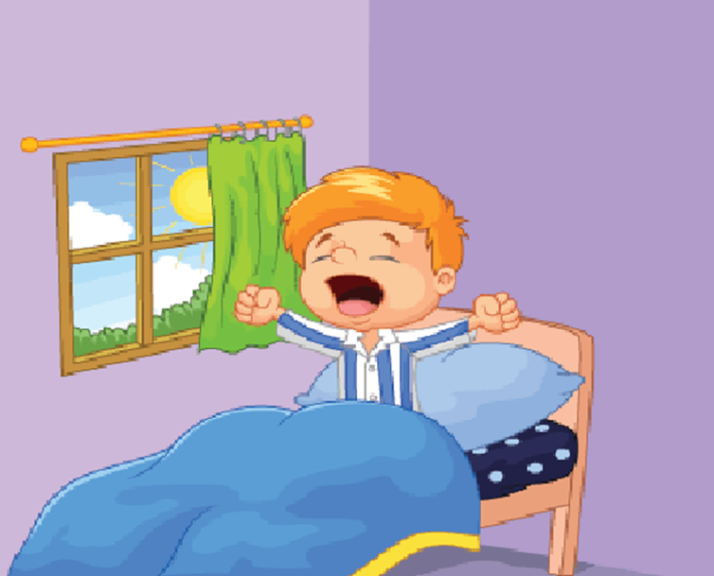
Unit 2: I always get up early. How about you?
Lesson 1: (1,2,3)

Slide 6
OBJECTIVES
Knowledge: students will be able to ask and answer questions about someone’s daily routine.
Skills: Listening – Speaking.
Vocabulary: always, usually, often, sometimes…
Grammar: What do you do…?
I always/ usually/ often….

Slide 7
New words

Slide 8
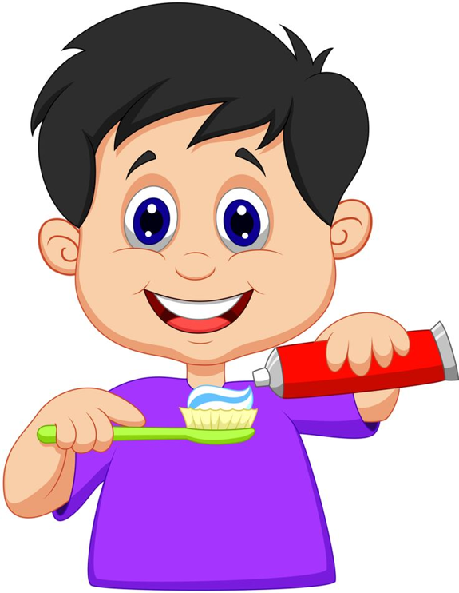
Brush teeth

Slide 9
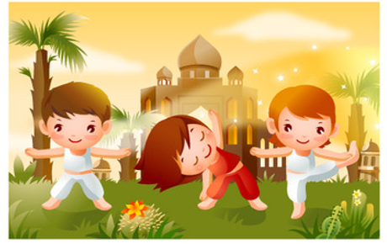
Do morning excercise

Slide 10
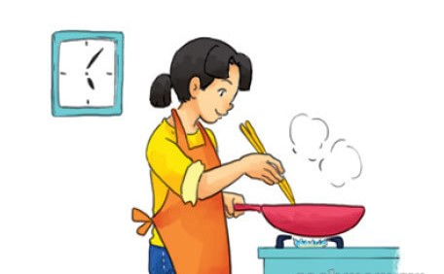
Cook dinner

Slide 11
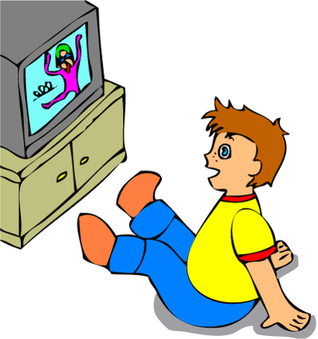
Watch TV

Slide 12
Get up

Slide 13
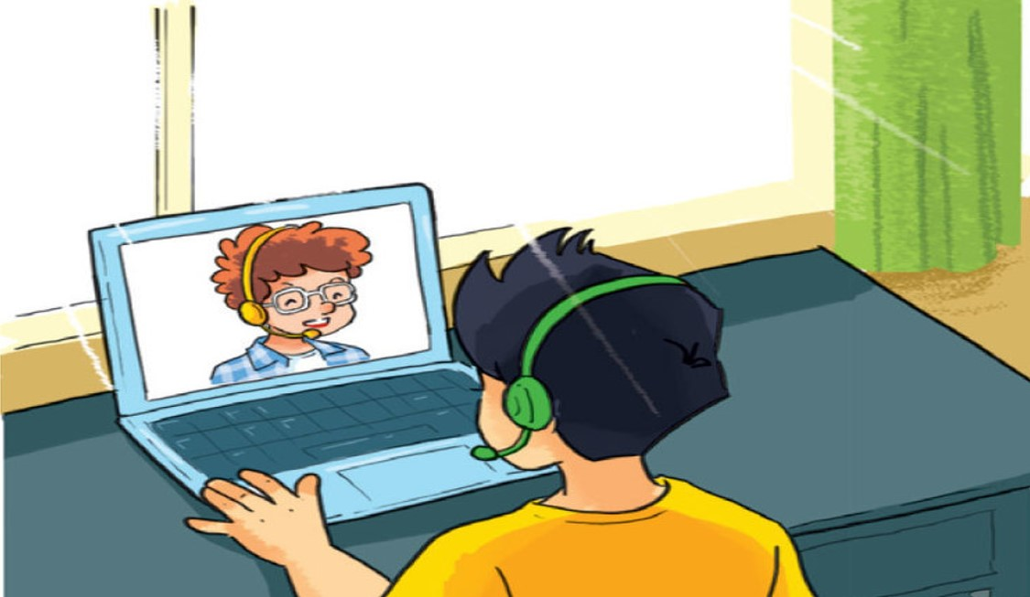
Talk with friends online

Slide 14
Let’s play
a matching game

Slide 15
Match the English words in column 1 with their meanings in column 2
Column 1
Column 2
D
1. Get up
A.
Xem tivi
C
2. Do morning excercise
B.
Nói chuyện trên mạng với bạn bè
A
3. Watch TV
C.
Tập thể dục buổi sáng
B
4. Talk with friends online
D.
Thức dậy
F
5. Cook dinner
E.
Đánh răng
E
6. Brush teeth
F.
Nấu bữa tối
Correct - Click anywhere or press Control Y to continue
Incorrect - Click anywhere or press Control Y to continue
You answered this correctly!
Submit
Clear
Your answer:
You must answer the question before continuing
You did not answer this question completely
The correct answer is:

Slide 16
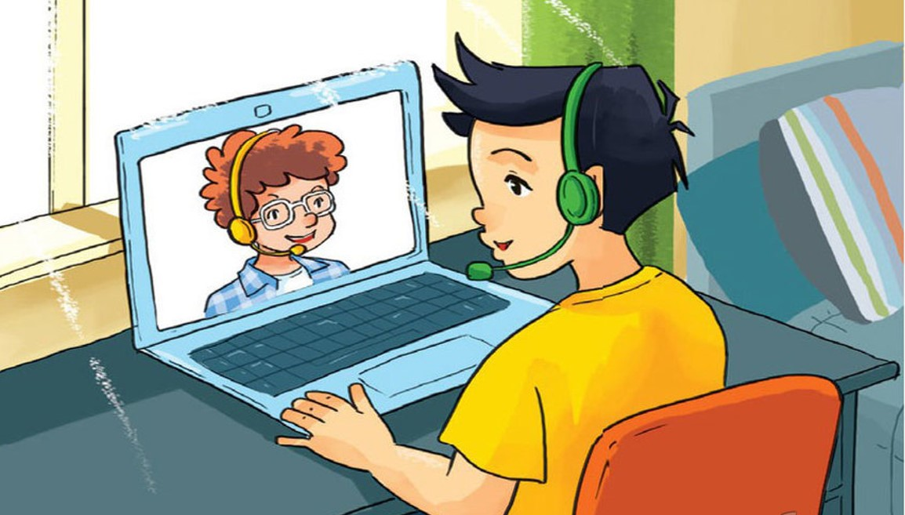
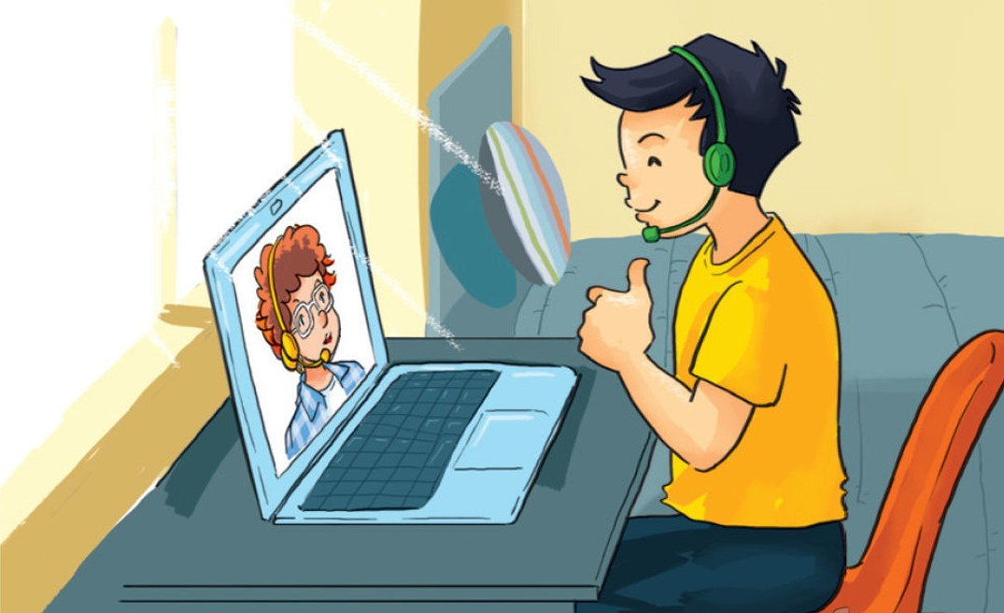
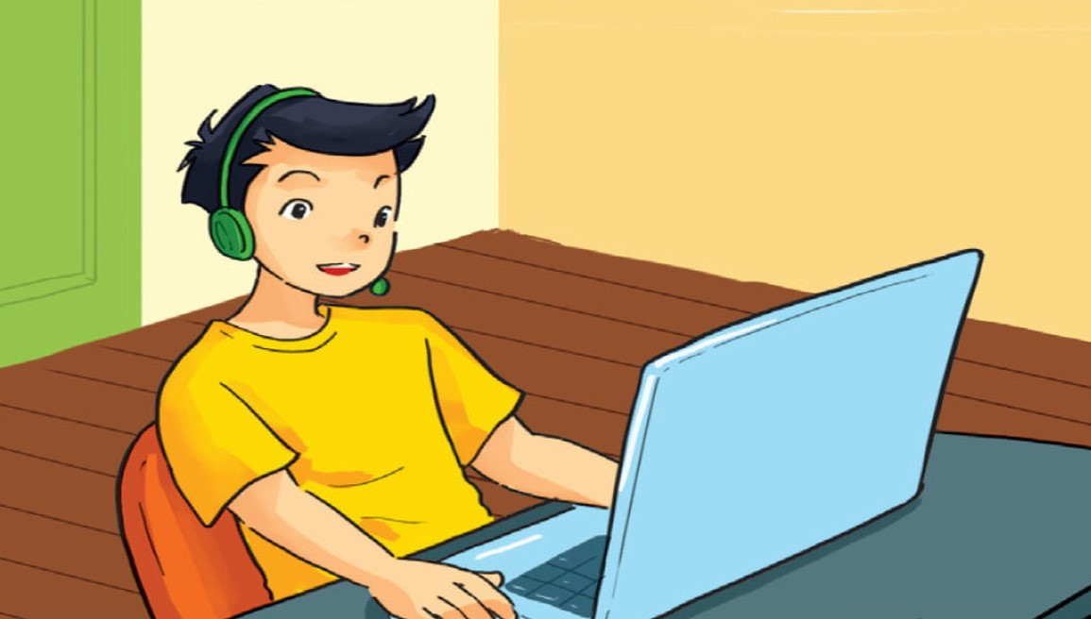
1. Look, listen and repeat

Slide 17
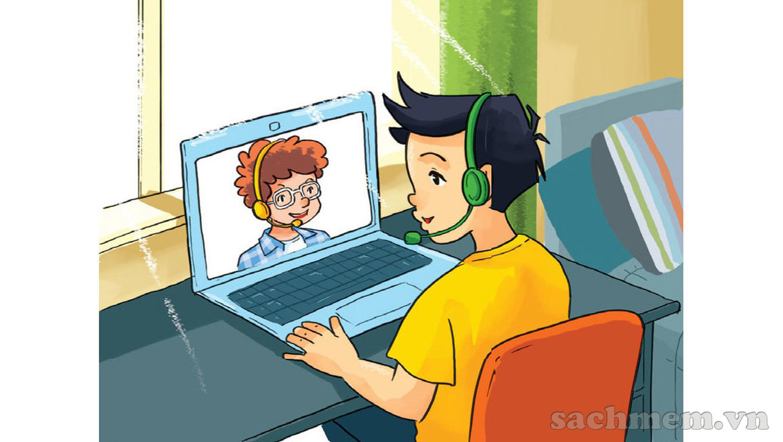

Hi, Quan! You’re up early.
Hi, Tom! Yes, I always get up early. How about you?

Slide 18
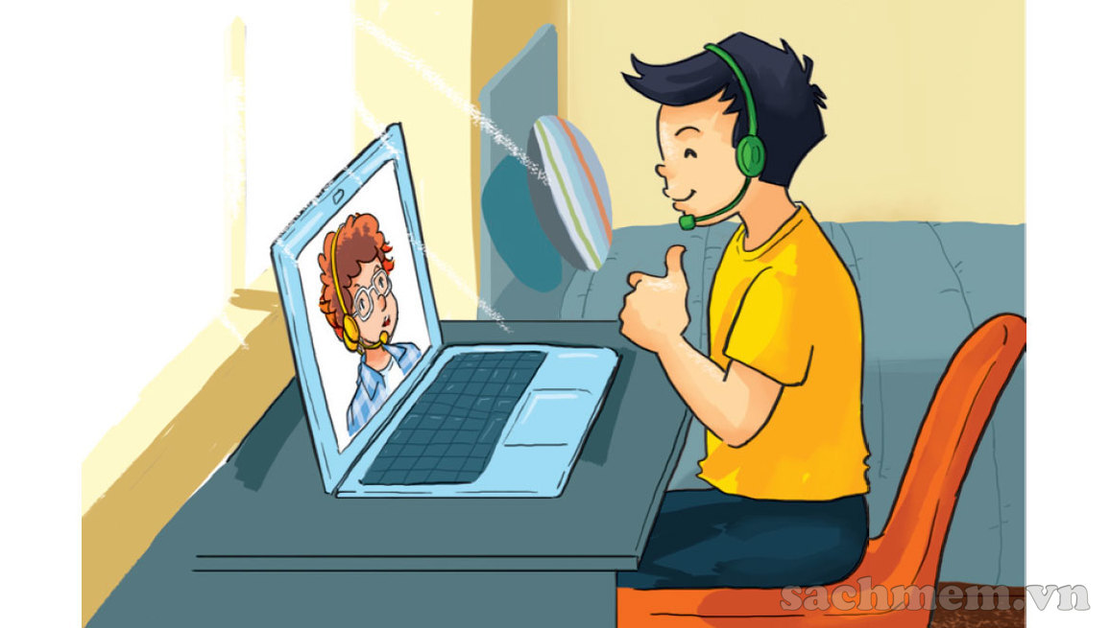
Me too. I get up early and I always have a big breakfast before I go to school.
Good idea!

Slide 19
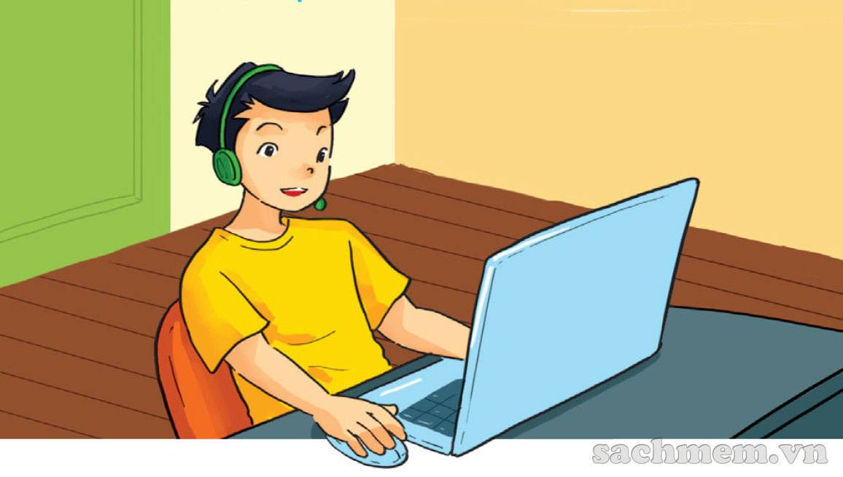
What do you do in the afternoon?
After school? I usually do my homework.

Slide 20
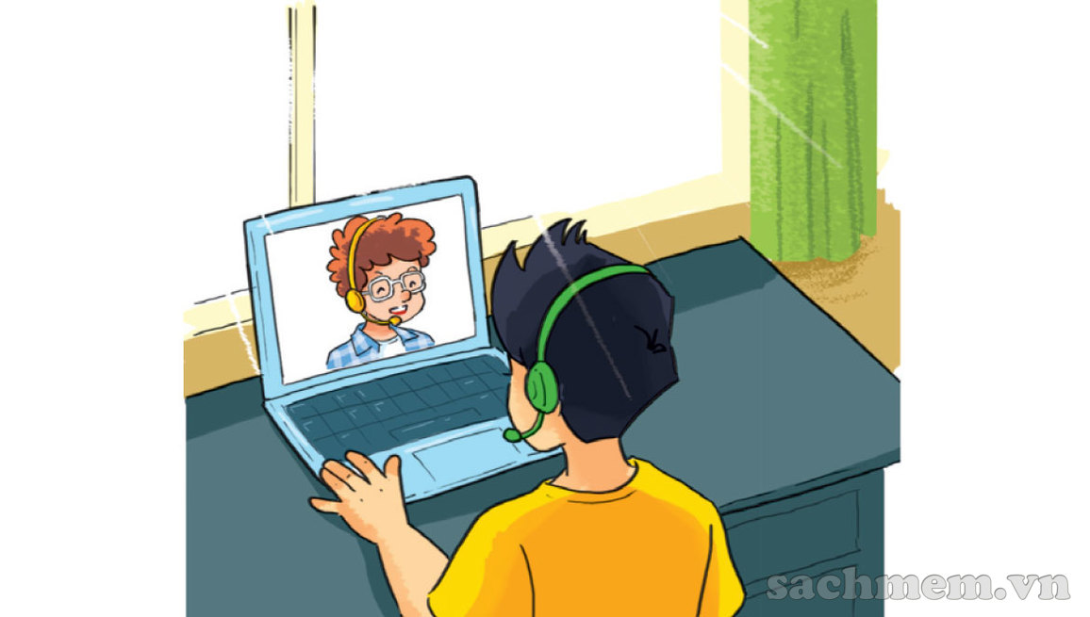
So do I. And I often talk with friends online.
I can see that, haha!

Slide 21
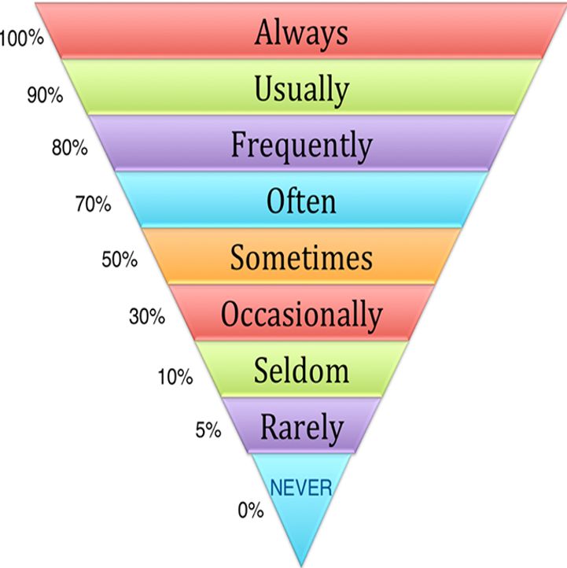
Adverbs of frequency
Luôn luôn
Thường xuyên
Thường xuyên
Thường xuyên
Thỉnh thoảng
Thi thoảng
Ít khi
Hiếm khi
Không bao giờ

Slide 22
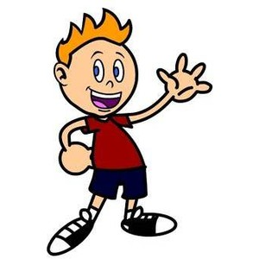

Grammar:
What do you do……….?
I always/ usually/ often/ sometimes......

Slide 23


Example 1:
What do you do in the morning?
I often read books.

Slide 24
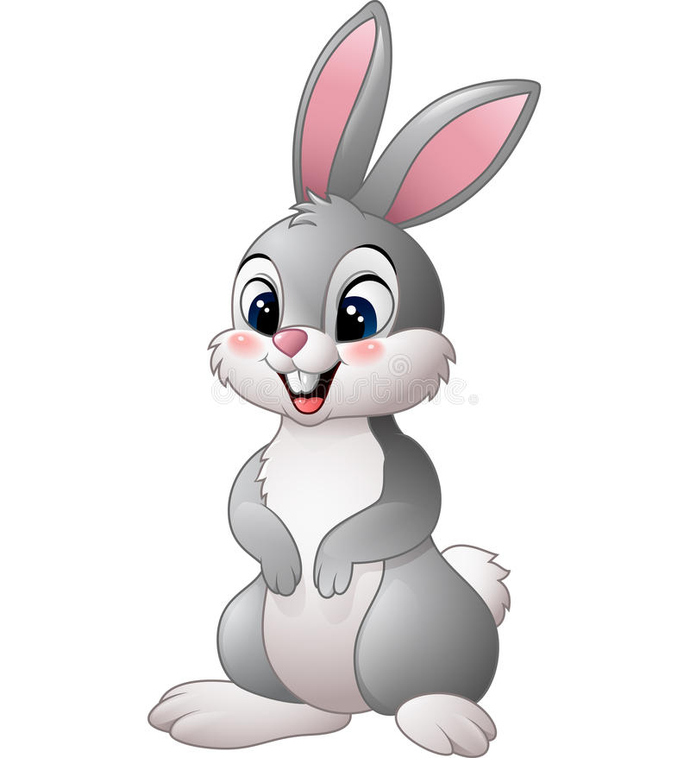
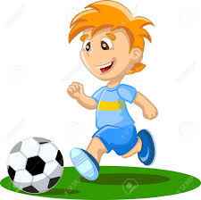
Example 2:
What do you do in the afternoon?
I usually play football.

Slide 25
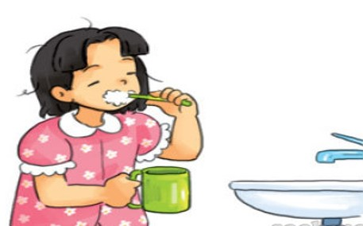
2. Point and say
morning/ always brush my teeth

Slide 26
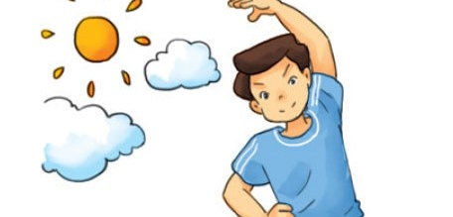
morning/ usually do morning exercise

Slide 27
afternoon/ often cook dinner

Slide 28
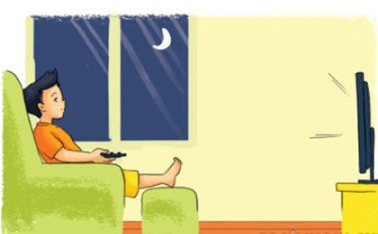
evening/ sometimes watch TV

Slide 29
Let’s talk
3
What do you do in the morning/ afternoon/ evening?
I always/ usually/ often/ sometimes……………

Slide 30
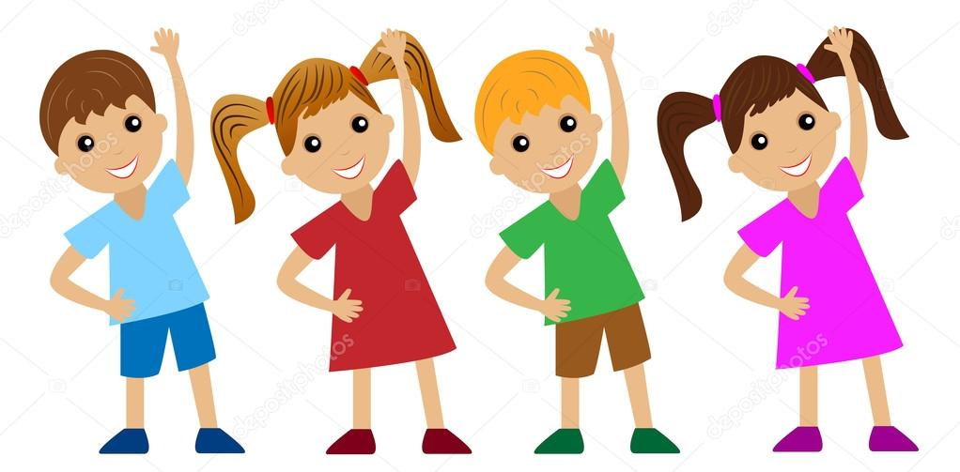
What do you do in the morning?
A)
I often do morning excercise.
B)
I often brush my teeth.
C)
I often cook dinner.
Correct - Click anywhere or press Control Y to continue
Incorrect - Click anywhere or press Control Y to continue
You answered this correctly!
Submit
Clear
Your answer:
You did not answer this question completely
You must answer the question before continuing
The correct answer is:

Slide 31
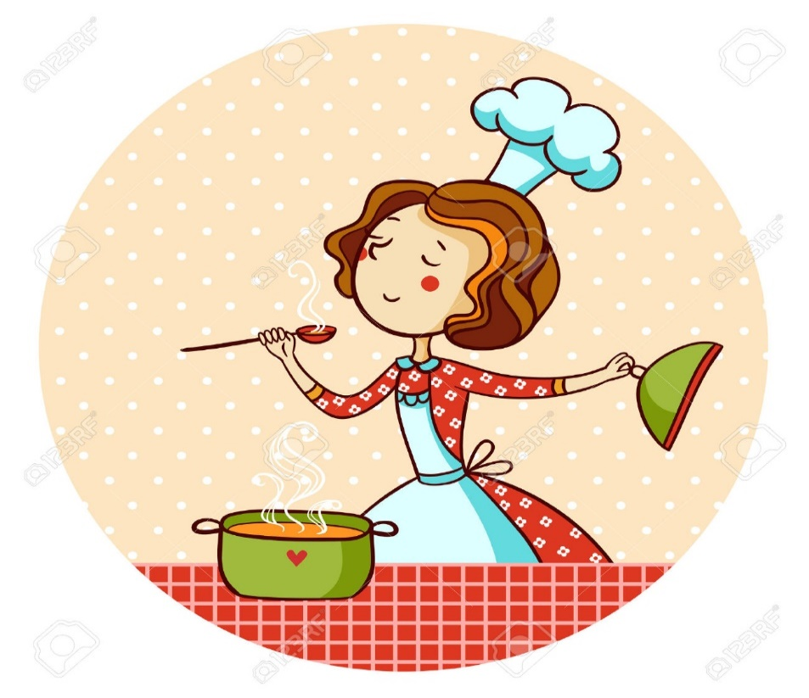
What do you do in the afternoon?
A)
I usually watch TV.
B)
I usually talk with friends online.
C)
I usually cook dinner.
Correct - Click anywhere or press Control Y to continue
Incorrect - Click anywhere or press Control Y to continue
Your answer:
You answered this correctly!
You did not answer this question completely
The correct answer is:
You must answer the question before continuing
Submit
Clear

Slide 32
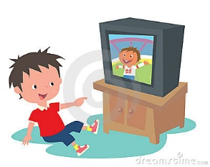
What do you do in the evening?
A)
I always brush my teeth.
B)
I always watch TV.
C)
I always talk with friends online.
Correct - Click anywhere or press Control Y to continue
Incorrect - Click anywhere or press Control Y to continue
Your answer:
You answered this correctly!
You did not answer this question completely
The correct answer is:
You must answer the question before continuing
Submit
Clear

Slide 33
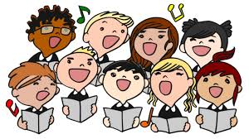
Let’s sing a song

Slide 34
Morning routines song

Slide 35


Slide 36
Tài liệu tham khảo
1, Nguồn tư liệu tham khảo
Google, Youtube
Sách giáo khoa và sách giáo viên Tiếng Anh 5 của BGD&ĐT
2, Các phần mềm sử dụng
Microsoft Powerpoint, Adobe Presenter 10.0
Chương trình ghi âm Adobe Audition
Chương trình cắt ghép video Camtasia 8.6

