Slide 1
welcome to class 5d
Tan Son Primary School
Teacher: VI HONG VAN

Slide 2
Wednesday, October 17th 2018
Warm - up
GUESSING GAME

Slide 3
Wednesday, October 17th 2018
Unit 5:What’ s your address
Lesson 1 : (Part 1, 2, 3)

Slide 4
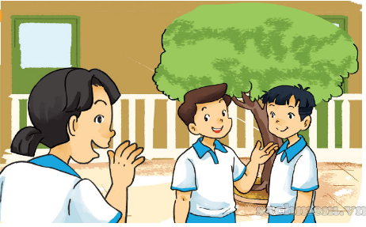
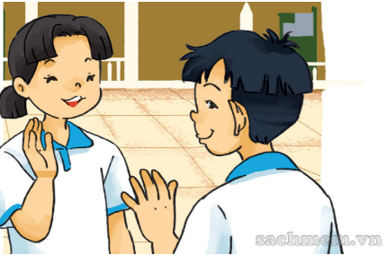
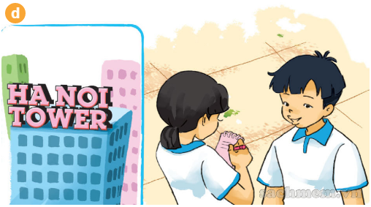
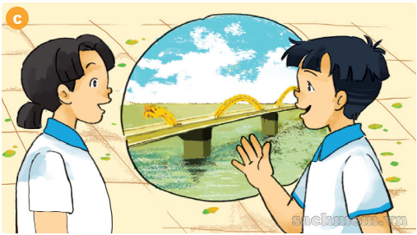
1. Look, listen and repeat

Slide 5
1
Mai :Hi, Nam! Nice to see you again.
Nam: Hi, Mai. Nice to see you, too. Mai, this is Trung. He’s a new pupil in ourclass.

Slide 6
2
Mai : Hello, Trung. Nice to meet you.
Trung: Nice to meet you, too.

Slide 7
3
Mai : Where are you from, Trung?
Trung : I’m from Da Nang. But now I live withmy grandparents in Ha Noi.

Slide 8
4
Mai : What’s your address in Ha Noi?
Trung : It’s 81, Tran Hung Dao Street. Where do you live?
Mai : I live in Flat 18 on the second floor ofHa Noi Tower.

Slide 9
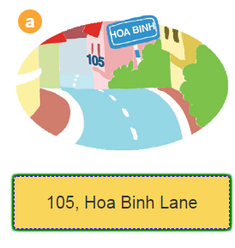
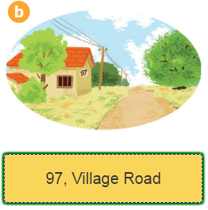
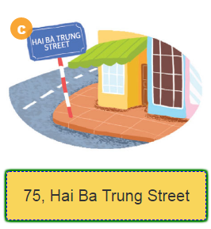
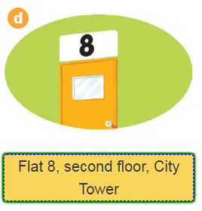
2. Point and say

Slide 10
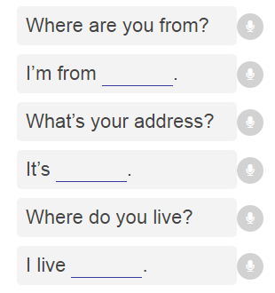
3. Let’ s talk

Slide 11
4. Listen and complete
Linda: …………., High Srteet
Tony: ………….., Green Lane
Peter: 765 ………….…………….
Tom : …………………………… of City Tower
208
321
White Street
the second floor

Slide 12
5. Read and complete
Trung is a new pupil in Class 5B. He is (1)………….. Da Nang. Now he (2)…....... with his grandparents in Ha Noi. His (3)…………. is 81, Tran Hung Dao (4)……….. , Hoan Kiem District.
from
lives
address
street

Slide 13
6. Let’ s sing
The wheels on the bus
The wheels on the bus go round and round,
Round and round, round and round.
The wheels on the bus go round and round all day long.
The bells on the bus go ding, ding, ding,
Ding, ding, ding, ding, ding, ding.
The bells on the bus go ding, ding, ding all day long.
The wheels on the bus go round and round,
Round and round, round and round.
The wheels on the bus go round and round
All day long, all day long, all day long.
The wheels on the bus

