Slide 1
Yen Tho primary school
Welcome to class 5B

Slide 2
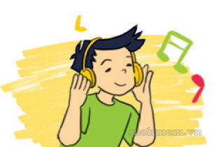
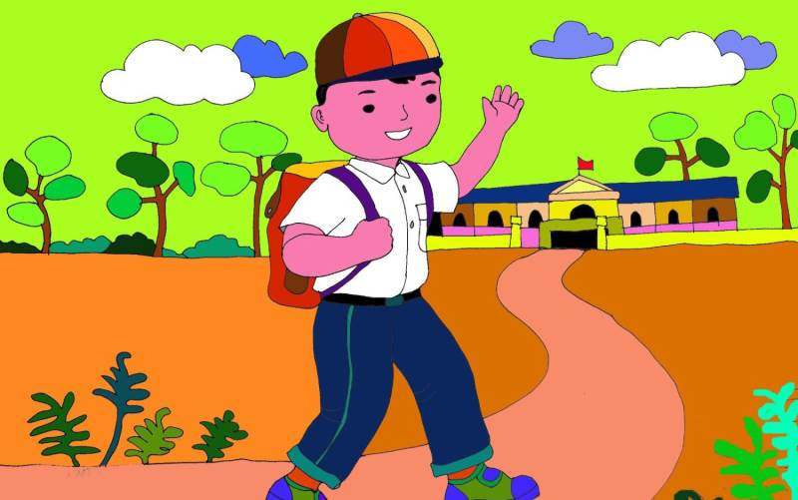
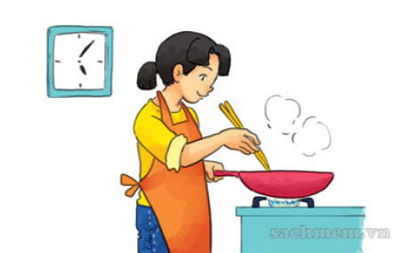
Warm up: Let’s play.
What do you do in the morning /afternoon/evening.
I always/ usually /sometimes……….

Slide 3
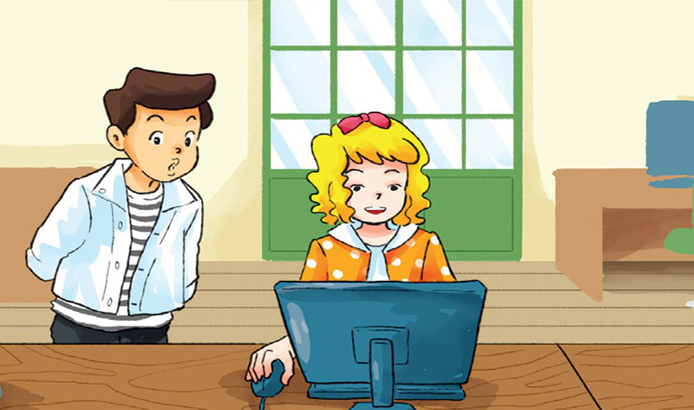
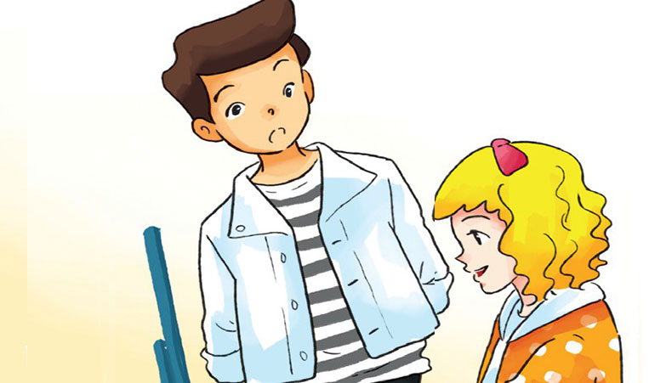
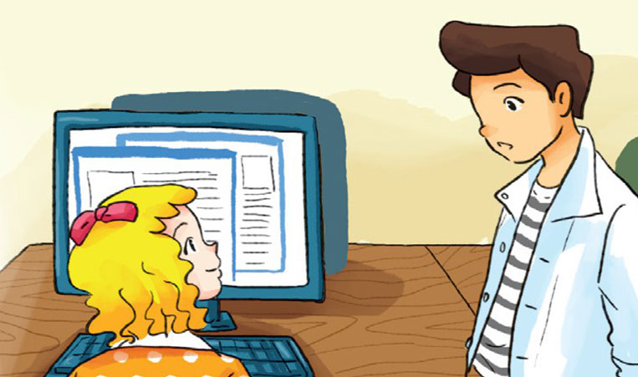
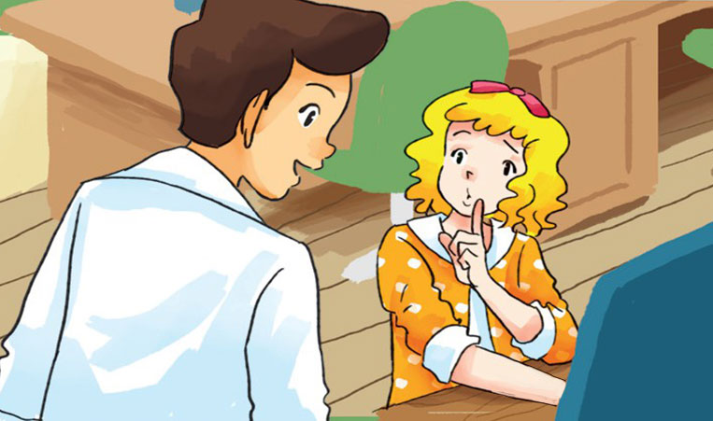
1.Look, listen and repeat.
What are you doing Linda?
What are you looking for?
I’m surfing the internet.
I’m looking for some information.
What kind of information are
you looking for?
How often do you come
to the library?
It’s for my English project.
Once a week. Sh! I’m busy.

Slide 4
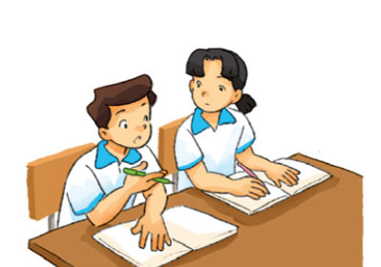
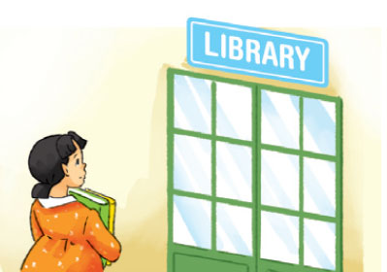
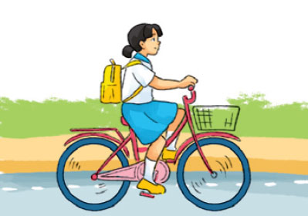
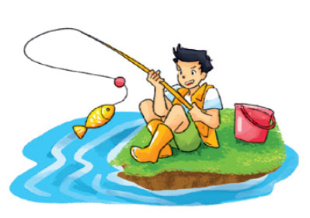
Study with a partner/ everyday
Once a week
Go to the library
once a month
Go fishing
Mon | Tues | Wed | Thur | Fri. | Sat. | Sun
√
Mon | Tue | Wed | Thur | Fri. | Sat. | Sun
√ |  |  | √
Ride a bicycle to school
twice a week

Slide 5
Study with a partner
How often do you……………………………..?
I…………….…………………………..……
Study with a partner everyday
Ride a bicycle to school / twice a week
Go to the library/ once a week
Go fishing / once a month

Slide 6
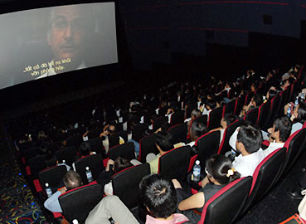
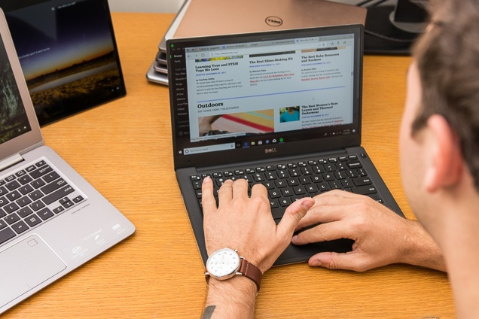
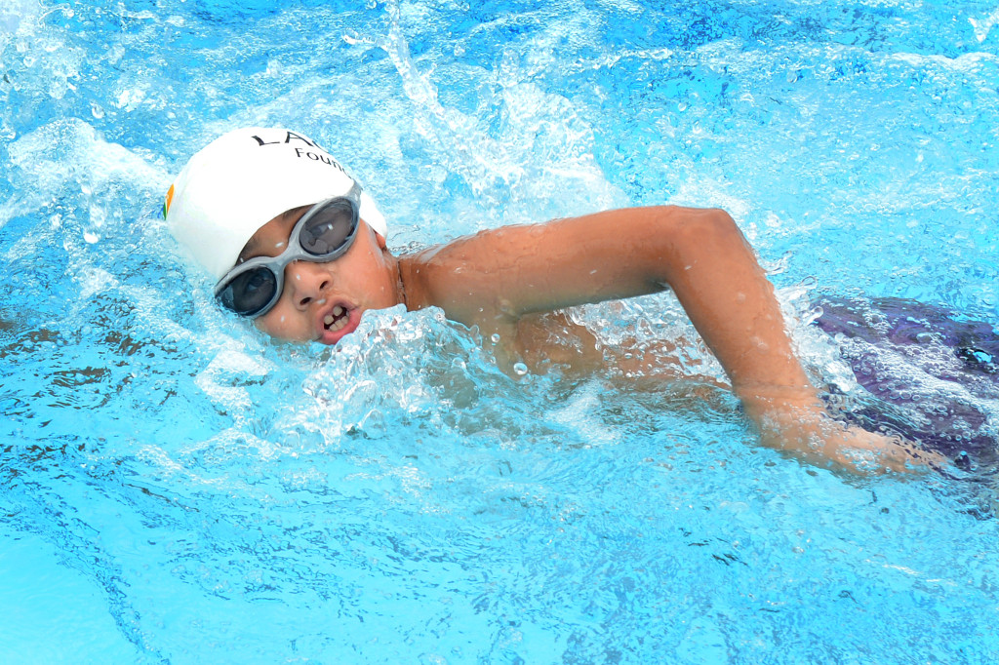
3. Let’s talk.
1. What do you do in the …………………………………………….?
I always / usually/ often …………....................
2. How often do you …………………………………………………?
I …………….. Once a / twice a ……………………

Slide 7
Fun corner: Let’s compose a song.
I study with a partner everyday
I study with a partner everyday
I study with a partner
I study with a partner
I study with a partner everyday
I go to the library once a week
I go to the library once a week
I go to the library
I go to the library
I go to the library once a week.

