Slide 1
WELCOME TO OUR CLASS
5A

Slide 2
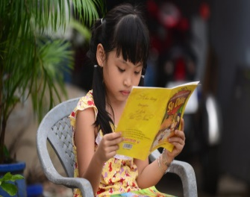
Look at the pictures and answer the questions
What is she doing?
She is reading a book.

Slide 3
What does she like?
She like listening to music.

Slide 4
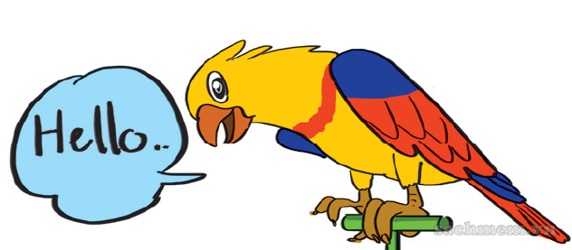
What is it doing?
It is speaking an English word.

Slide 5
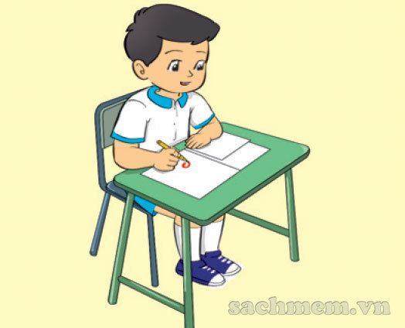
What is he doing?
he is writing.

Slide 6
Reading
Listening
Speaking
Writing
=>How to practise these skills ?

Slide 7
Unit 7.How do you learn english?
Lesson 1 (1-2-3)
1. Look, listen and repeat
Vocabulary:
Listen
Read
Speak
Write
Practise =
Luyện tập

Slide 8
Thanks for your attendance.
Good bye!

