Slide 1
WELCOME TO OUR CLASS
5A

Slide 2
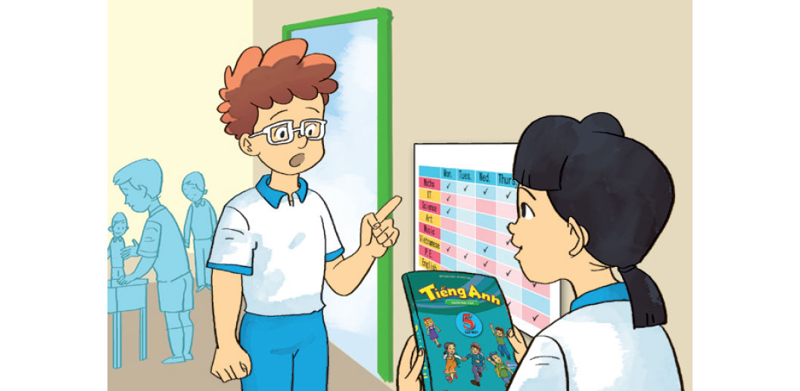
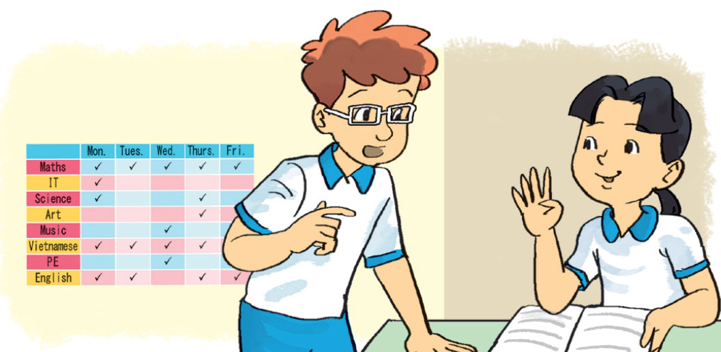
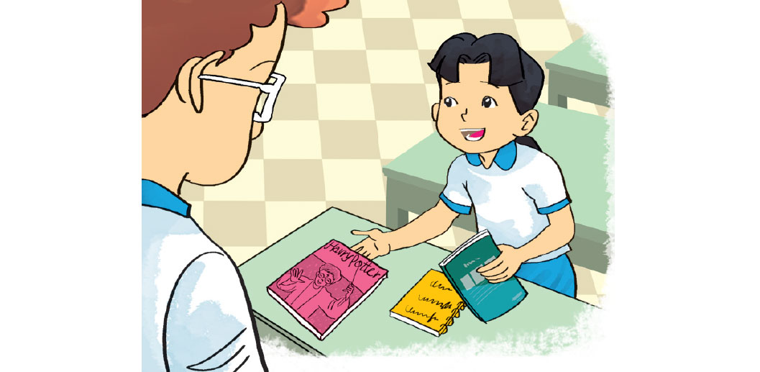
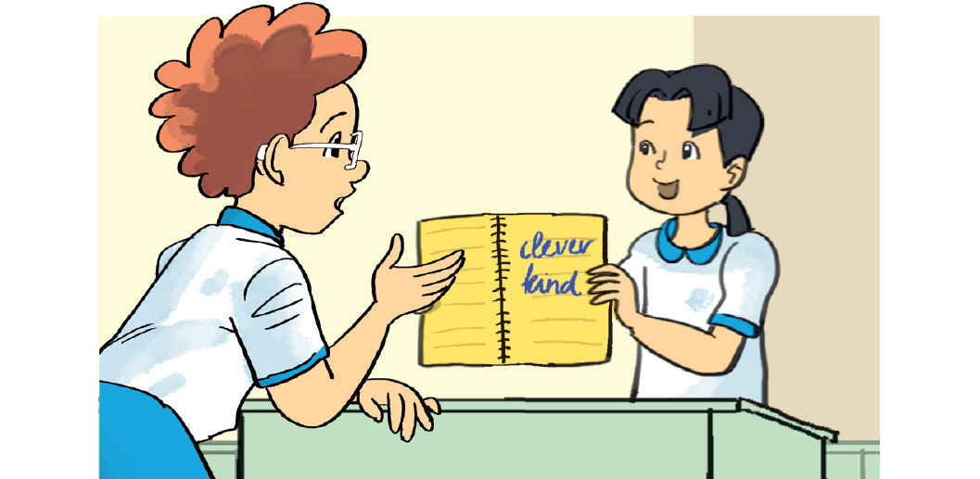
Unit 7.How do you learn english?
Lesson 1 (1-2-3)
1. Look, listen and repeat
Do you have English today?
How often do you have English, Mai.
I have it four times a week.
a
b
Yes, I do.
How do you learn vocabulary?
How do you practise reading?
I read English comic books.
c
d
I write new words in my notebook and read them aloud.

Slide 3
Unit 7. How do you learn english?
Lesson 1 (1-2-3)
Sentence pattern
Ask and answer questions about how someone learns English.
How do you practise ______________?
reading English
I ______________________.
read English comic books

Slide 4
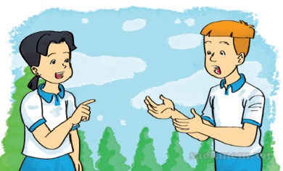
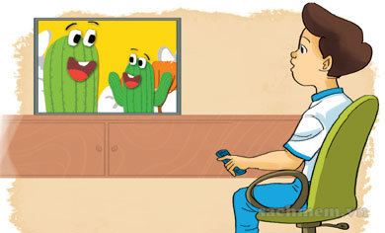
Unit 7. How do you learn english?
Lesson 1 (1-2-3)
1. Look, listen and repeat
2. Point and say
How do you practise __________________?
I _________________.
a. speak English/ speak English every day
b. listen to English/ watch English cartoons on TV
c. write English/ write emails to my friends
d. read English/ read short stories

Slide 5
How do you practise __________________?
I _______________.
speak English every day
speaking English
a. speak English
/ speak English every day

Slide 6
How do you practise __________________?
listening to English
I ____________________.
watch English cartoons on TV
b. listen to English/
watch English cartoons on TV

Slide 7
How do you practise __________________?
I ______________________.
write emails to my friends
writing English
c. write English/
write emails to my friends

Slide 8
How do you practise __________________?
I _______________.
read short stories
reading English
d. read English /
read short stories

Slide 9
Unit 7.How do you learn english?
Lesson 1 (1-2-3)
1. Look, listen and repeat
2. Point and say
3. Let’s talk
Ask and answer questions about how you learn English.
How often do you have English?
I have English four times a week.
Do you have English today?
Yes, I do.
How do you practise listening English?
I listen to English songs.

Slide 10
Thanks for your attendance.
Good bye!

