Slide 1
small
tall
old
big
short
young

Slide 2
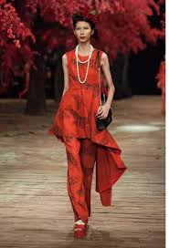
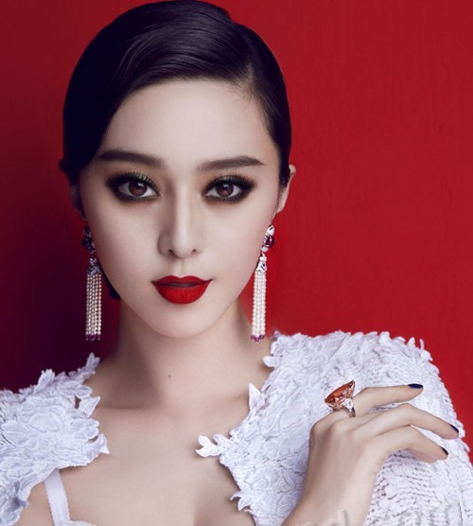
She is short. He is tall.
She is slim. He is fat.
He’s old. She is young.

Slide 3
Wednesday, 17th April 2020
Unit 14. What does he look like?
Lesson 2(1-2-3-4)
1. Look, listen and repeat
2. Point and say.
a. Vocabulary
big- bigger: to hơn
small- smaller: nhỏ hơn
short- shorter: thấp hơn
b. Modelsentences.
Who’s taller?
My brother’s taller than my father.

