Slide 1
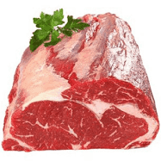
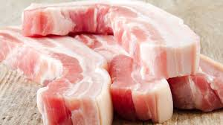
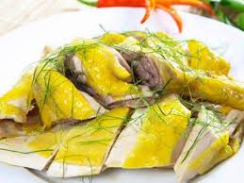
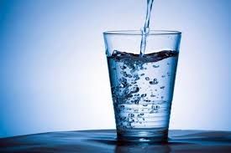
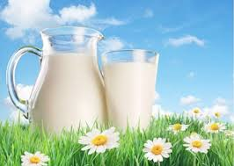
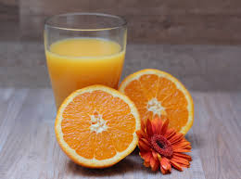
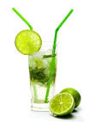
What’s your favourite food?
It’s ……………………
I like …………………
What’s your favourite drink?

Slide 2
water
milk
Pork
Orange juice
beef
bread
lemonade
chicken
rice
fish
drink
food

Slide 3
Wednesday, 17th April 2020
Unit 14. What does he look like?
Lesson 1(1-2-3-4)
1. Look, listen and repeat
2. Point and say.
a. Vocabulary
Tall: cao
Short: thấp
Slim: mảnh mai
Old: già, cũ, tuổi
Young: trẻ

Slide 4
Wednesday, 17th April 2020
Unit 14. What does he look like?
Lesson 1(1-2-3-4)
1. Look, listen and repeat
2. Point and say.
a. Vocabulary
Tall: cao
Short: thấp
Slim: mảnh mai
Old: già, cũ, tuổi
Young: trẻ
b. Modelsentences
What does he look like?
she
He’s tall.
She’s
Note: He’s = He is
She’s = she is

