Slide 1
A doctor works in a hospital
A farmer works in a field
A worker works in a factory
A clerk works in an office.

Slide 2
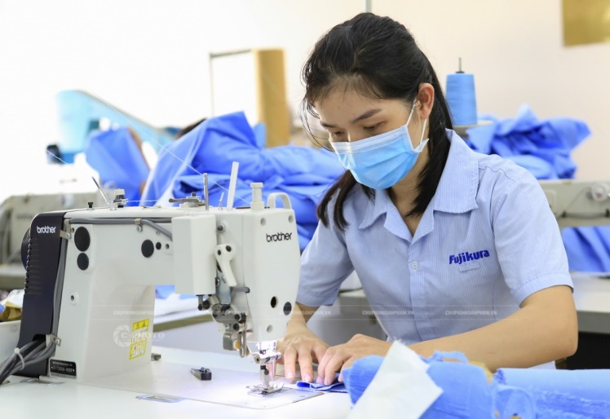
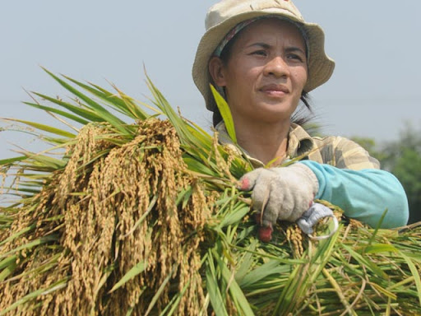
A farmer works in a field
A worker works in a factory
A doctor works in a hospital
A clerk works in an office.

Slide 3
Wednesday, 9th April 2020
Unit 13. Would you like some milk?
Lesson 1(1-2-3-4-5)
1. Look, listen and repeat
2. Point and say.
a. Vocabulary
Beef: thịt bò
Pork: thịt lợn
Orange juice: nước cam
Water: nước
Milk: sữa
Chicken: thịt gà
Food: thức ăn
Drink: đồ uống
Favourite: yêu thích
Fish: cá

Slide 4
Wednesday, 9th April 2020
Unit 13. Would you like some milk?
Lesson 1(1-2-3-4-5)
1. Look, listen and repeat
2. Point and say.
a. Vocabulary
b. Modelsentences
Beef: thịt bò
Pork: thịt lợn
Orange juice: nước cam
Water: nước
Milk: sữa
Chicken: thịt gà
Food: thức ăn
Drink: đồ uống
Favourite: yêu thích
Fish: cá
What’s your favourite food?
drink?
It’s fish.
orange juice.

