Slide 1
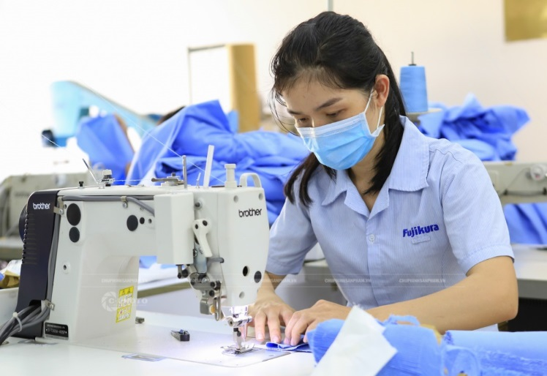
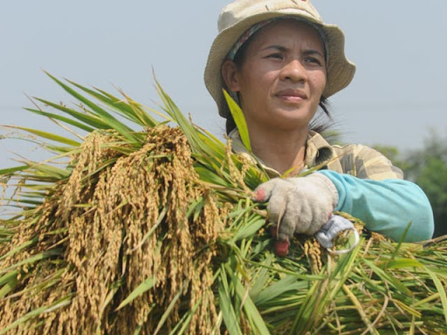
A farmer works in a field
A worker works in a factory
A doctor works in a hospital
A clerk works in an office.

Slide 2
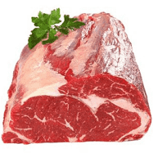
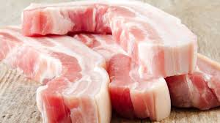
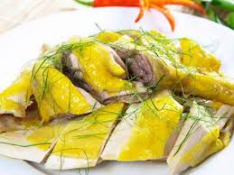
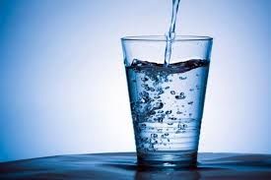
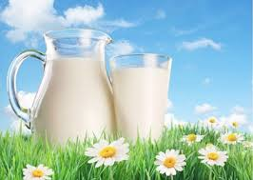
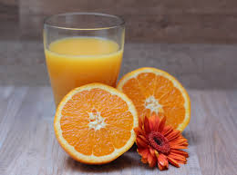
What’s your favourite food?
It’s ……………………
I like …………………
What’s your favourite drink?

Slide 3
Wednesday, 14th April 2020
Unit 13. Would you like some milk?
Lesson 2(1-2-4-5)
1. Look, listen and repeat
2. Point and say.
a. Vocabulary
Bread: bánh mì
Rice: gạo ,cơm
Vegetables: rau
Lemonade: nước chanh
Noodles: phở, mì, mì ăn liền

Slide 4
Wednesday, 9th April 2020
Unit 13. Would you like some milk?
Lesson 2(1-2-4-5)
1. Look, listen and repeat
2. Point and say.
a. Vocabulary
b. Modelsentences
Bread: bánh mì
Rice: gạo ,cơm
Vegetables: rau
Lemonade: nước chanh
Noodles: phở, mì, mì ăn liền
Would you like some milk?
Yes, please.
No, thanhks.

