Slide 1
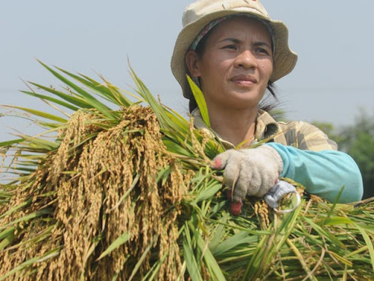
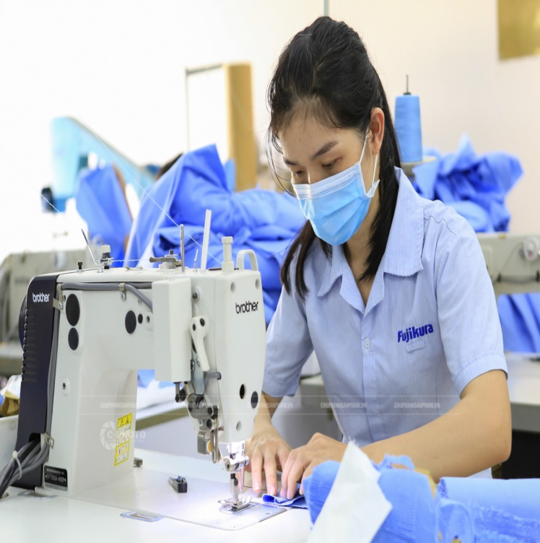

Slide 2
Farmer
Nurse
Driver
teacher
Factory worker
Student/ pupil
b. Model sentences.
What does your father do?
he’s a teacher.

Slide 3
Wednesday, 9th April 2020
Unit 12. What does your father do?
Lesson 2(1-2-3)
1. Look, listen and repeat
2. Point and say.
a. Vocabulary
Doctor: bác sĩ
Hospital: bệnh viện
Field: cánh đồng
Factory: nhà máy
Worker: công nhân
Clerk: nhân viên văn phòng
Office: văn phòng

Slide 4
Wednesday, 9th April 2020
Unit 12. What does your father do?
Lesson 2(1-2-3)
1. Look, listen and repeat
b. Model sentences.
Where does a doctor work?
A doctor works in a hospital.
2. Point and say.
a. Vocabulary
Doctor: bác sĩ
Hospital: bệnh viện
Field: cánh đồng
Factory: nhà máy
Worker: công nhân
Clerk: nhân viên văn phòng
Office: văn phòng

