Slide 1
Yen Phu 2 Primary School
Võ Cuong 3 Primary School
Welcome to our class
Class: 4A1
Teacher: Nguyen Thu Hong

Slide 4
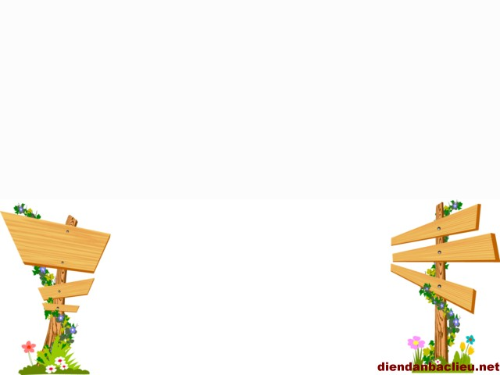
Tuesday, November 13th 2018
Period 44:
Unit 7: What do you like doing? Lesson 1 ( part 3, 4, 5)

Slide 5
1.
2.
3.

Slide 6
1.
2.
3.

Slide 7
1.
√
2.
√
3.
√

Slide 8
* Choose the correct answer after watching video:
fishing
boating
swimming
running
Mermaid likes………….......and……….........
Anna likes…………………..and……………………..

Slide 10
playing football.
reading (books).
1. I like………………
3. I like………………
playing chess.
collecting stamps.
2. I like………………
4. I like………………

Slide 12
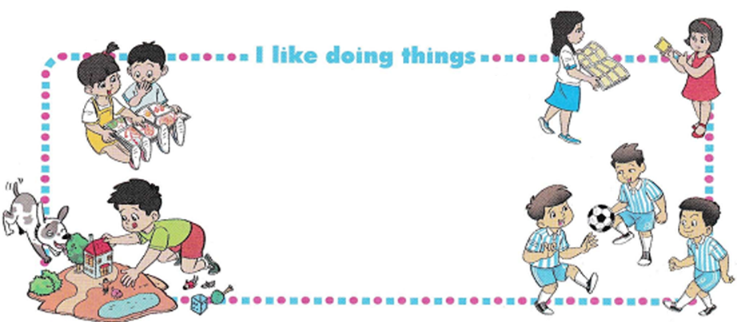

Slide 13
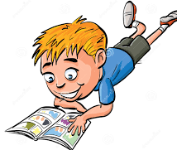
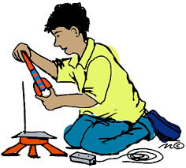
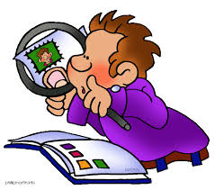
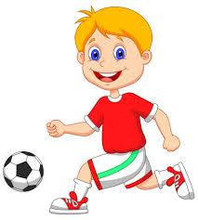
I like so much
Reading comic books is lots of fun.
I like ,too.
Making models is very cool.
I like so much.
Collecting stamps is lots of fun.
I like , too.
Playing football is very cool.

Slide 14
Homework
B. VOCABULARY
1. Reading and match. ( Page: 28)
1. reading

Slide 15
B. VOCABULARY
2. Complete the sentences with the phrases above( page 29)
flying a kite.

