Slide 1
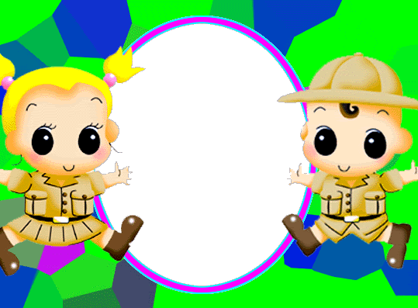
3A

Slide 2
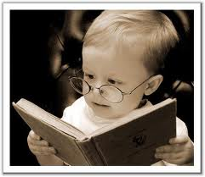
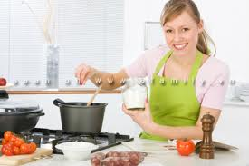
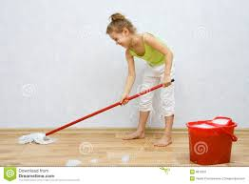
a
b
What are you doing?
reading
cooking
reading.
I’m …..
c
d
listening to music
cleaning the floor

Slide 3
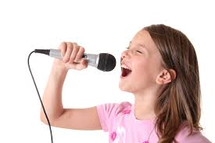
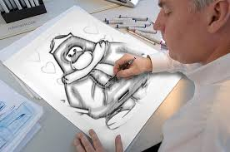
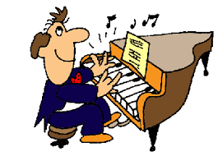
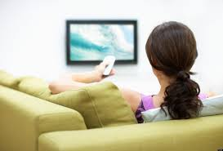
a
b
What’s he doing?
What’s she doing?
What’s he/she doing?
singing
drawing
He’s drawing.
He’s/She’s …..
She’s singing.
c
d
playing the piano
watching TV

Slide 4
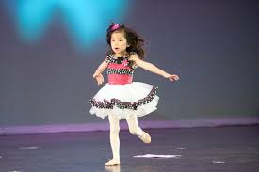
Let’s play! KIM’S GAME
0:5
0:4
0:3
0:2
0:1
0:0
Start

Slide 5
Let’s play! KIM’S GAME
watching TV
playing the piano
drawing
singing
listening to music
cleaning the floor
dancing

Slide 6
Thursday April 9th, 2015
Unit 18: What are you doing?
Period 123: Lesson 3 (4-5-6)
4. Read and complete.
5. Let’s write.
6. Project.

Slide 7
4. Read and complete
watching
is
listening
playing
in
My name is Quan. Today my family (1)
is
at home. We are (2)
in
the living room. My father is (3)
watching
TV. My mother is (4)
playing
the piano. My brother is (5)
listening
to music and I am
singing.

Slide 8
5. Let’s write
1. Where is Quan’s family?
Quan’s family is at home.
His family is at home.
2. What is his father doing now?
He is watching TV.
3. What is his mother doing now?
She is playing the piano.
4. What is his brother doing now?
He is listening to music.
5. What is Quan doing now?
He is singing.

Slide 9
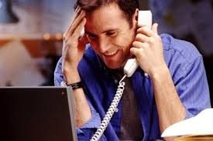
6. Project: Tell your classmates what they are doing.
1
2
3
4
5
6
7
8

Slide 10
goodbye
see you again

