Slide 1
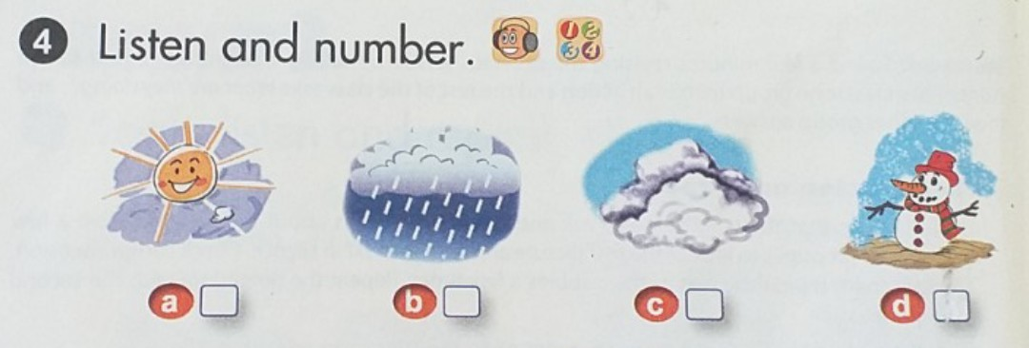

Slide 2
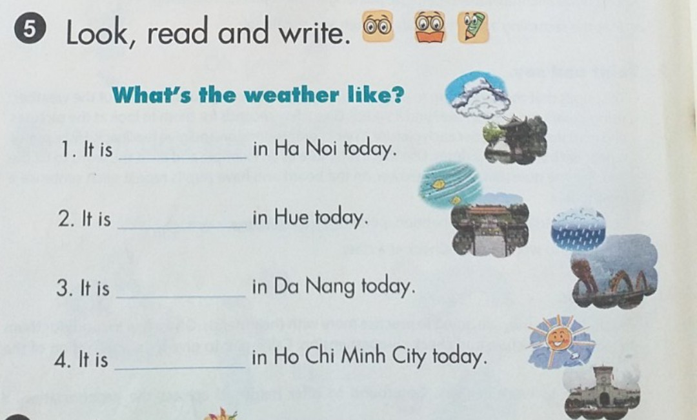
cloudy
windy
rainy
sunny

Slide 3
