Slide 1
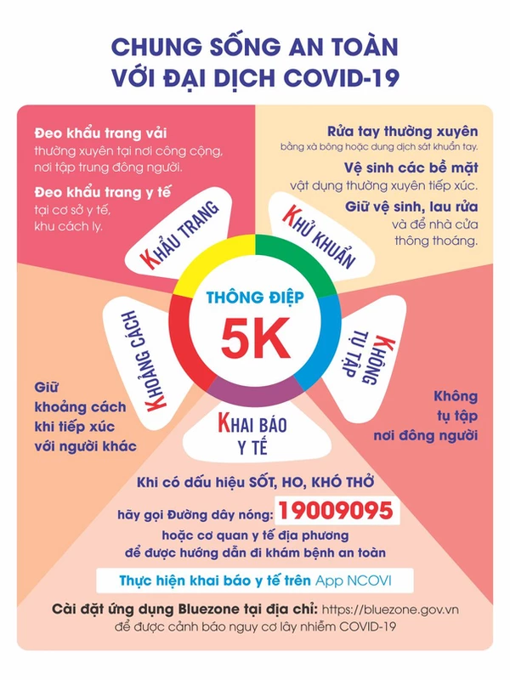

Slide 2
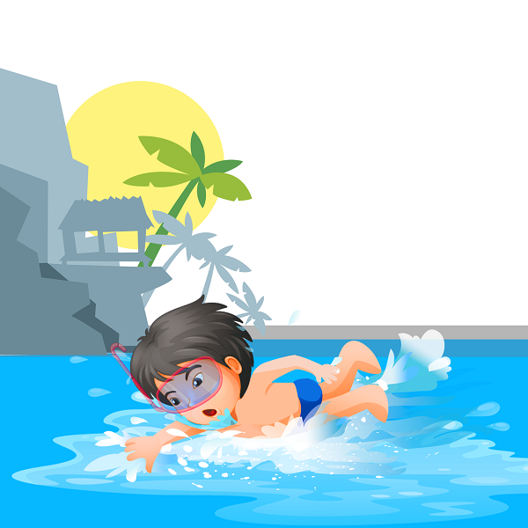
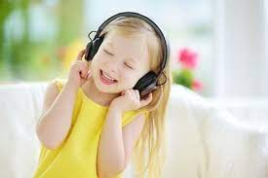
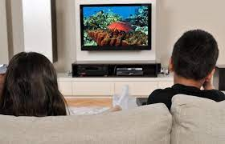
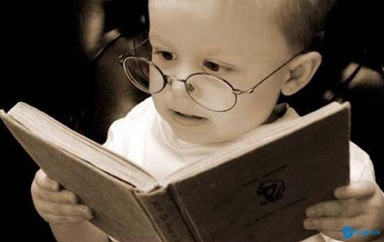
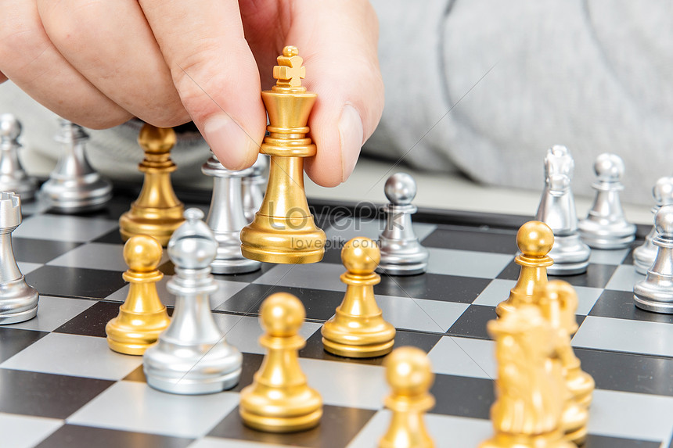

Slide 4
Friday, November 12th 2021
Unit 7. Lesson 1: 1-2
1.Vocab
Collect stamps: sưu tầm tem
2. Model sentences
What do you like doing?
I like watching TV.

Slide 5
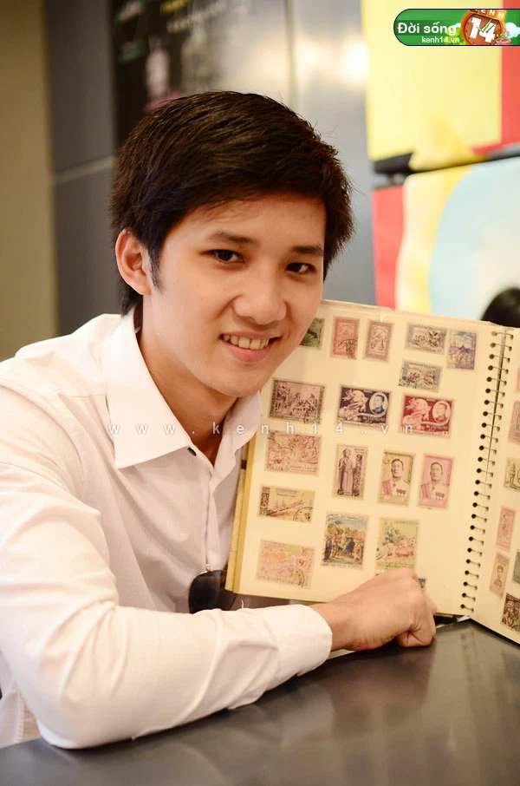
What do you like doing?
I like ………
swimming
cooking
collecting stamps
playing chess

