Slide 1
Warm up
invite English sentence enjoy party repeat July complete jumper
in‘vite
en‘joy
re‘peat
Ju‘ly
com‘plete

Slide 2
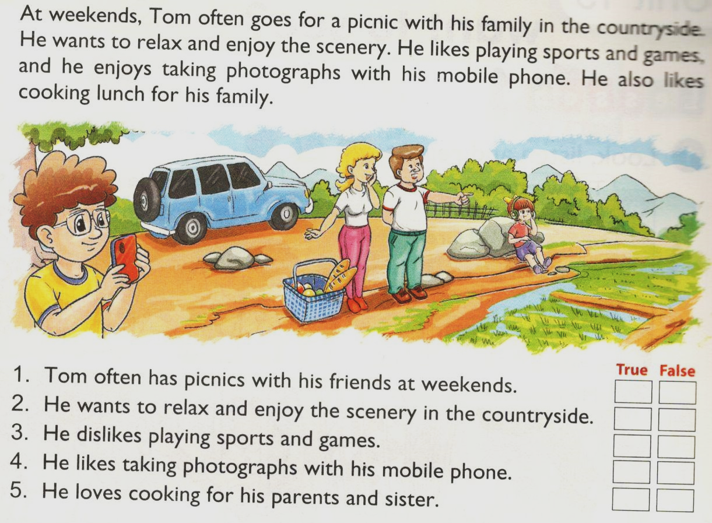
UNIT 18. WHAT’S YOUR PHONE NUMBER?
Lesson 3: Part 4-5-6
1. Read and tick.
v
v
v
v
v

Slide 3
UNIT 18. WHAT’S YOUR PHONE NUMBER?
Lesson 3: Part 4-5-6
1. Read and tick.
5. Let’s write.
go for a picnic with my family.
relax and enjoy fresh air
skipping and listening to music.
taking photos.
cooking dinner for my family.

Slide 4
UNIT 18. WHAT’S YOUR PHONE NUMBER?
Lesson 3: Part 4-5-6
1. Read and tick.
5. Let’s write.
6. Project
Ask four classmates
for their phone numbers.Then tell the class about them.
Mai
Lan
Ngọc
Dung

