Slide 2
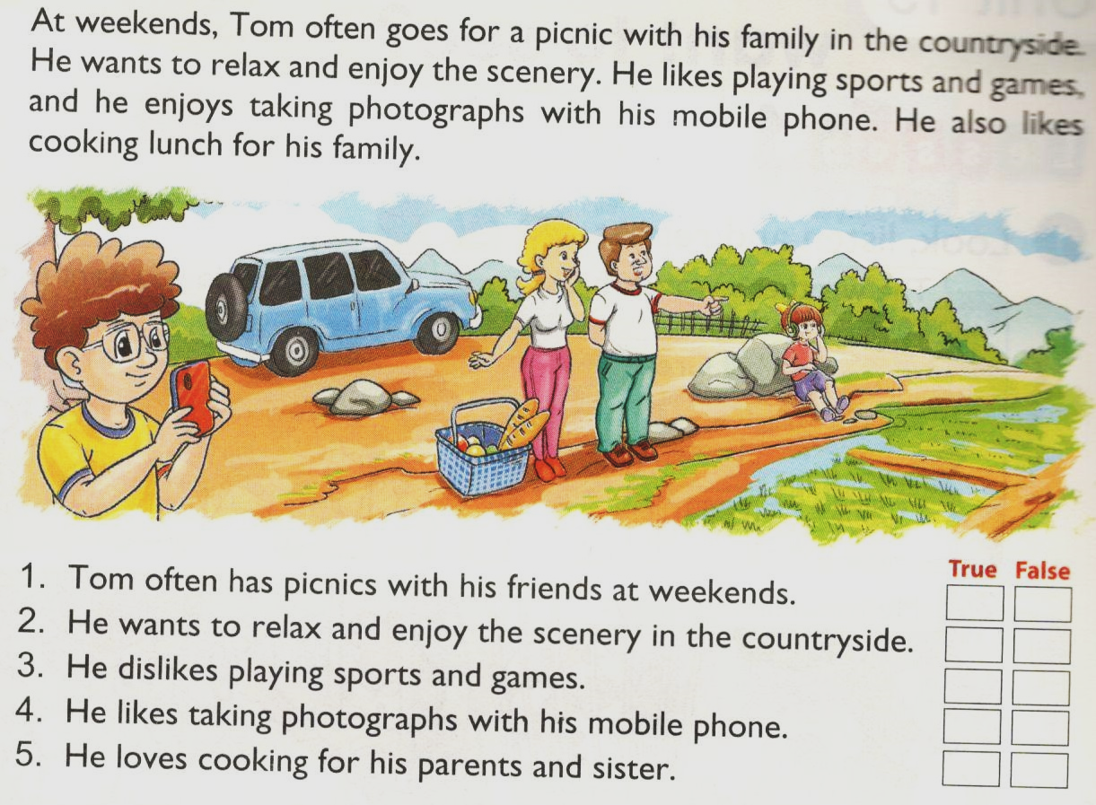
UNIT 18. WHAT’S YOUR PHONE NUMBER?
Lesson 3: Part 4-5-6
4. Read and tick

Slide 3
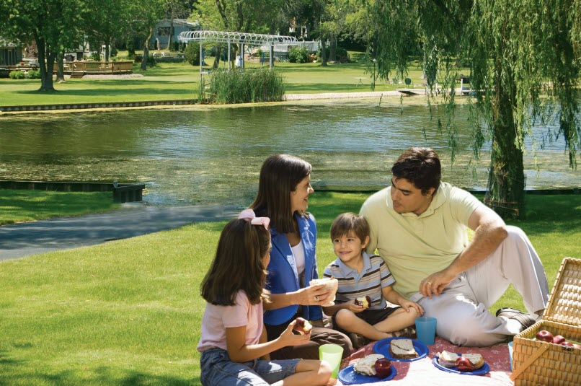
UNIT 18. WHAT’S YOUR PHONE NUMBER?
Lesson 2: Part 1-2-3
1. Look, listen and repeat.
2. Point and say.
a. Vocabulary.
go for a walk: đi bộ
go for a picnic: đi giã ngoại
go fishing: đi câu cá
go skating: đi trượt pa tanh
go skating
go for a picnic
go fishing
go for a walk

Slide 4
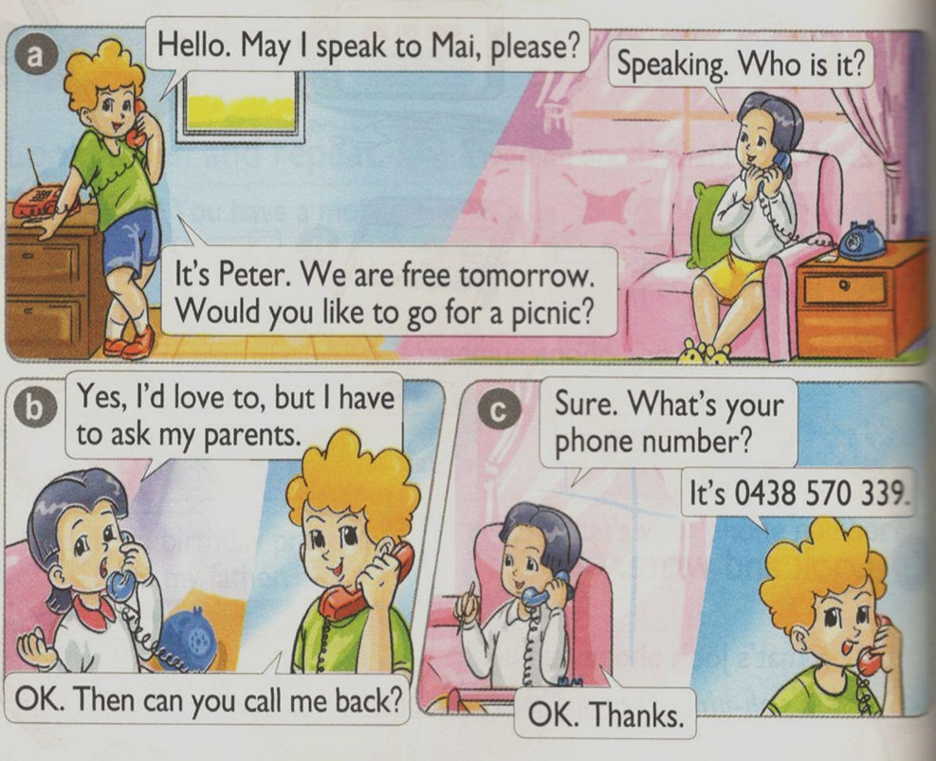
UNIT 18. WHAT’S YOUR PHONE NUMBER?
Lesson 2: Part 1-2-3
1. Look, listen and repeat.
2. Point and say.
a. Vocabulary
go for a walk: đi bộ
go for a picnic: đi giã ngoại
go fishing: đi câu cá
go skating: đi trượt pa tanh
b. Model sentences.
Would you like to go for a picnic?
Yes, I’d love to.
Sorry, I can’t.

Slide 5
UNIT 18. WHAT’S YOUR PHONE NUMBER?
Lesson 2: Part 1-2-3
1. Look, listen and repeat.
2. Point and say.
a. Vocabulary
go for a walk: đi bộ
go for a picnic: đi giã ngoại
go fishing: đi câu cá
go for a walk
go for a picnic
go skating: đi trượt pa tanh
b. Model sentences.
Would you like to go for a picnic?
Yes, I’d love to.
Sorry, I can’t.
go skating
go fishing

Slide 6
UNIT 18. WHAT’S YOUR PHONE NUMBER?
Lesson 2: Part 1-2-3
1. Look, listen and repeat.
2. Point and say.
a. Vocabulary
go for a walk: đi bộ
go for a picnic: đi giã ngoại
go fishing: đi câu cá
go skating: đi trượt pa tanh
b. Model sentences.
Would you like to go for a picnic?
Yes, I’d love to.
go fishing
go for a picnic
Sorry, I can’t.
go for a walk
go skating

Slide 7
UNIT 18. WHAT’S YOUR PHONE NUMBER?
Lesson 2: Part 1-2-3
1. Look, listen and repeat.
3. Let's talk.
• Hello. May I speak to…, please? • Would you like to...? • What's your phone number?
2. Point and say.
a. Vocabulary
go for a walk: đi bộ
go for a picnic: đi giã ngoại
go fishing: đi câu cá
go skating: đi trượt pa tanh
b. Model sentences.
Would you like to go for a picnic?
Yes, I’d love to.
Sorry, I can’t.

