Slide 2



Let’s sing a song and dance

Slide 3
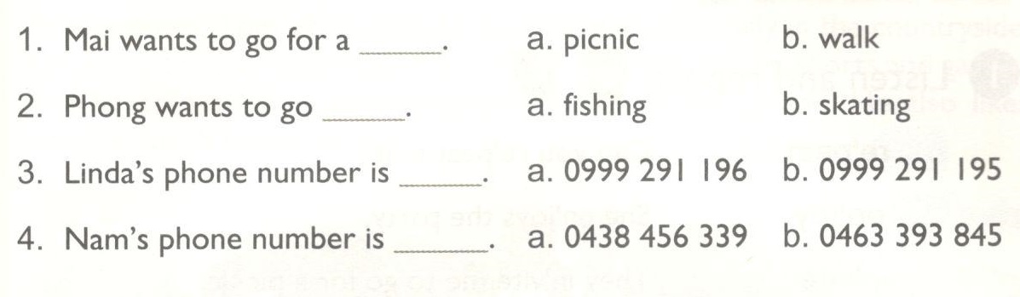
UNIT 18. WHAT’S YOUR PHONE NUMBER?
Lesson 2: Part 4-5
4. Listen and circle.
a
b
a
b

Slide 5
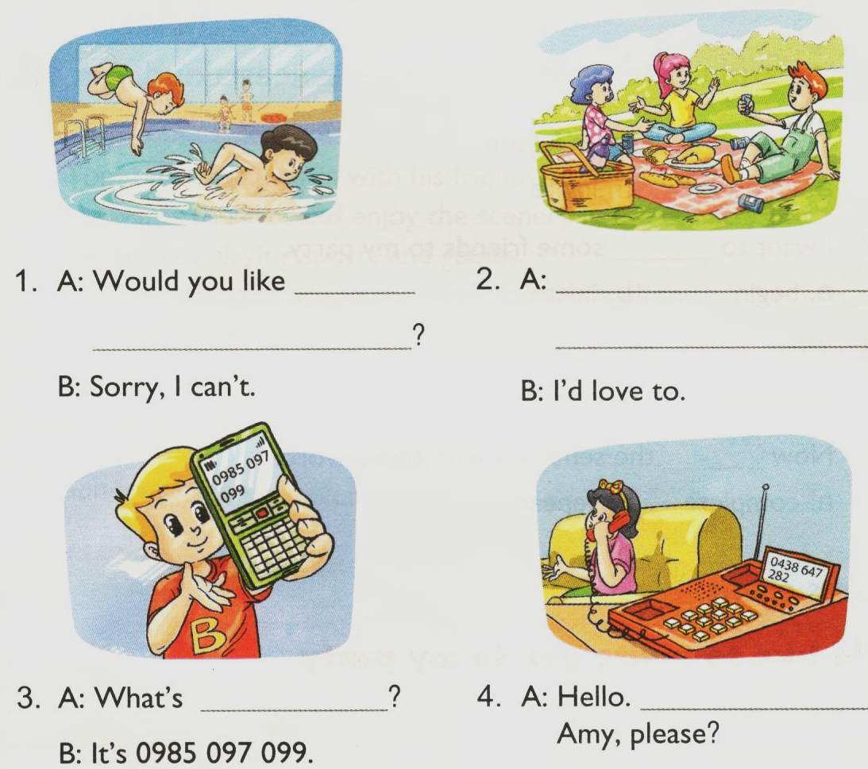
UNIT 18. WHAT’S YOUR PHONE NUMBER?
Lesson 2: Part 4-5-6
5. Look and write.
to go swimming
Would you like to go for a picnic?
your phone number
May I speak to

Slide 6


