Slide 1
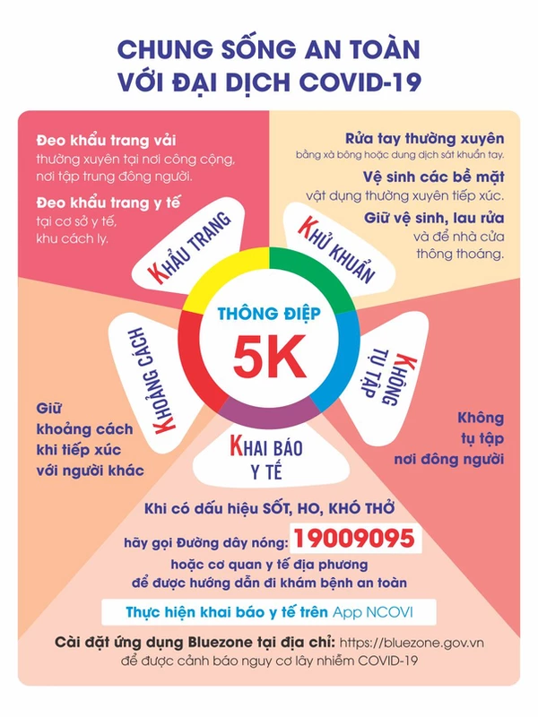

Slide 2
Tuesday, January 28th 2022
Unit 13. Lesson 2.
1. Vocab
bread: bánh mỳ
rice: cơm, gạo
vegetables: rau
lemonade: nước chanh
noodles: phở, mỳ
2. Model sentences.
Would you like some noodles?
Yes, please.
No, thanks.

Slide 3
Family: grandfather/ grandpa, grandmother/ grandma, mother, father, sister, brother
Jobs: Farmer, nurse, driver, factory worker,
What does your brother do?
He’s a farmer.

Slide 4
Tuesday, January 4th 2022
Unit 12. Lesson 2.
1. Vocab
Hospital; bệnh viện
Field; cánh đồng
Factory: nhà máy
Clerk: nhân viên văn phòng
Office: văn phòng
2. Model sentences.
Where does a doctor work?
A doctor works in a hospital.

Slide 5
What does your mother do?
She is a farmer.
Where does she work?
She works in a field.

