Slide 1
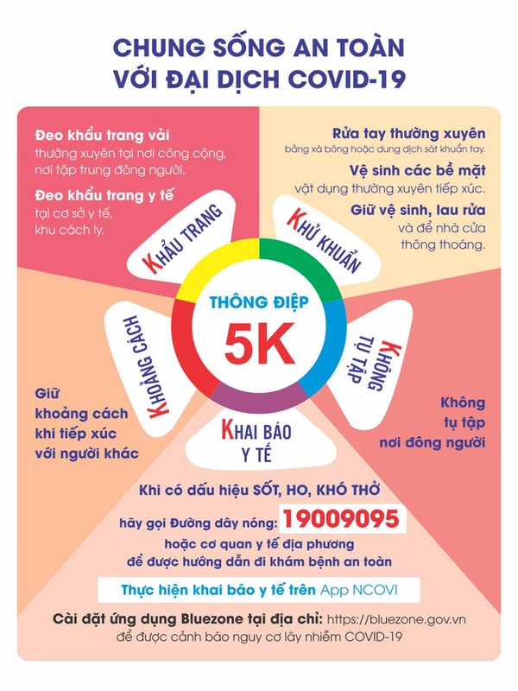

Slide 2
Family: grandfather/ grandpa, grandmother/ grandma, mother, father, sister, brother
Jobs: Farmer, nurse, driver, factory worker,
What does your brother do?
He’s a farmer.

Slide 3
Tuesday, January 4th 2022
Unit 12. Lesson 2.
1. Vocab
Hospital; bệnh viện
Field; cánh đồng
Factory: nhà máy
Clerk: nhân viên văn phòng
Office: văn phòng
2. Model sentences.
Where does a doctor work?
A doctor works in a hospital.

Slide 4
What does your mother do?
She is a farmer.
Where does she work?
She works in a field.

Slide 5
Tuesday, January 4th 2022
Unit 13. Lesson 1.
1. Vocab
beef: thịt bò
pork: thịt lợn
chicken: thịt gà
food: thức ăn
water: nước
milk: sữa
orange juice: nước cam
drink: đồ uống
favourite: yêu thích
2. Model sentences.
What’s your favourite food?
It’s fish.
I like fish.
What’s your favourite drink?
It’s milk.
I like milk.

