Slide 1
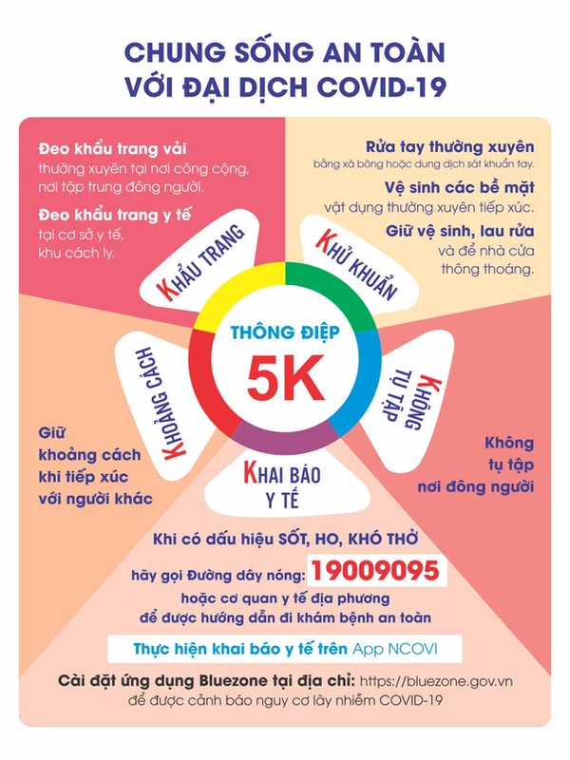

Slide 2
Play the guitar Play the piano
Play badminton Ride a bike
Where were you yesterday?
I was at home.
What did you do?
I watched tv with my family.

Slide 3
Moday, January 1st 2022
Unit 11. Lesson 2: 1-2-3
1. Vocab
Have /eat dinner: ăn tối
Have/ eat lunch: ăn trưa
Have/ eat breakfast: ăn sang
Go to bed: đi ngủ
2. Model sentences
What time do you get up?
I get up at six o’clock.

Slide 4
Subjects: Maths, Music, Art, PE, IT, Vietnamese, Science, English
When do you have Music?
I have it on Thursdays.
I have it on
What subjects do you have today?
I have maths, vnamese and English.

