Slide 1
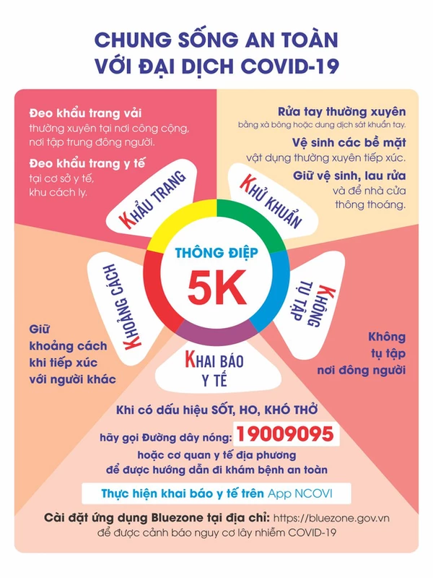

Slide 2
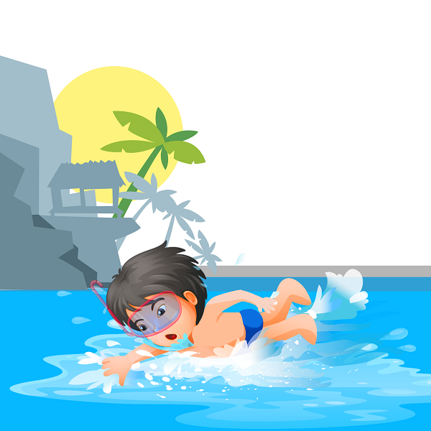
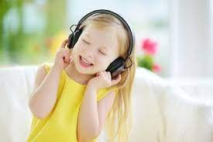
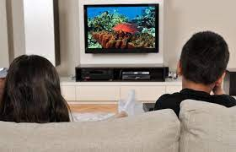
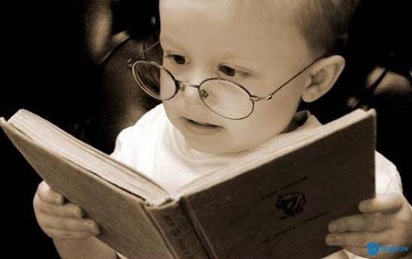
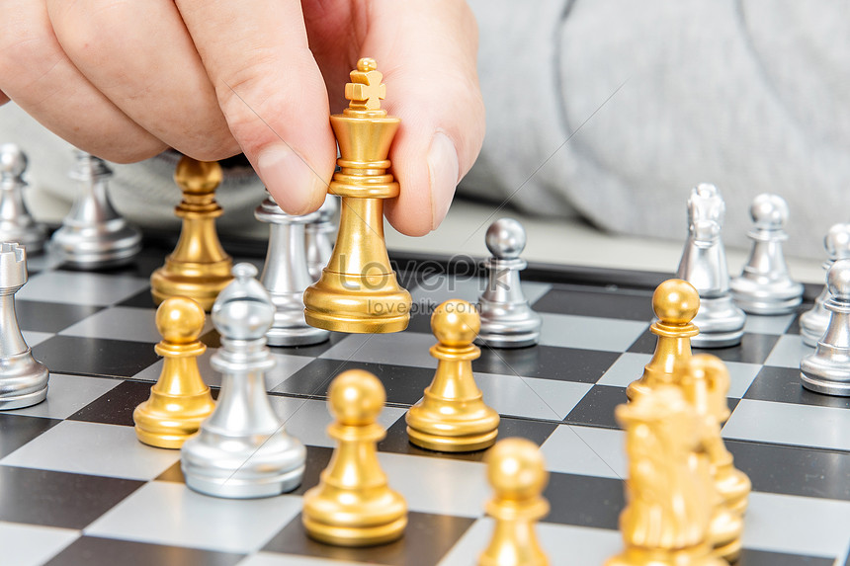

Slide 3
Eleven twelve thirteen fourteen
fifteen Sixteen Seventeen Twenty
Twenty-one Thirty Thirty one

Slide 4
Wednesday, December 22nd 2021
Unit 11. Lesson 1: 1-2
1. Vocab
Get up: thức dậy
breakfast: bữa sang
O’clock: giờ
2. Model sentences
What time is it?
It’s seven o’clock.
It’s seven ten.

