Slide 1
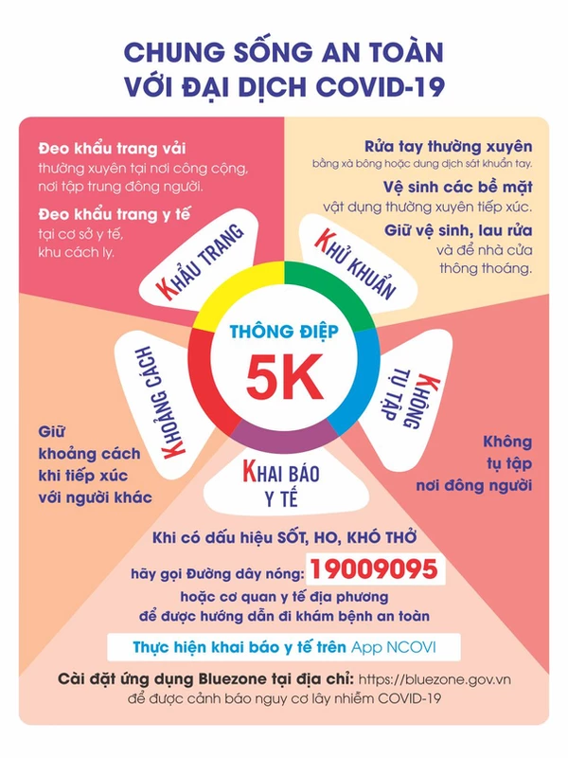

Slide 2
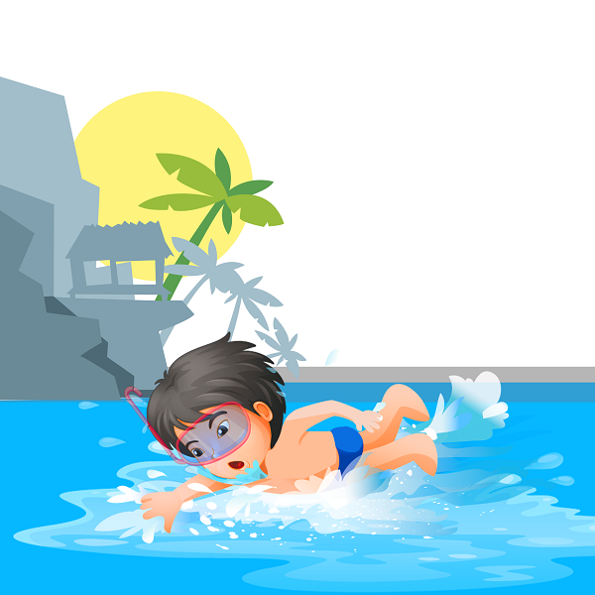
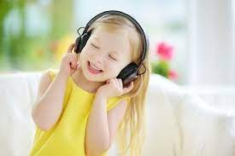
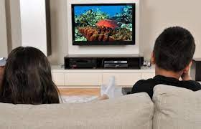
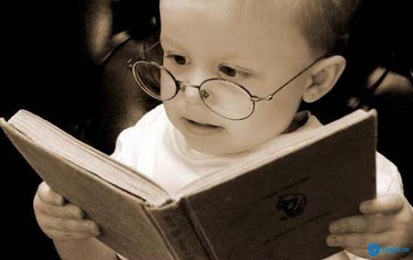
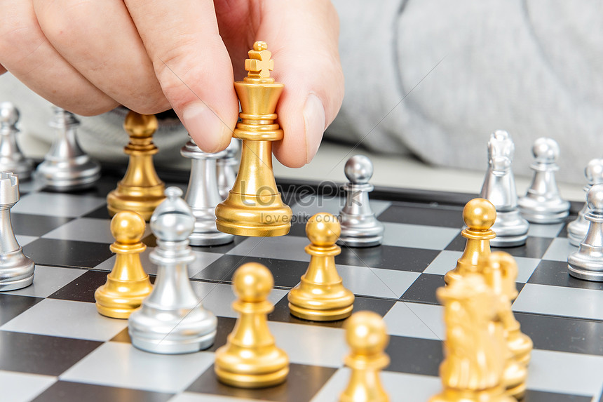

Slide 3
Friday, November 19th 2021
Unit 7. Lesson 2: 1-2
1.Vocab
fly a kite: thả diều
take a photo: chụp ảnh
club: câu lạc bộ
hobby: sở thích
2. Model sentences
What’s your hobby?
I like playing the piano.

