Slide 1
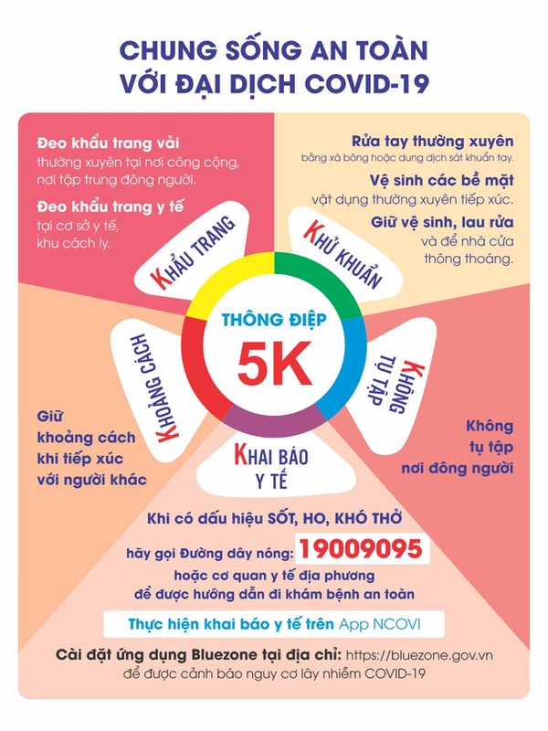

Slide 2
1. Vocab
bread: bánh mỳ
rice: ơm, gạo
vegetables: rau
lemonade: nước chanh
noodles: phở, mỳ
Hospital; bệnh viện
Field; cánh đồng
Factory: nhà máy
Clerk: nhân viên văn phòng
Office: văn phòng

Slide 3
Tuesday, January 22th 2022
Unit 16. Lesson 1.
1. Vocab
Bakery; tiệm bánh
Pharmacy; hiệu thuốc
Supermarket: siêu thị
Sweet shop: cửa hang kẹo
Medicine: thuốc
Want: muốn
2. Model sentences.
Let’s go to the bookshop.
I want to buy some books.
Great I dea!
Sorry. I’m busy.

Slide 4
Tuesday, January 22th 2022
Unit 16. Lesson 2.
1. Vocab
Bakery; tiệm bánh
Pharmacy; hiệu thuốc
Supermarket: siêu thị
Sweet shop: cửa hang kẹo
Medicine: thuốc
Want: muốn
2. Model sentences.
Let’s go to the bookshop.
I want to buy some books.
Great I dea!
Sorry. I’m busy.

Slide 5
What does your mother do?
She is a farmer.
Where does she work?
She works in a field.

