Slide 1
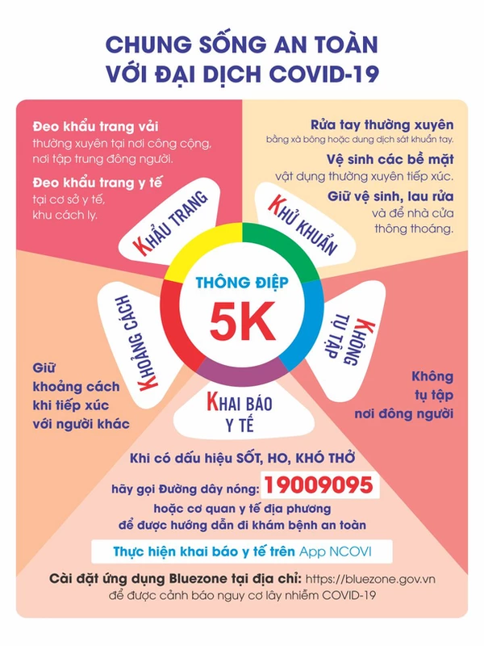

Slide 2
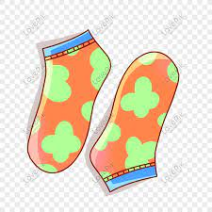
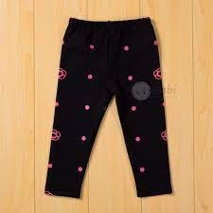
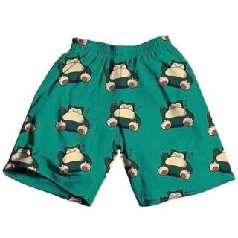
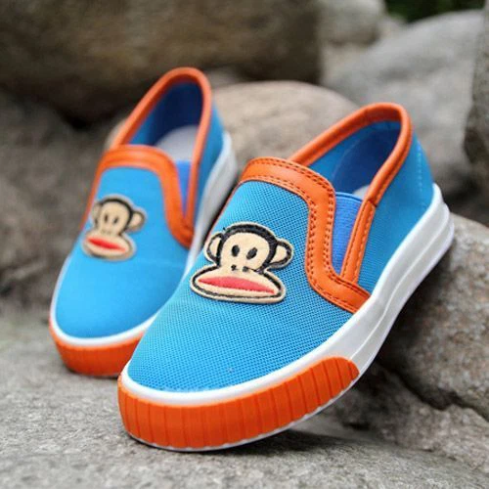
Shorts
Socks
Shoes
pants

Slide 3
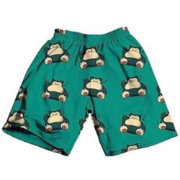
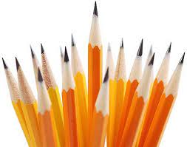
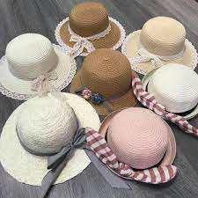
These are my socks.
hats
pens

Slide 4
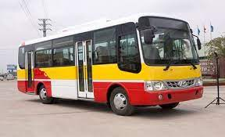
Tuesday, January 22nd 2022
Unit 8. Lesson 1.
1. Vocab
Bus: xe buýt
Boat; thuyền, tàu

Slide 5
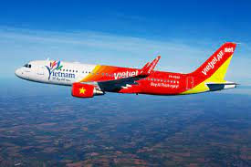
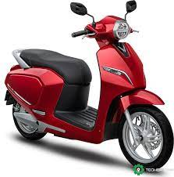
Tuesday, January 23nd 2022
Unit 8. Lesson 1.
1. Vocab
Bus: xe buýt
Boat; thuyền, tàu
Plane: máy bay
Motorbike: xe máy
2. Model sentences.
Can you see the motorbike?
No, I can’t.
Yes, I can.

