Slide 2
Is this your T-shirt?
Yes, it is.
Is this your dress?
No, it isn’t.
Is this your hat?
Yes, it is.
Is this your shirt?
No, it isn’t.

Slide 3
Tuesday, January 25th 2022
Unit 7. CLOTHES

Slide 4
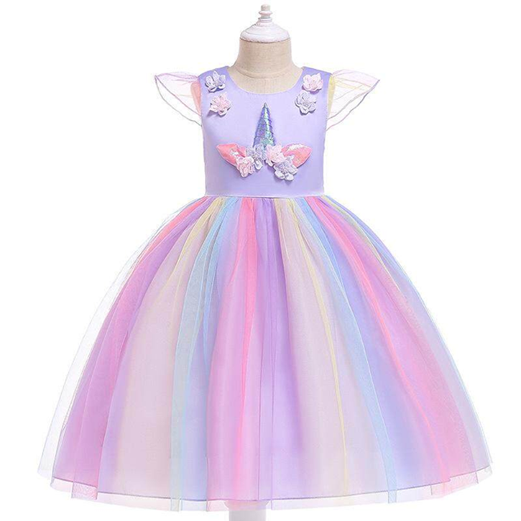
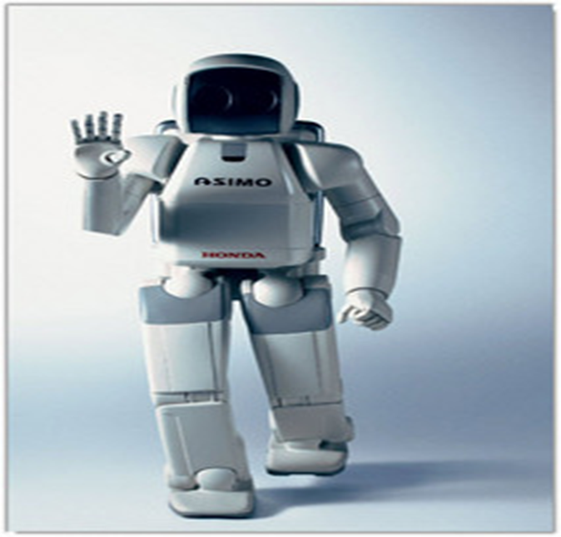
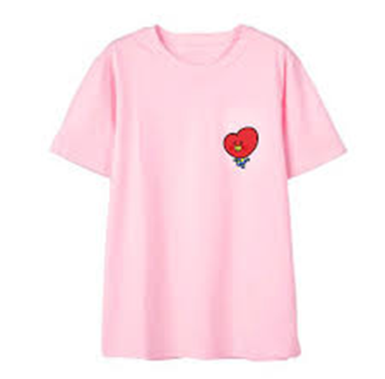
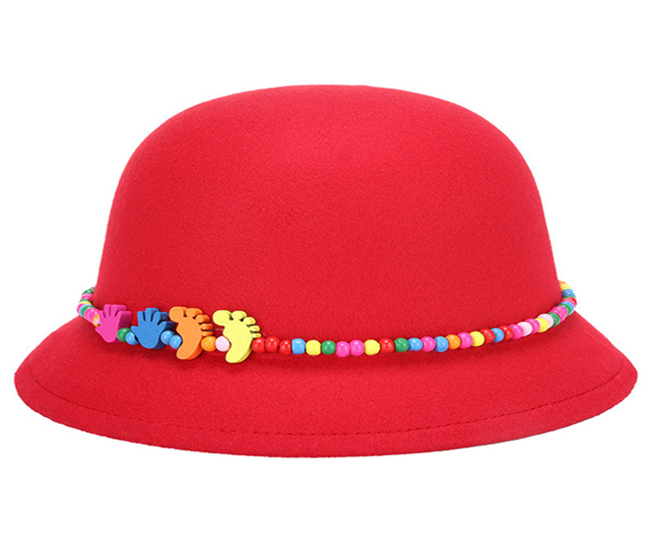
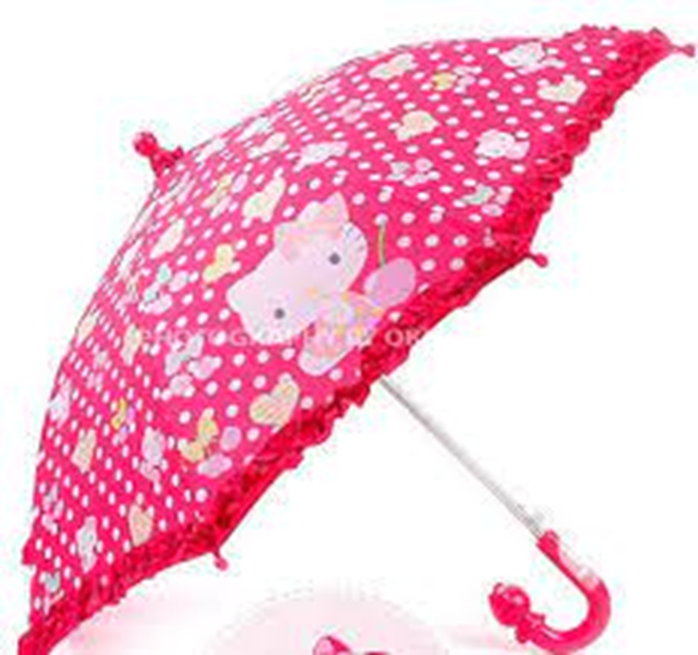
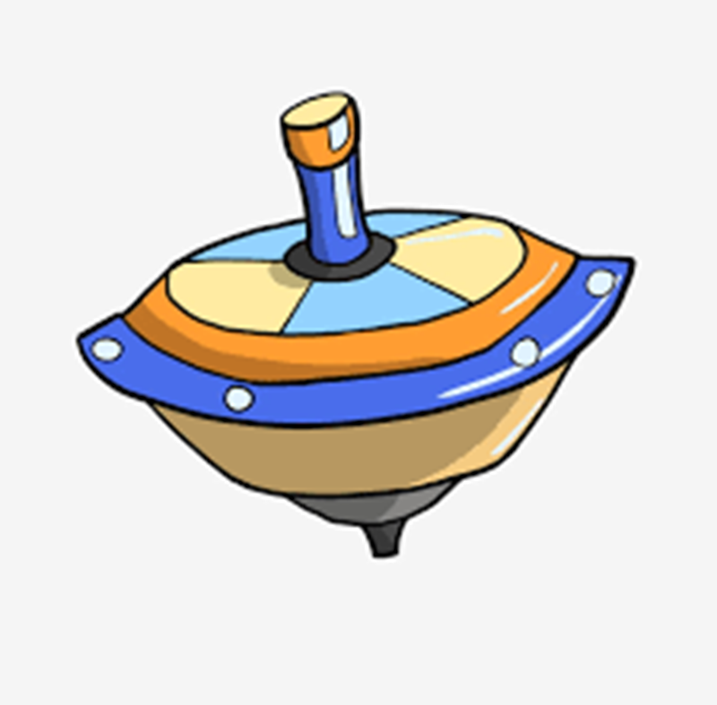

Slide 6
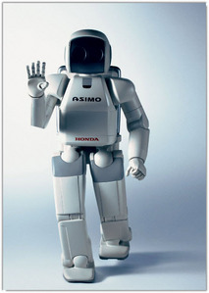
Tuesday, January 11th 2022
Tuesday, January 25th 2022
Unit 7. CLOTHES

Slide 7
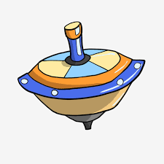

Slide 8
E. Listen and repeat.Trace.

Slide 9
E. Listen and repeat.Trace.

