Slide 2
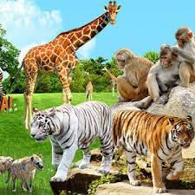
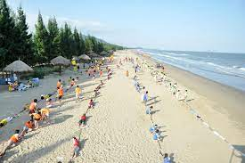
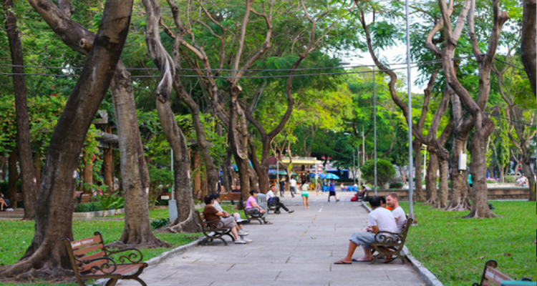
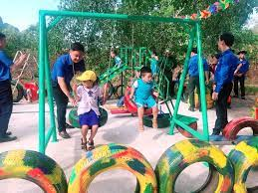
beach
zoo
park
playground

Slide 3
Park
Tiger
Zoo
Playground
Umbrella
Sun
Beach
Sở thú
Cái ô
Mặt trời
Con hổ
Bãi biển
Sân chơi
Công viên

Slide 4
Tuesday, January 11th 2022
Unit 7. CLOTHES

Slide 5
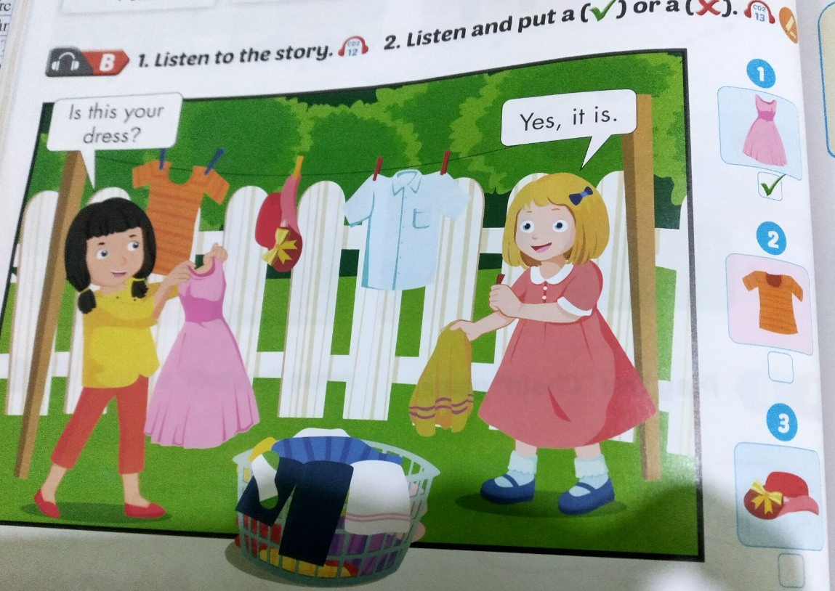

Slide 6
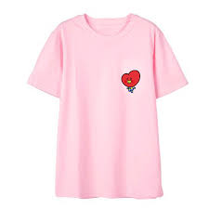
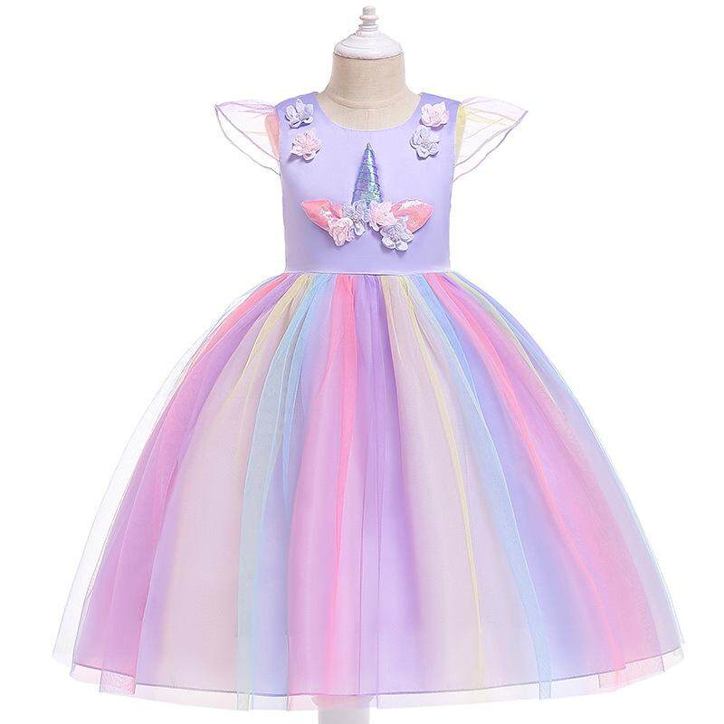
Tuesday, January 11th 2022
Unit 7. CLOTHES
1. Vocab
T-shirt: áo phông
Dress: cái váy

Slide 7
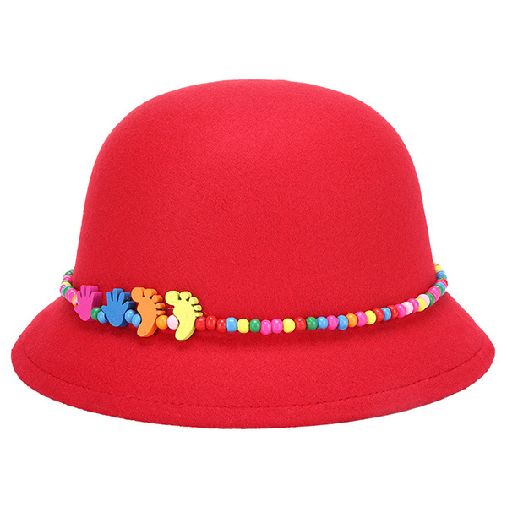
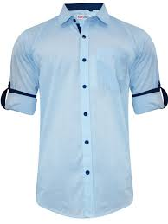
Tuesday, January 11th 2022
Tuesday, January 11th 2022
Unit 7. CLOTHES
1. Vocab
T-shirt: áo phông
dress: cái váy
hat: cái mũ
shirt: áo sơ mi
2. Model sentences
Is this your dress?
Yes, it is.
No, it isn’t

Slide 8
Is this your T-shirt?
Yes, it is.
Is this your dress?
No, it isn’t.
Is this your hat?
Yes, it is.
Is this your shirt?
No, it isn’t.

