Slide 2
I want to go to the zoo.

Slide 3
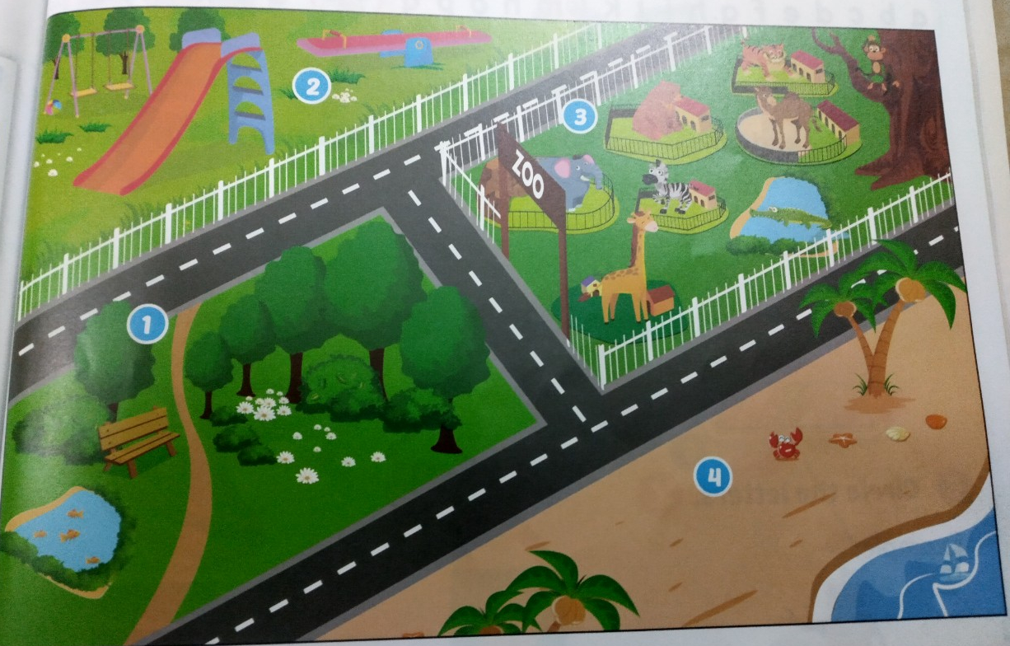
I want to go to the zoo.
play ground
park
beach

Slide 4
Tuesday, January 11th 2022

Slide 5
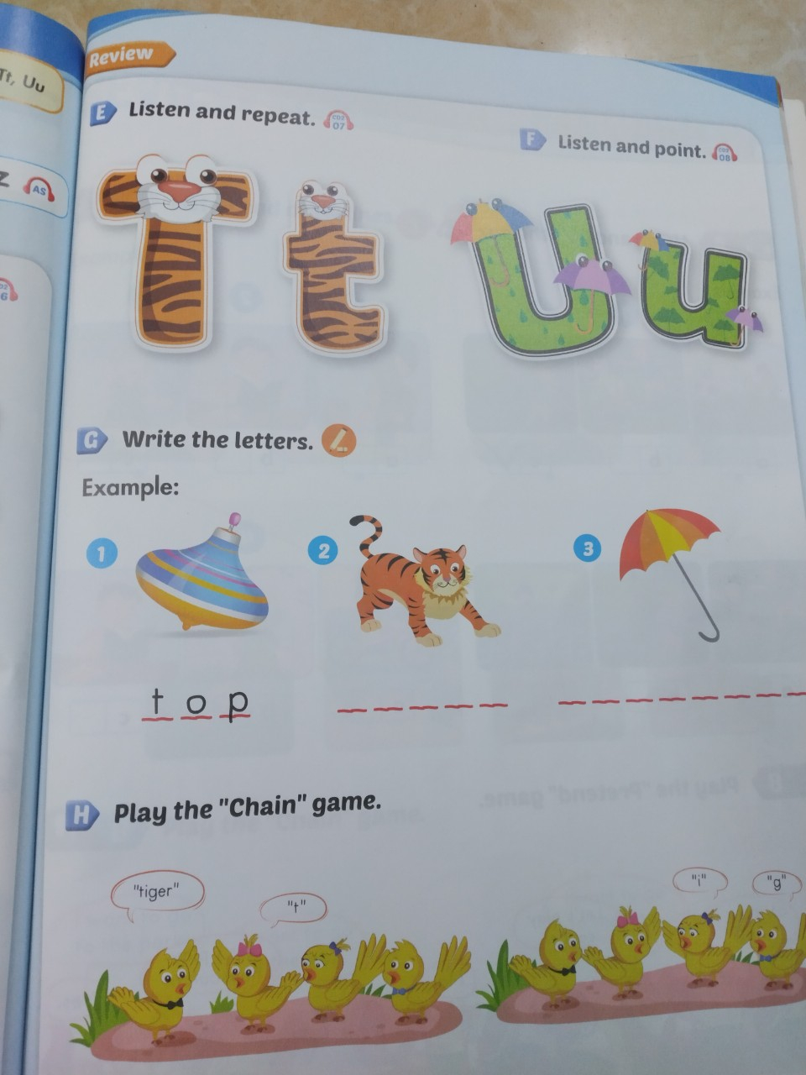
Tuesday, January 11th 2022

