Slide 3
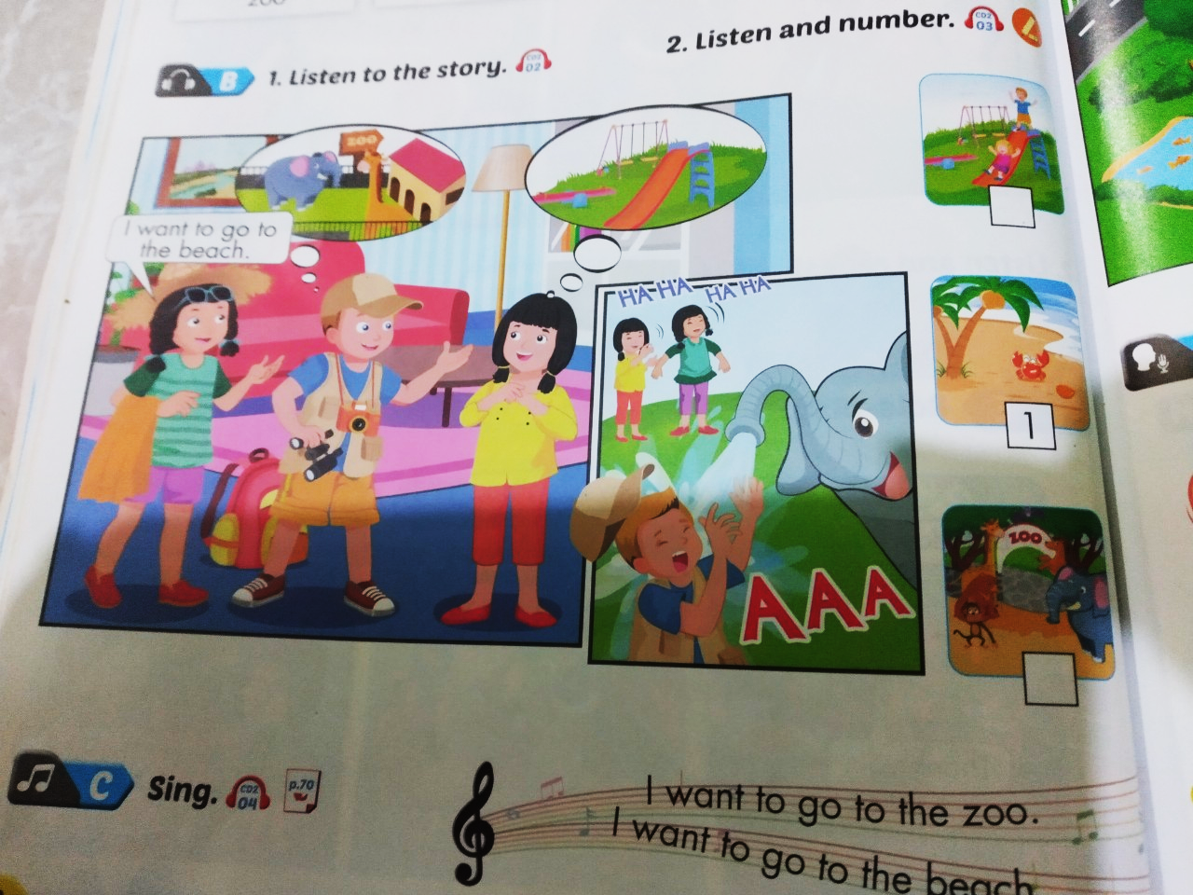

Slide 4
Wednesday, January 6th 2022
Unit 6. Around town
1. Vocab
zoo: sở thú
beach: bãi biển
park: công viên
playground; sân chơi
2.Model sentences.
I want to go to the beach.

Slide 5
I want to go to the zoo.
I want to go to the beach.
I want to go to the park.
I want to go to the playground.

Slide 6
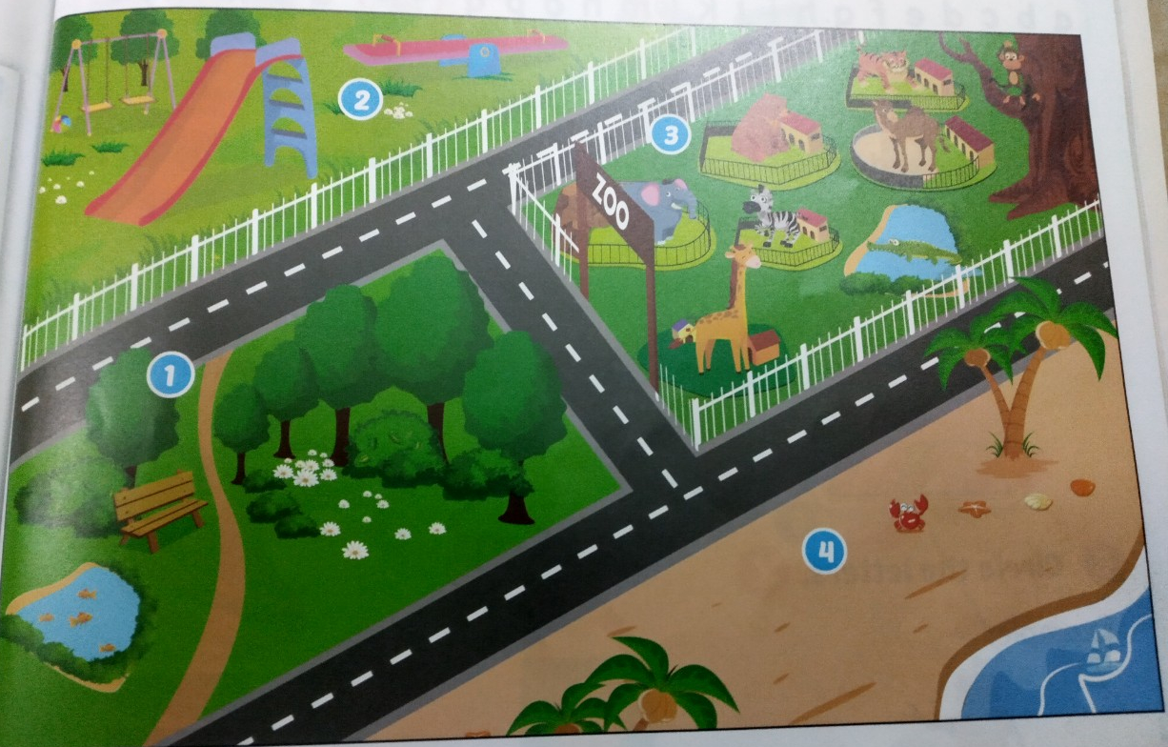
I want to go to the zoo.
play ground
park
beach

Slide 7
Tuesday, January 4th 2022

Slide 8
Tuesday, January 4th 2022

