Slide 2
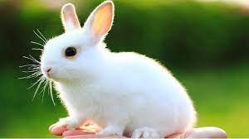
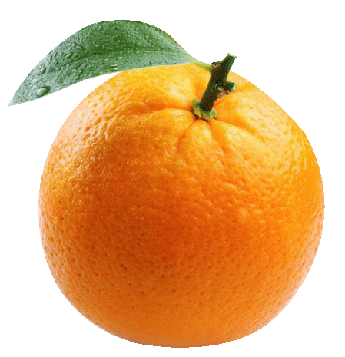
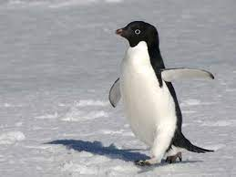
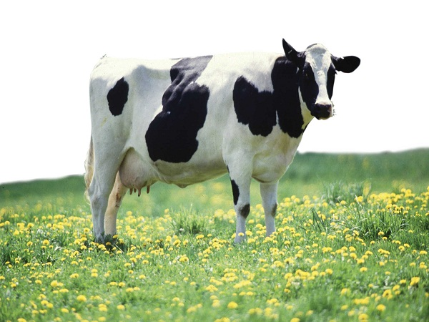
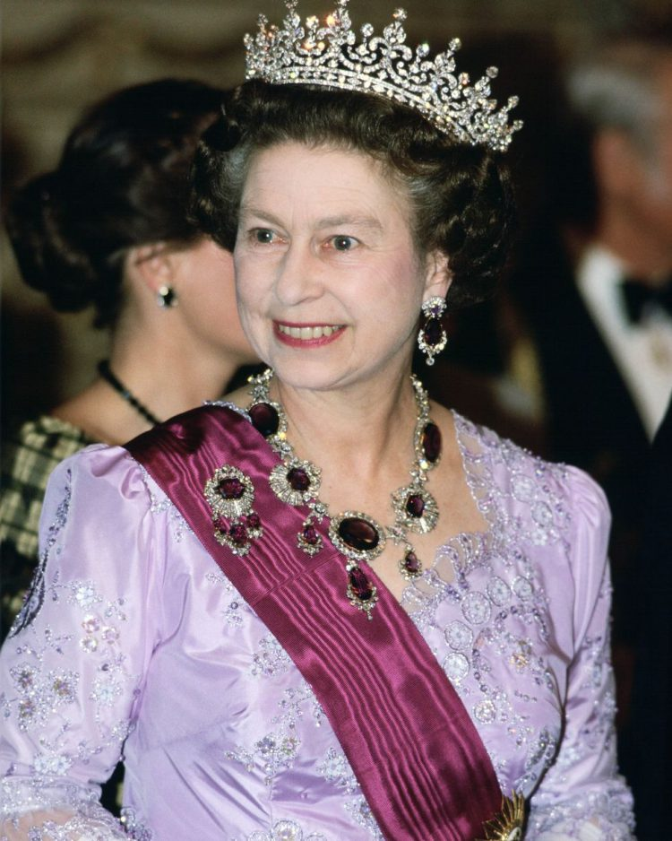

Slide 3
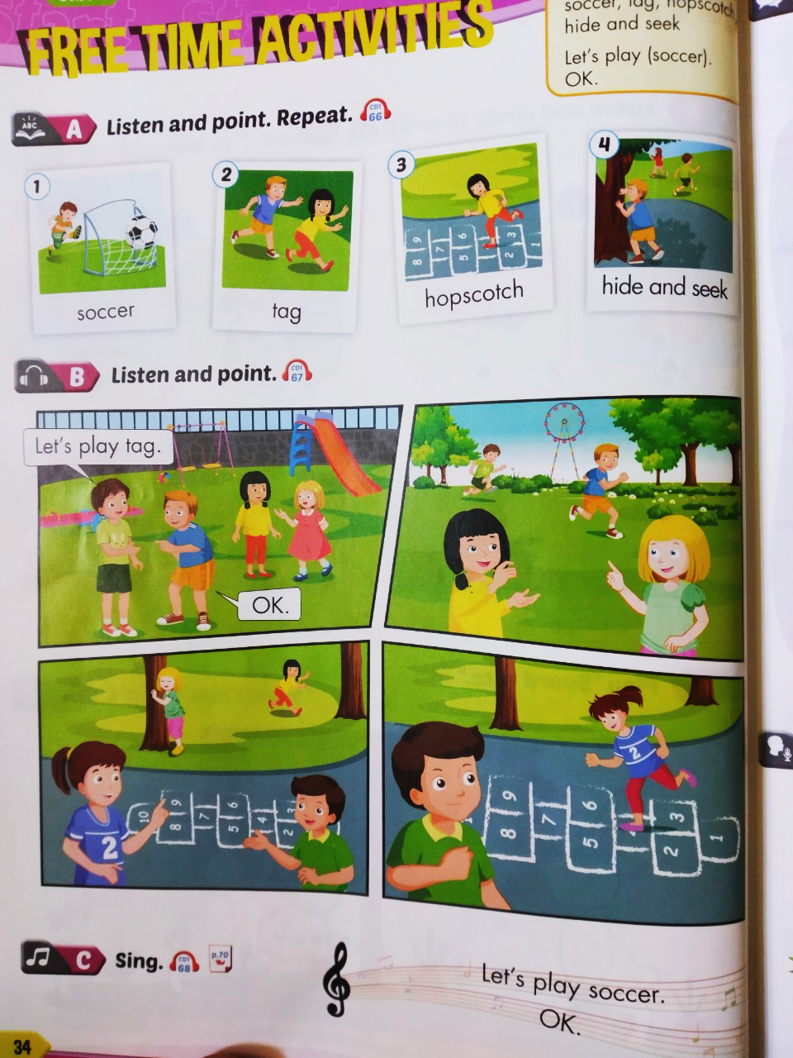

Slide 4
Tuesday, December 7th 2021
Unit 5: Free time activities
1. vocab
Soccer: môn bóng đá
tag: trò chơi đuổi bắt
Hopscotch: trò nhảy lò cò
Hide and seek; trò chơi trốn tìm
Play; chơi
2. Model sentences
Let’s play tag.
Ok

Slide 5
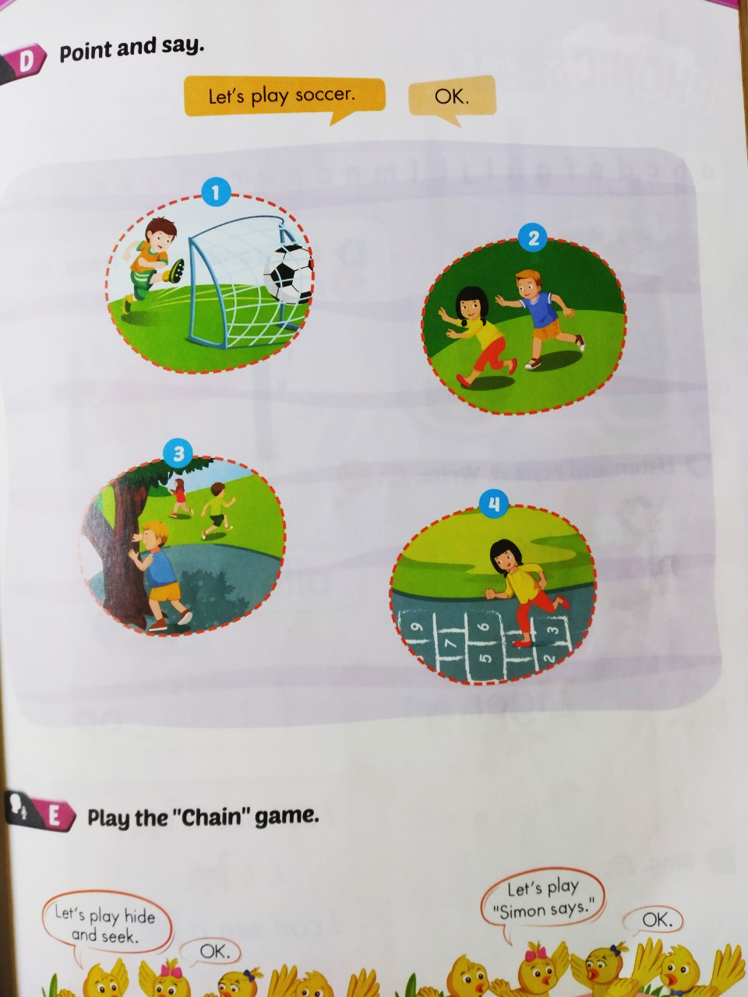

Slide 6
Sing
Let’s play soccer
Ok
Let’s play tag
Ok
Let’s play hopscotch
Ok
Let’s play hide and seek.
Ok

Slide 7
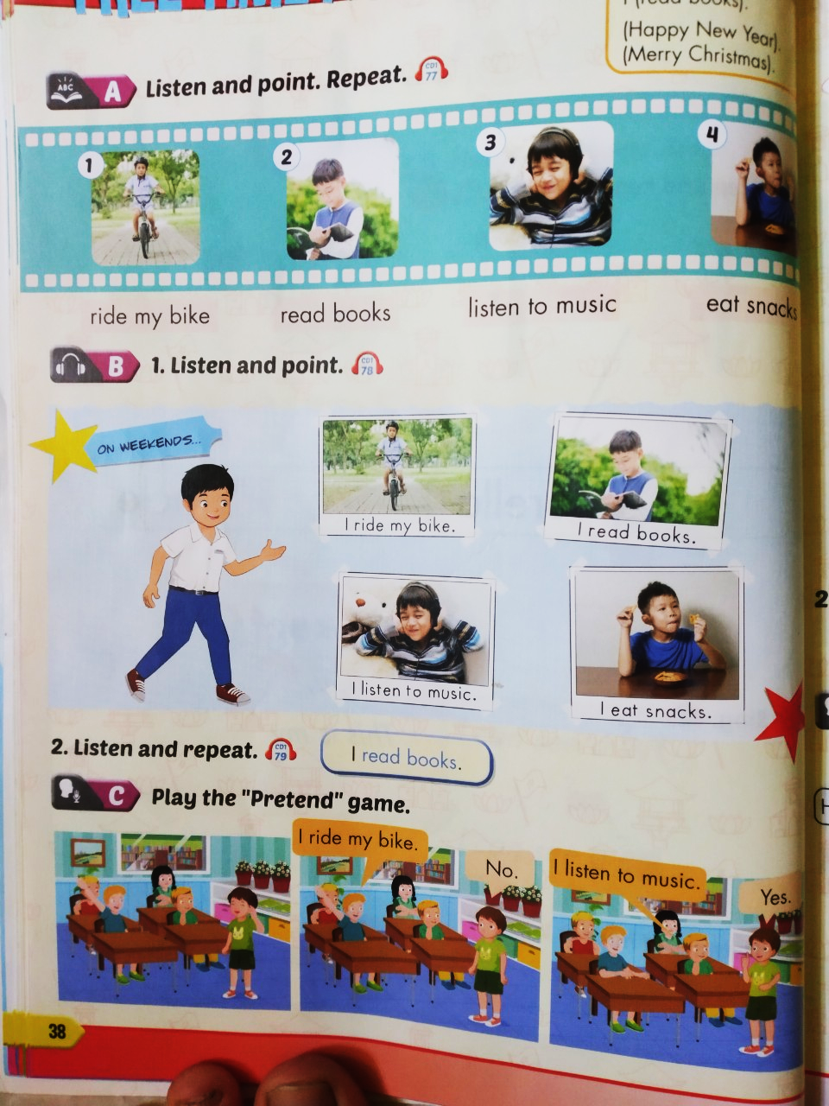

Slide 8
Tuesday, December 7th 2021
Unit 5: Free time activities
1. vocab
Ride my bike: đi xe đạp
Read books: đọc sách
Listen to music: nghe nhạc
Eat snacks: ăn thức ăn nhẹ
2. Model sentences
I ride my bike.

