Slide 2
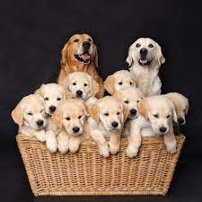
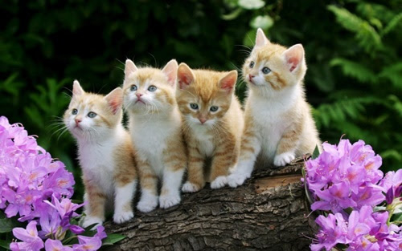
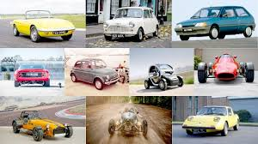
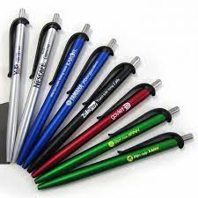
dogs
cats
Cars
pens

Slide 3
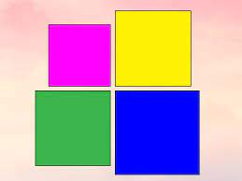
11
There are four squares.
There are ………….

Slide 4
1. Listen and read

Slide 5
Friday, November 19th 2021
Unit 3. Numbers
Lesson 3.
1. Listen and read
2. Listen and repeat
a. New words.
from: từ
city: thành phố
b. Model sentences
Where are you from?
I’m from Hai Phong.

Slide 7
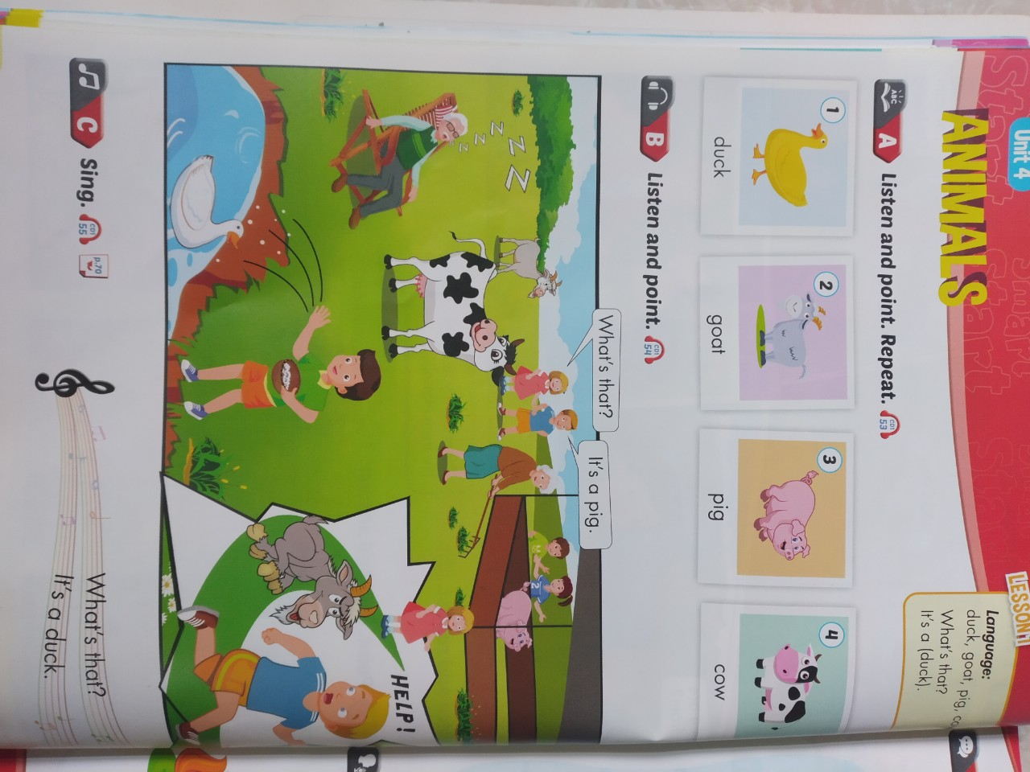

Slide 8
