Slide 2
11 12 13 14 15

Slide 3
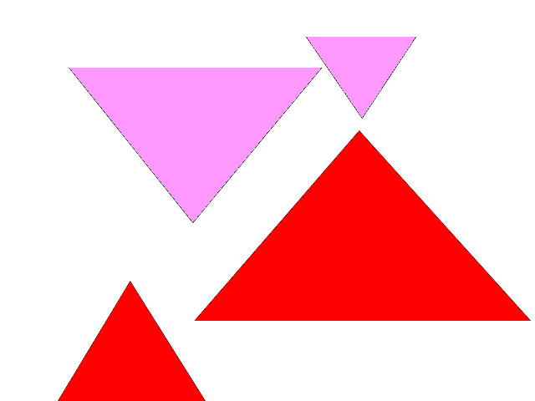
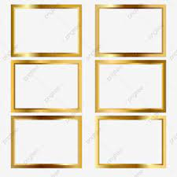
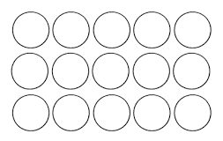

Slide 4
How many triangles are there?
Four triangles.

Slide 5
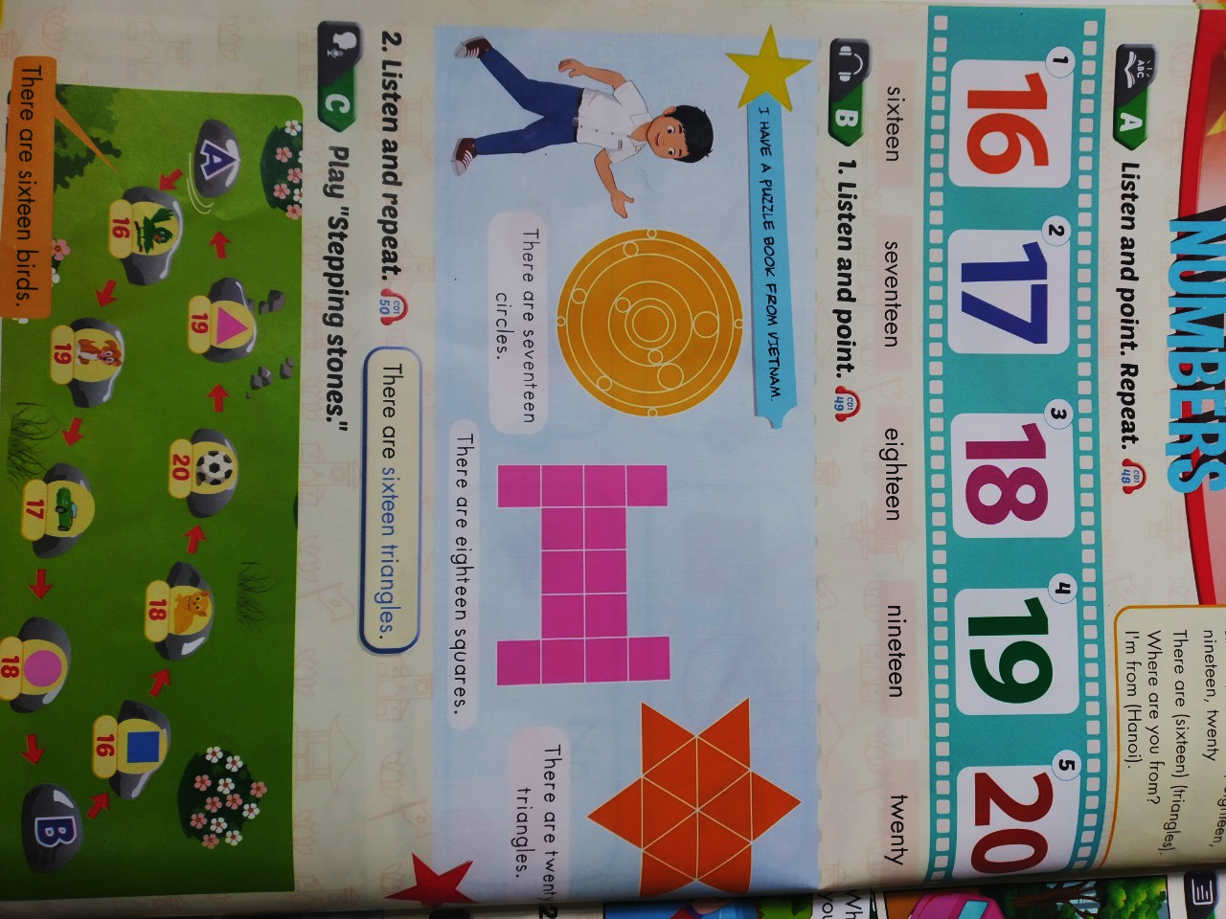

Slide 6
November 9th 2021
Unit 3. Numbers.
Lesson 3
1. New words.
Sixteen: 16
Seventeen: 17
Eighteen: 18
Nineteen: 19
Twenty:20
2. Modelsentences.
There are seventeen circles.

Slide 7
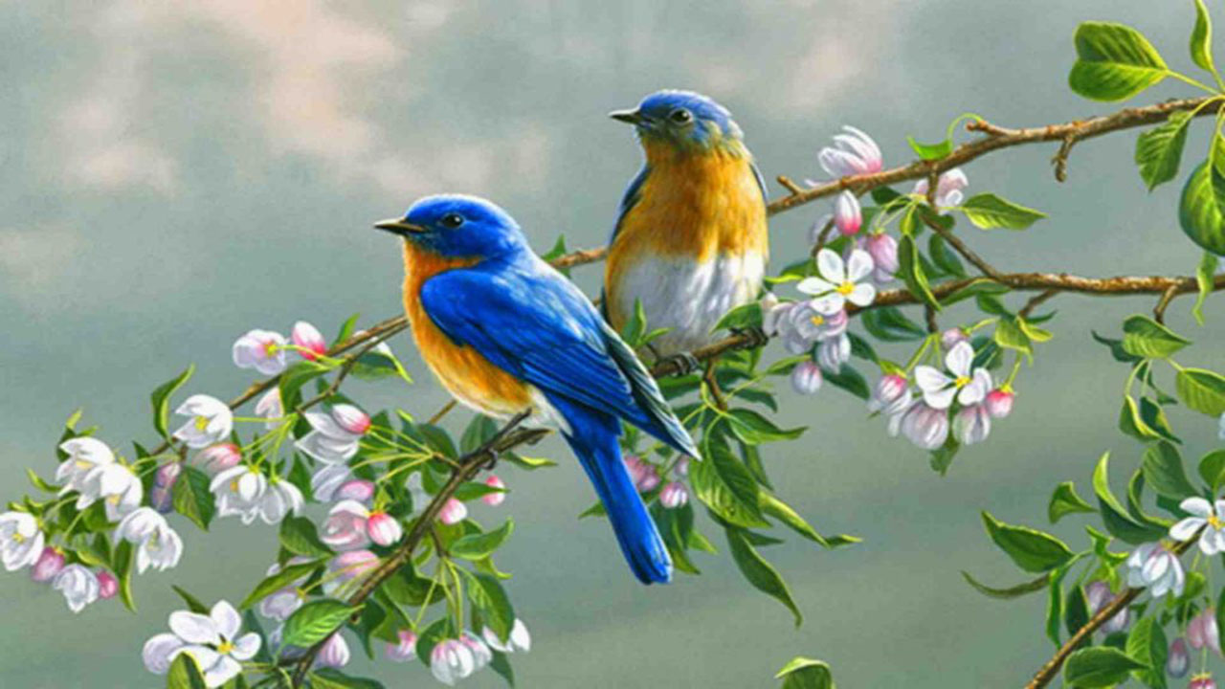
birds
caps

Slide 8
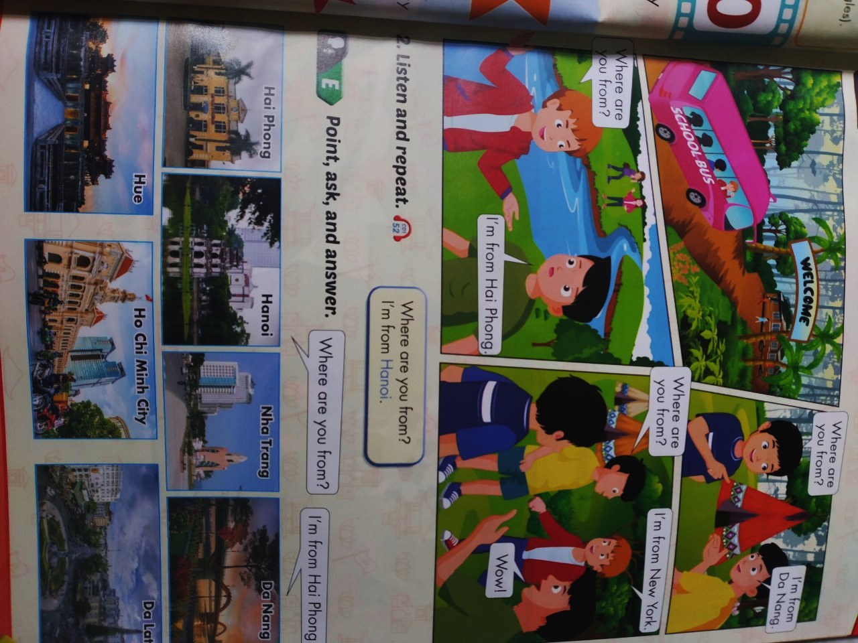
D. Listen and read

