Slide 1
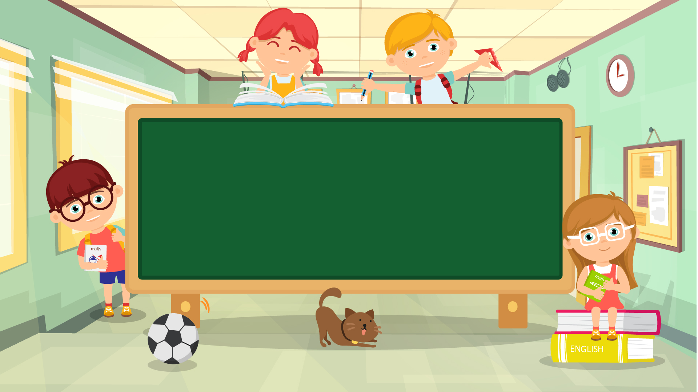
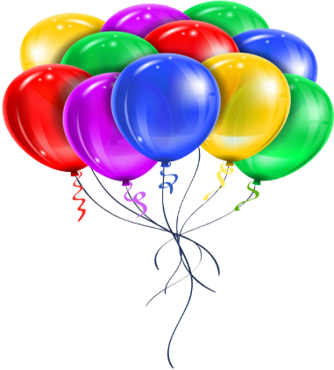
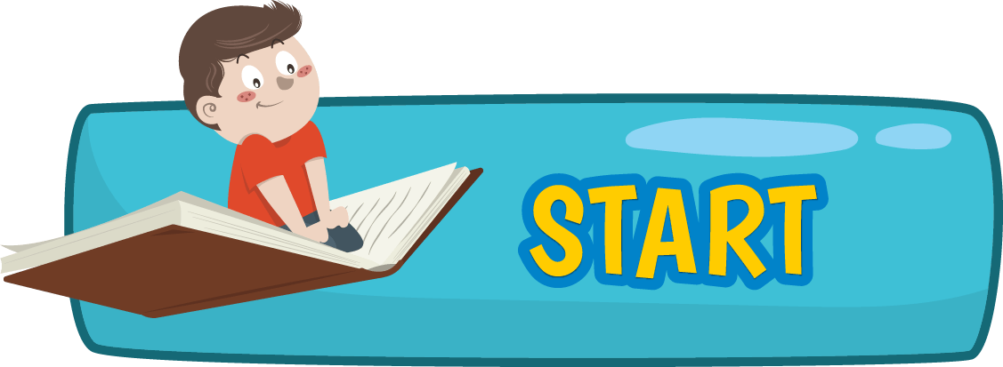
English 5

Slide 2
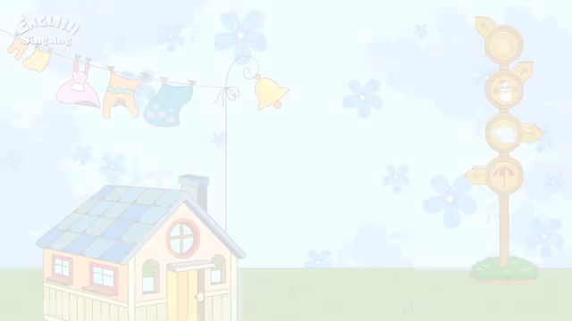
Warm-up
Sing

Slide 3
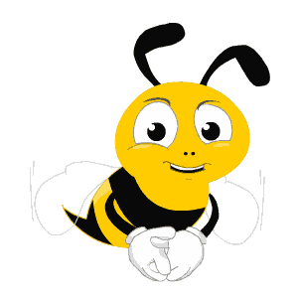
Check-up
Unit 18 – Lesson 1

Slide 4

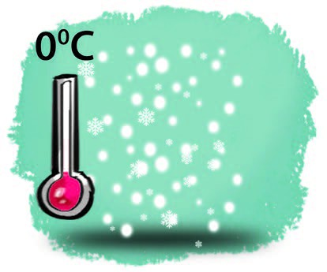
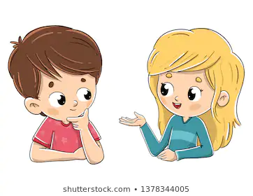
What will the weather be like tomorrow?
cold, snowy
It will be_________________.
cold and snowy

Slide 5
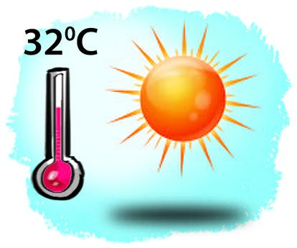
What will the weather be like tomorrow?
hot, sunny
It will be_________________.
hot and sunny

Slide 6
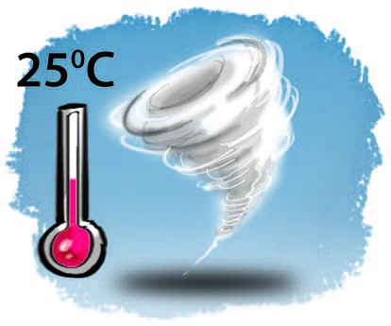
What will the weather be like tomorrow?
warm, stormy
It will be_________________.
warm and stormy

Slide 7
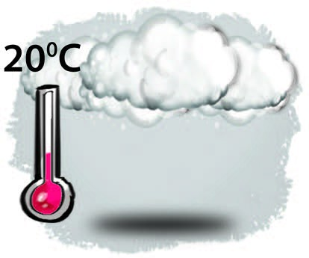
What will the weather be like tomorrow?
cool, cloudy
It will be_________________.
cool and cloudy

Slide 8
Unit 18
What will the weather be like tomorrow?
Lesson 2(1,2,3)

Slide 9
New words

Slide 10
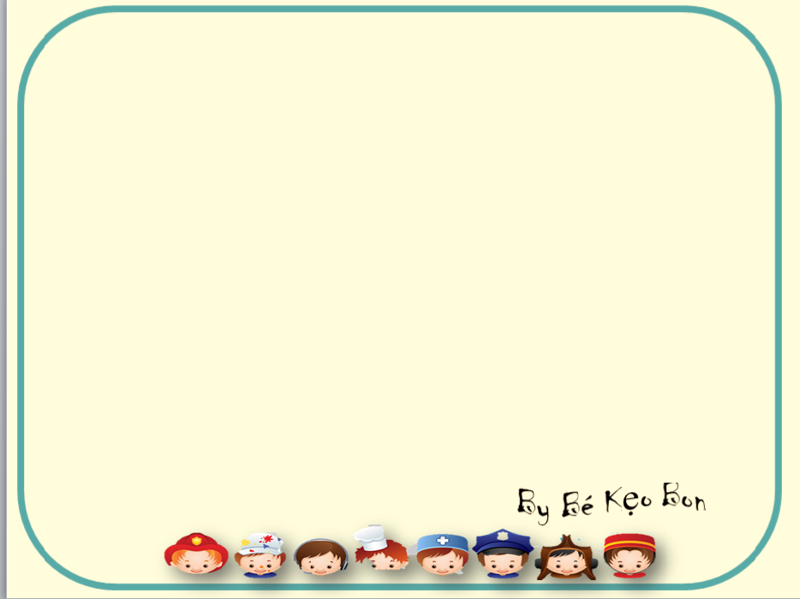
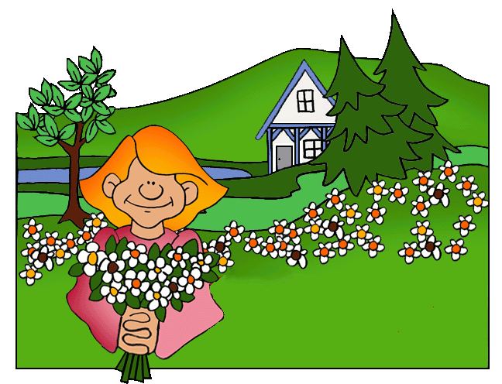

SEASONS OF THE YEAR
SPRING

Slide 11

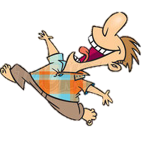
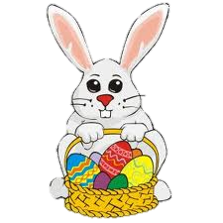

Slide 12
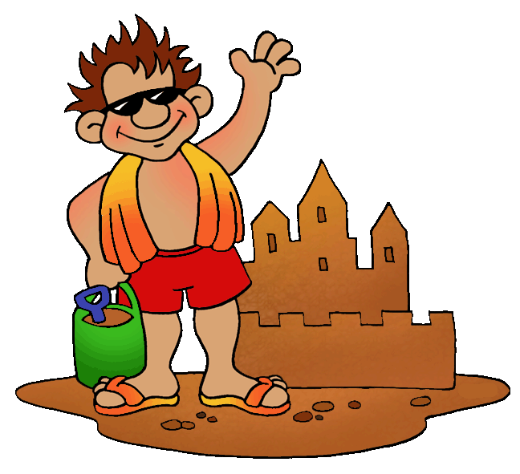


SEASONS OF THE YEAR
SUMMER

Slide 13


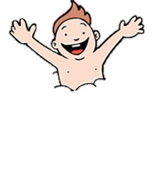

Slide 14
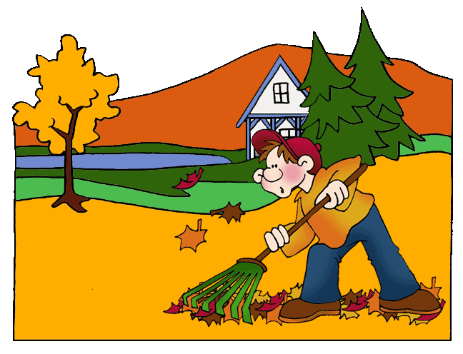
SEASONS OF THE YEAR
AUTUMN

Slide 15

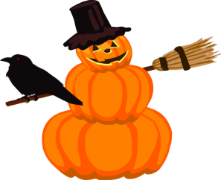

Slide 16
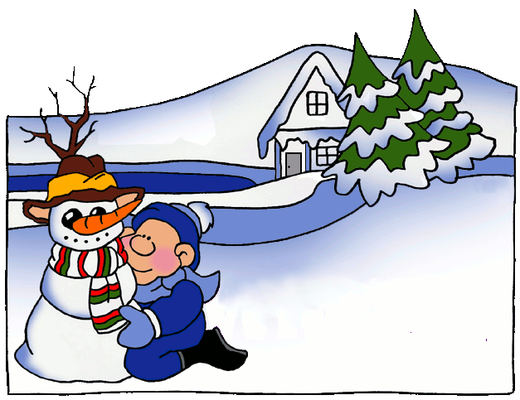
SEASONS OF THE YEAR
WINTER

Slide 17

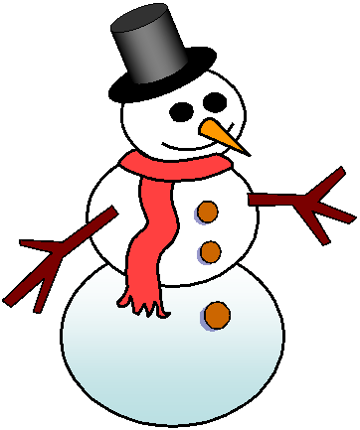
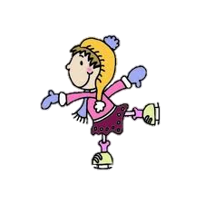

Slide 18

SEASONS OF THE YEAR
SPRING
SUMMER
AUTUMN
WINTER

Slide 19
1. Look, listen and repeat

Slide 20
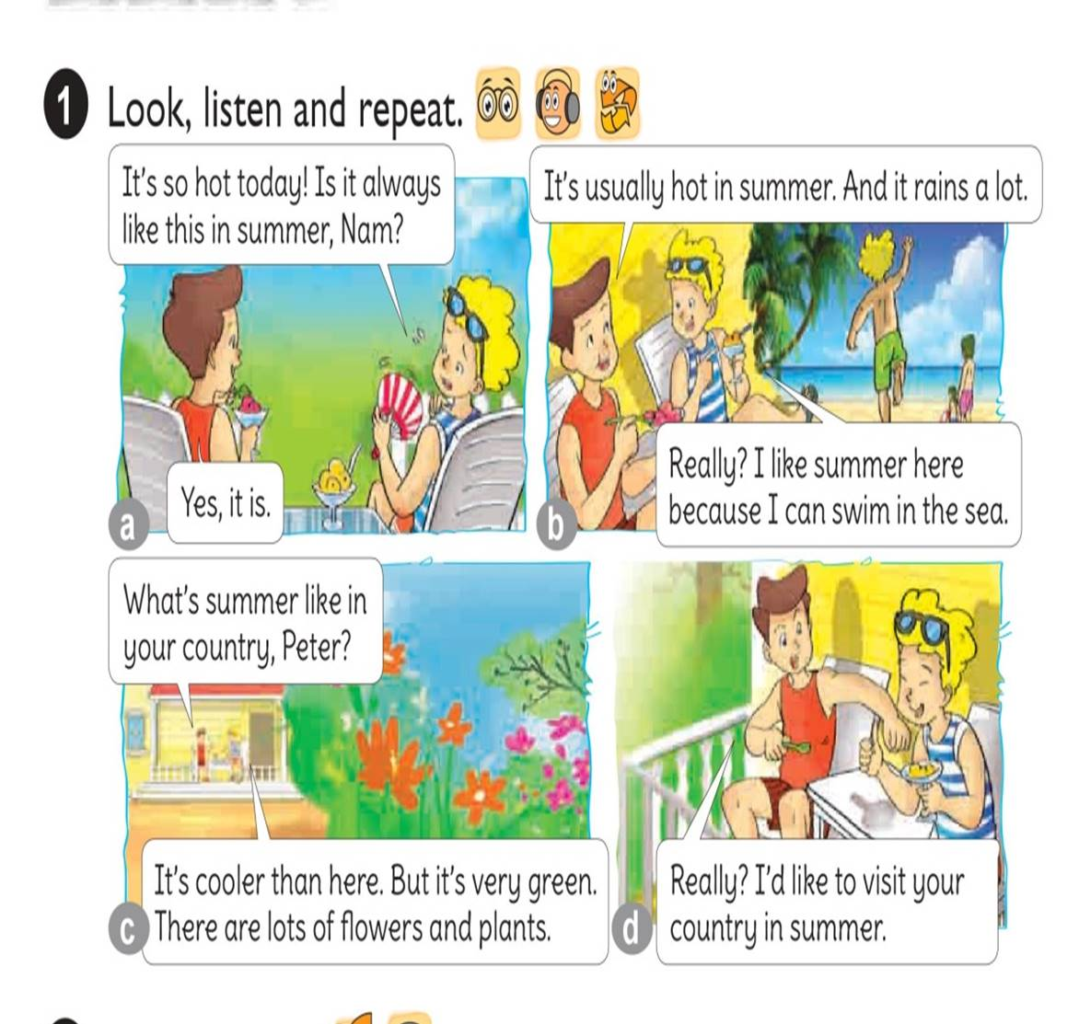




Slide 21
Sentence
What’s summer like in your country?
It’s usually cool. There are lots of flowers.

Slide 22
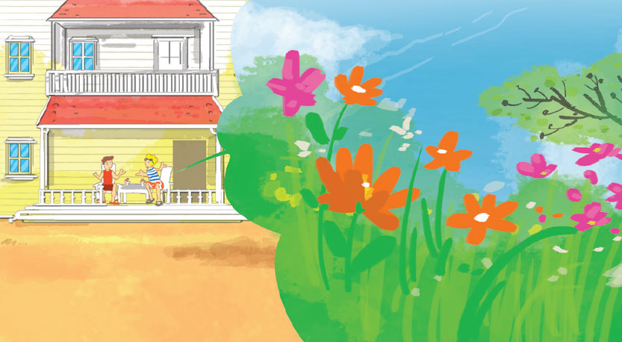
Example
It
What’s summer like in your country?
It
It’s usually cool.
There are lots of flowers.

Slide 23
2. Point and say

Slide 24
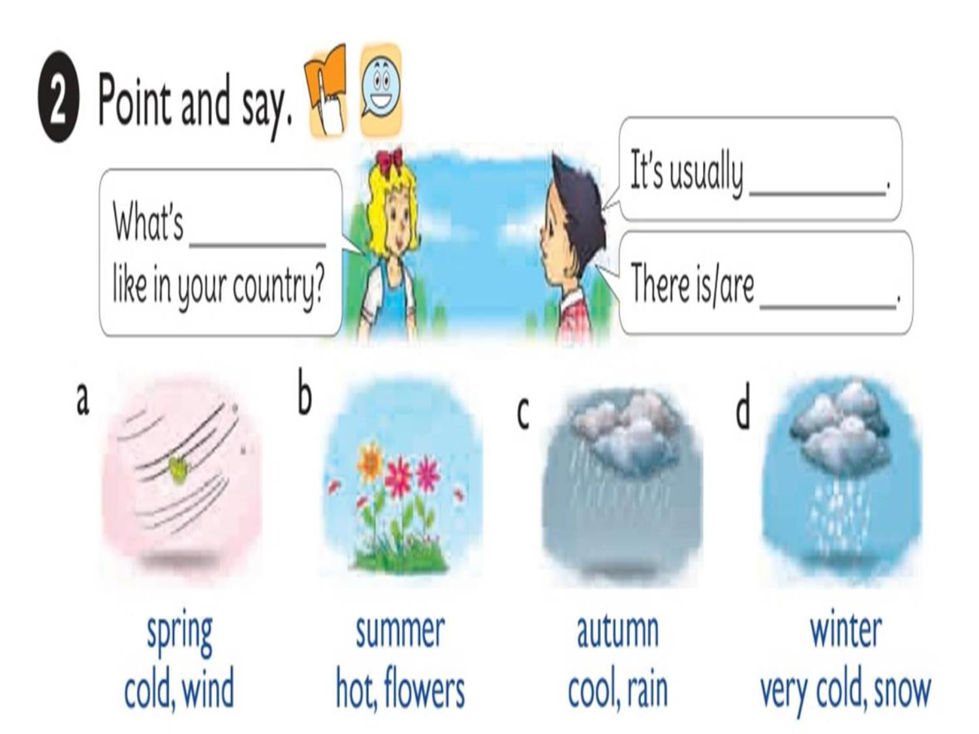


Slide 25
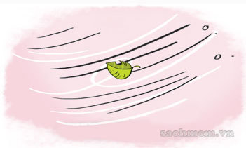
What’s _________ like in your country?
spring
spring
cold, wind
cold
It’s usually _______.
There is ________.
wind

Slide 26
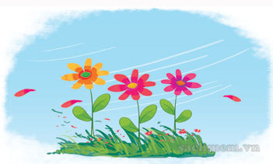
What’s _________ like in your country?
summer
summer
hot, flowers
hot
It’s usually _______.
There are ________.
flowers

Slide 27
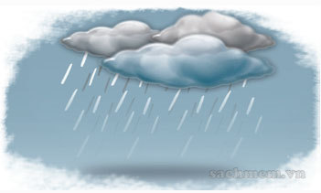
What’s _________ like in your country?
autumn
autumn
cool, rain
cool
It’s usually _______.
There is ________.
rain

Slide 28
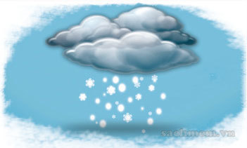
What’s _________ like in your country?
winter
winter
very cold, snow
very cold
It’s usually __________.
There is ________.
snow

Slide 29
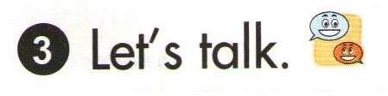
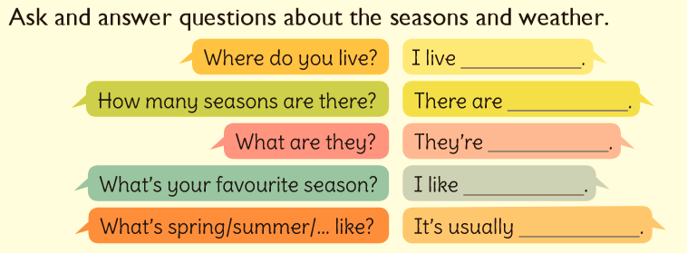

Slide 30
Consolidation

Slide 31

GAMES

Slide 32
What is the weather
usually like in the SPRING?
snowy and cold
sunny and warm
windy and freezing
sunny and cold

Slide 33
What is celebrated
in the SPRING?
Christmas
Valentine’s Day
Halloween
Easter

Slide 34
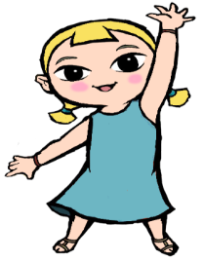
What do we usually wear
in the SPRING?
coats and gloves
dresses and shirts
hats and scarves
jumpers and boots

Slide 35

Click on the odd-one-out
SNOWY
WARM
SUNNY

Slide 36
GAMES

Slide 37
What is the weather
usually like in the SUMMER?
snowy and cold
windy and freezing
sunny and hot
sunny and cold

Slide 38
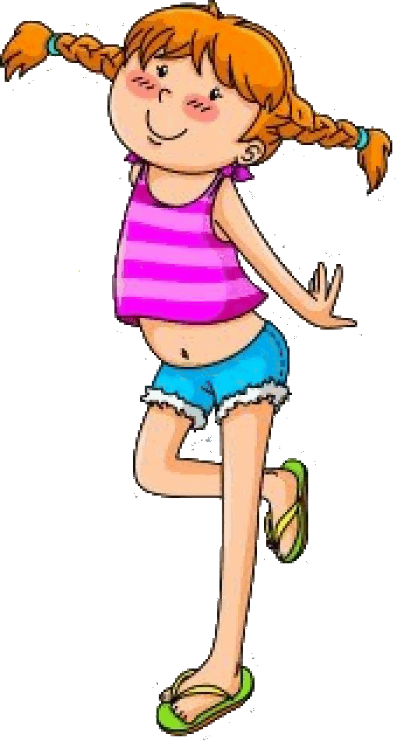
What do we usually wear
in the SUMMER?
jumpers and boots
scarves and gloves
raincoats and wellies
shorts and flip-flops

Slide 39
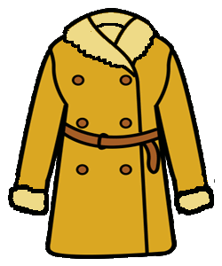

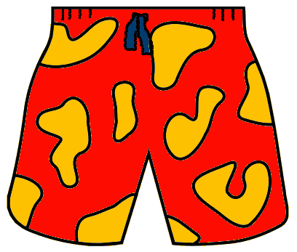
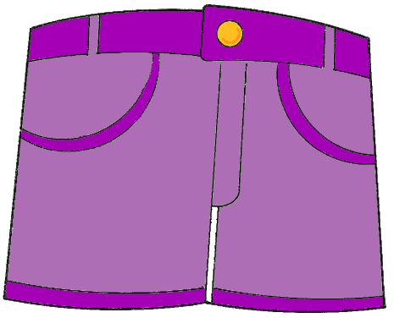
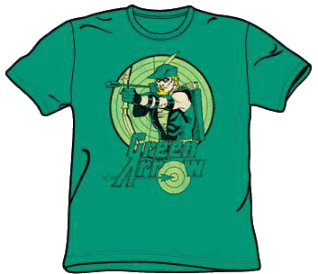
We don’t wear …
in the SUMMER
shorts
a dress
a coat
swimsuit
a T-shirt

Slide 40
What do we usually do
in the SUMMER?
go skiing
go swimming
go to school
go ice skating

Slide 41
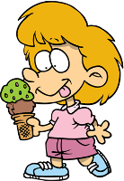
What do we usually have
in the SUMMER?
soup
ice cream
hot chocolate
turkey

Slide 42
GAMES

Slide 43
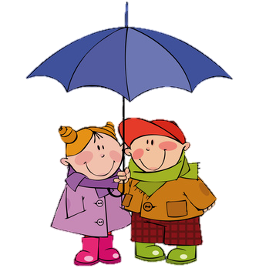
What is the weather
usually like in the AUTUMN?
cool and rainy
windy and freezing
snowy and cold
sunny and hot

Slide 44
What do we usually
wear in the AUTUMN ?
dresses and sandals
scarves and gloves
T-shirts and flip-flops
raincoats and wellies

Slide 45
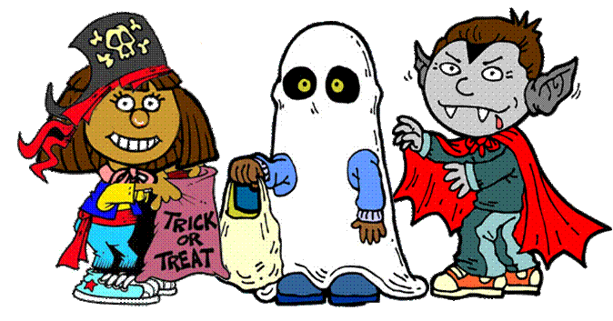

What is celebrated
in the AUTUMN ?
Christmas
Valentine’s Day
Easter
Halloween

Slide 46
Click on the odd-one-out
CLOUD
LEAF
PUMPKIN
FLOWER

Slide 47
GAMES

Slide 48
What is the weather
usually like in the WINTER ?
sunny and cool
snowy and freezing
windy and warm
cloudy and hot

Slide 49
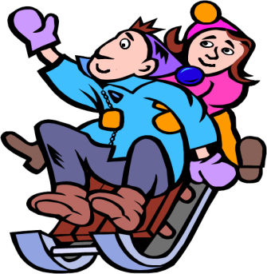
What do we usually
wear in the WINTER ?
jeans and sandals
scarves and gloves
T-shirts and flip-flops
shirts and shorts

Slide 50
What is celebrated
in the WINTER ?
Halloween
Valentine’s Day
Easter
Christmas

Slide 51
Click on the odd-one-out
SNOW
HOT
ICE
COLD

Slide 52
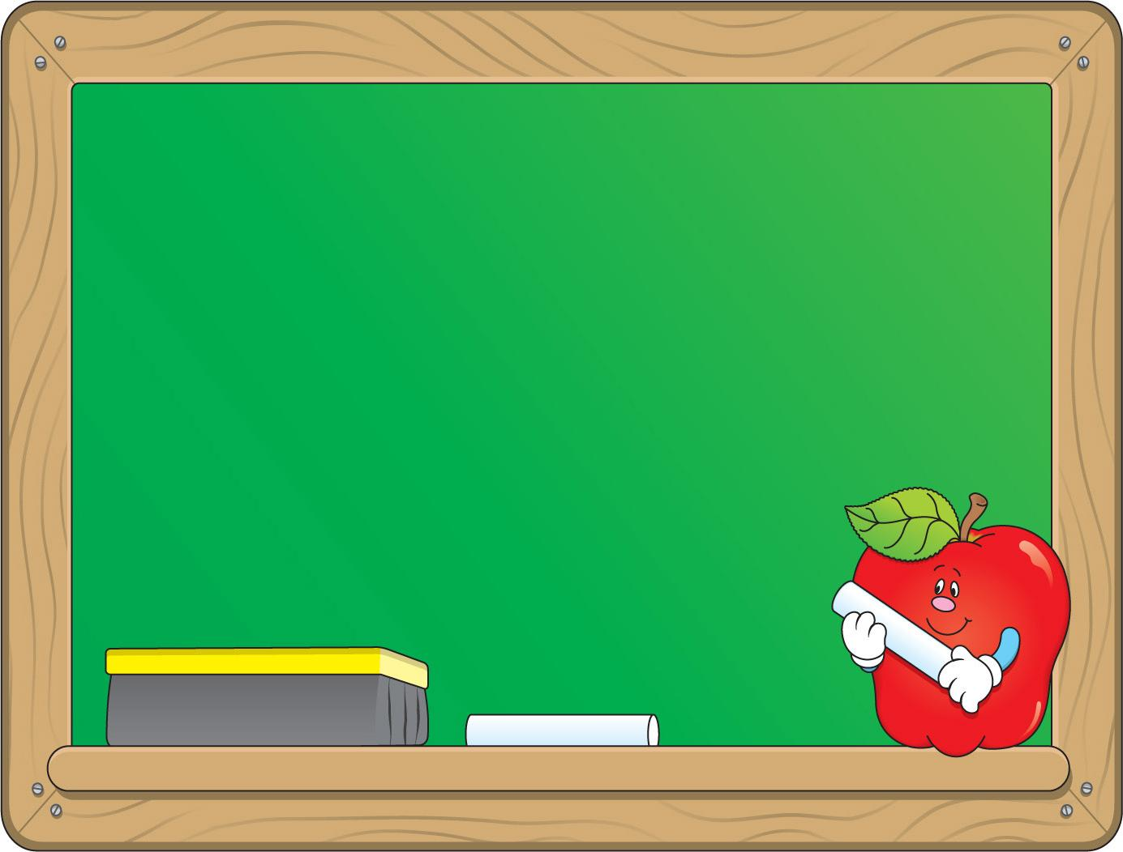
Tuesday, April 13th 2021
Unit 18: What will the weather be like tomorrow?
Lesson 2
Look, listen and repeat
plants : cây cối
Point and say
spring : mùa xuân
summer : mùa hè
autumn : mùa thu
winter : mùa đông
* Sentence pattern:
What’s summer like in your country?
It’s usually hot. There are flowers.

Slide 53
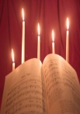
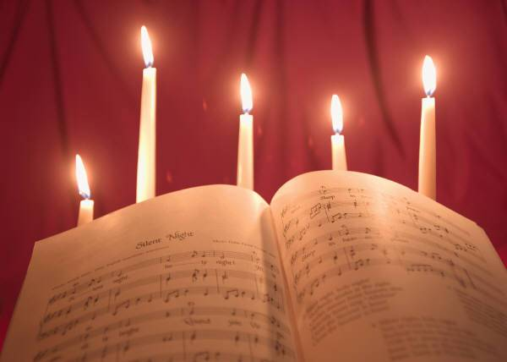

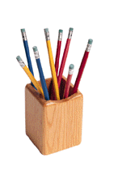
Homework
Learn all the new words.
Prepare for new lesson.

Slide 54
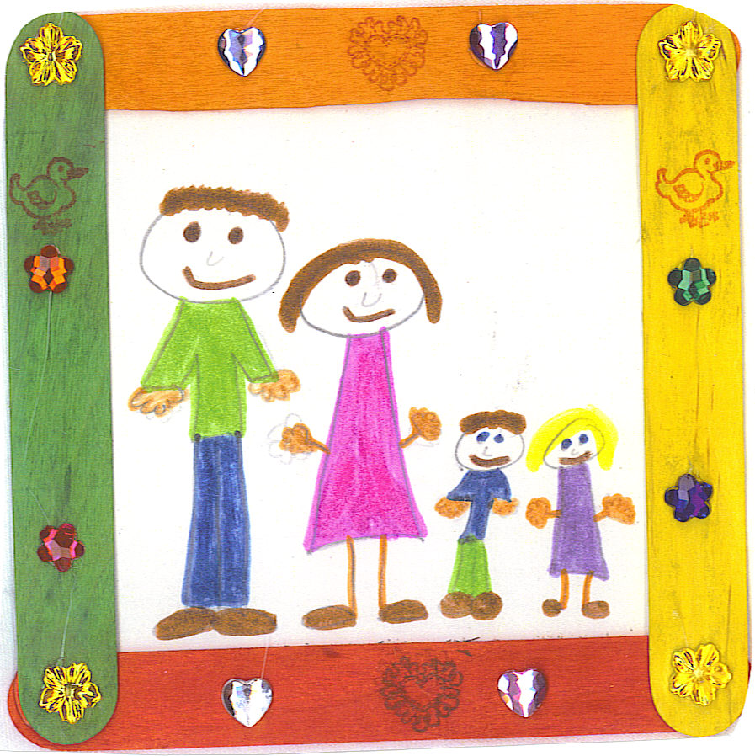


THANK YOU FOR ATTENTION!
GOODBYE
SEE YOU LATER

