Slide 1
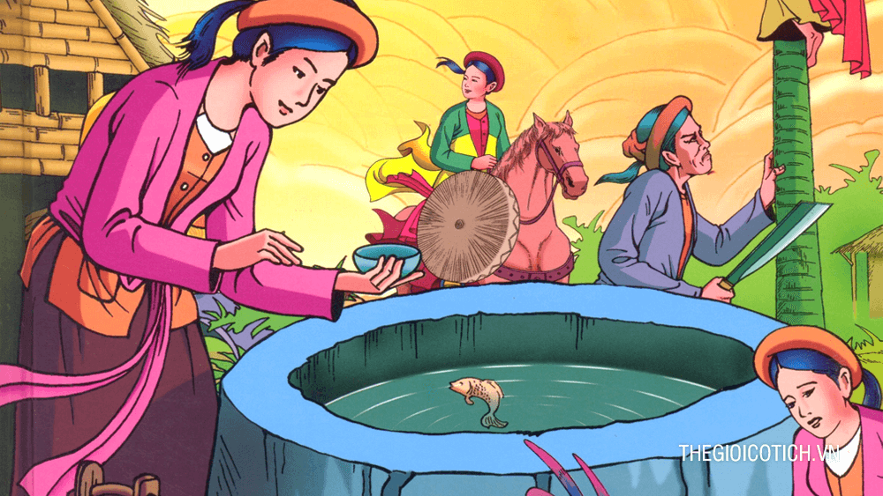
Tam Cam

Slide 2
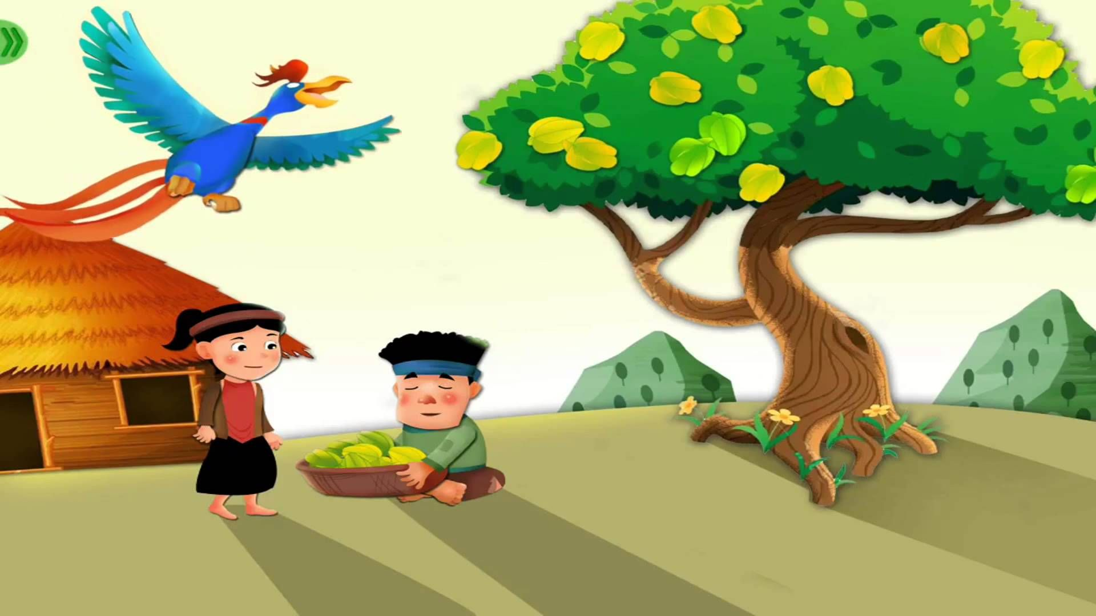
The story of starfruit tree

Slide 3
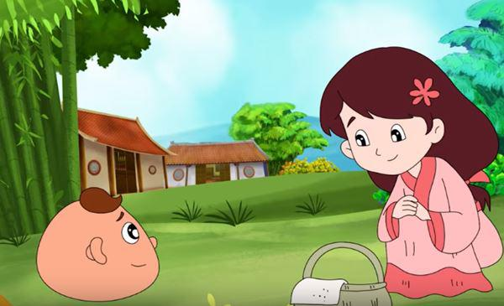
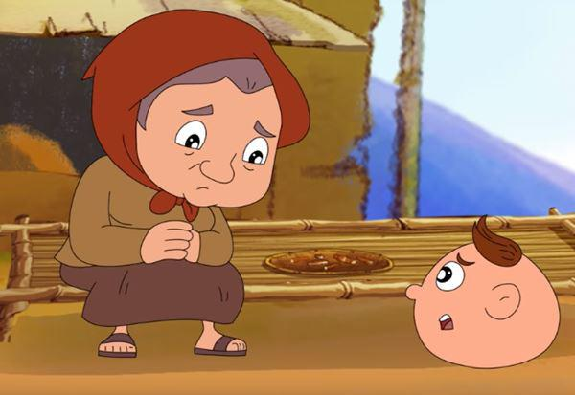
Coconut

Slide 5
Friday,February 26th 2021
Unit 14: What happened in the story?
Lesson 1(1,2,3)

Slide 6
Vocabulary
- delicious: ngon
- seed: hạt giống
- watermelons: dưa hấu
- called: gọi là
- Oh, really?: Ồ, thật không
- happened: đã xảy ra

Slide 7
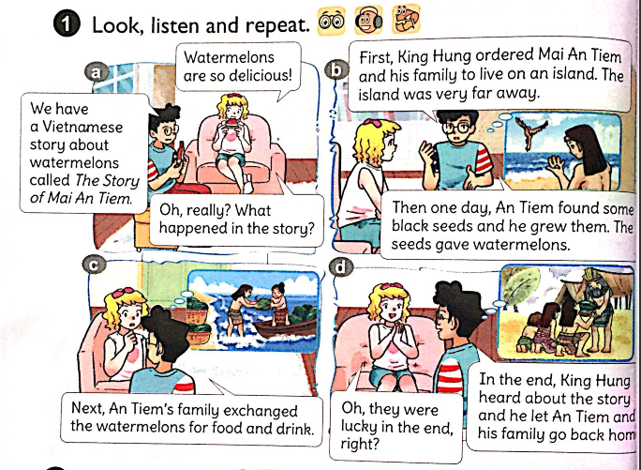

Slide 8
Infinitive ( Nguyên thể) | Past simple (Quá khứ đơn) | Meaning (Nghĩa)
happen | happened | Xảy ra
order | ordered | Ra lệnh
find | found | Tìm thấy
grow | grew | gieo, trồng
give | gave | Cho ra, mang lại
exchange | exchanged | Đổi, trao đổi
hear | heard | nghe
let | let | Cho phép, để cho

Slide 9
What happened in the story?
First, __________.
Then, __________.
Next, __________.
In the end, __________.

Slide 10
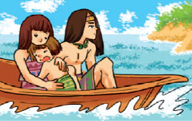
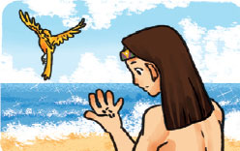
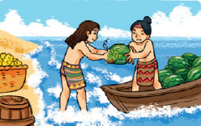
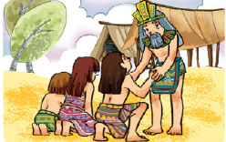
2. Point and say
First, King Hung ordered Mai An Tiem and his family to live on an island. The island was very far away.
Then one day, An Tiem found some black seeds and he grew them. The seeds gave watermelons.
Next, An Tiem's family exchanged the watermelons for food and drink.
In the end, King Hung heard about the story and he let An Tiem and his family go back home.

Slide 11
