Slide 1
Unit 12
Don’t ride your bike
too fast
Lesson 2

Slide 2
VOCABULARY

Slide 3
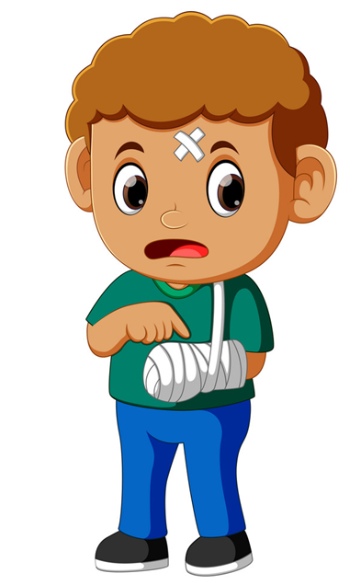
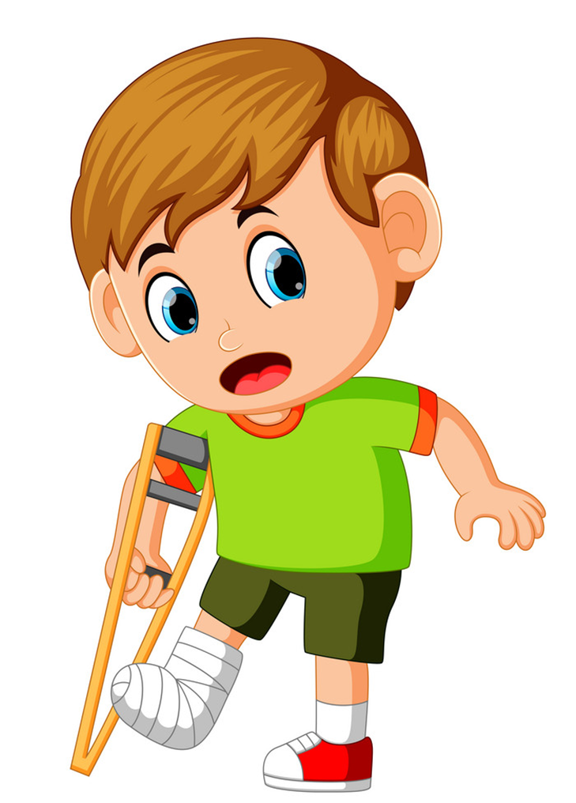
Vocabulary
Break your arm
Break your leg
/breɪk jɔːr ɑːrm/
/breɪk jɔːr leg/

Slide 4
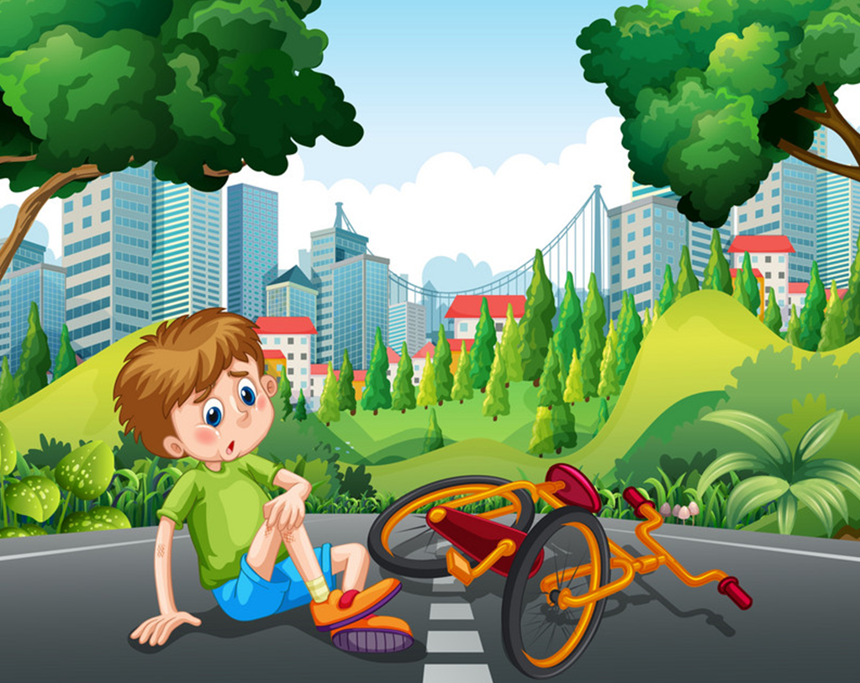
Vocabulary
fall off your bike
/fɔːl əv jɔːr baɪk/

Slide 5
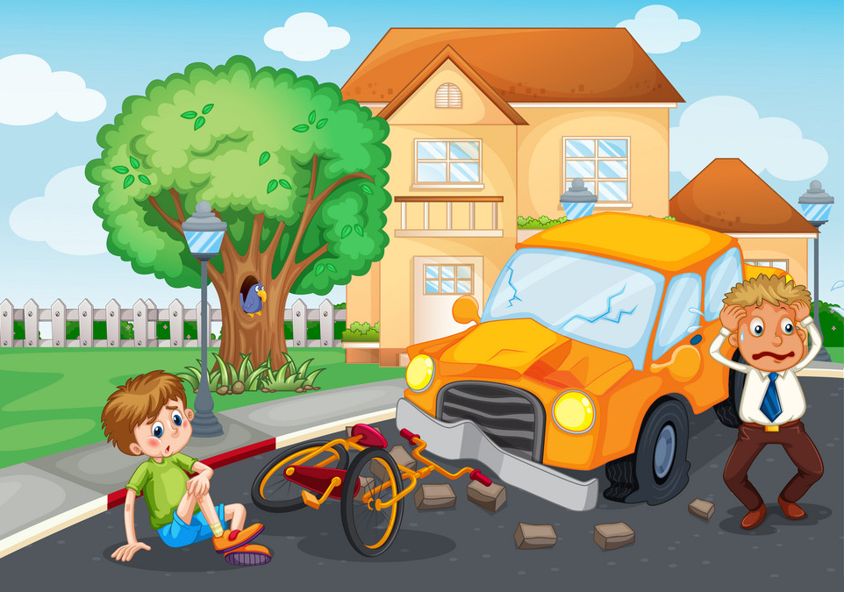
Vocabulary
Have an accident
/hæv ənˈæksɪdənt/

Slide 6
Vocabulary
Break your arm
Break your leg
Have an accident
fall off your bike

Slide 7
GRAMMAR

Slide 8
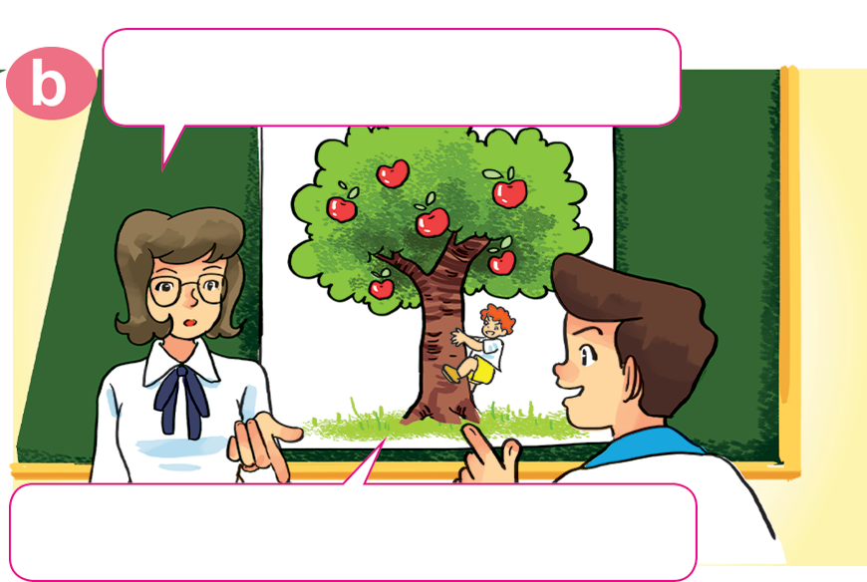
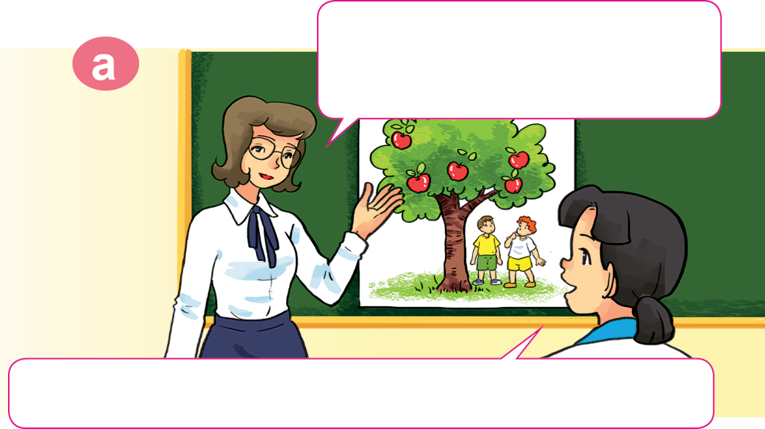
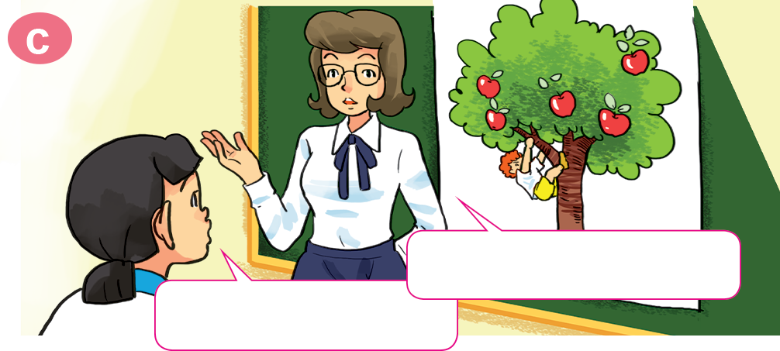
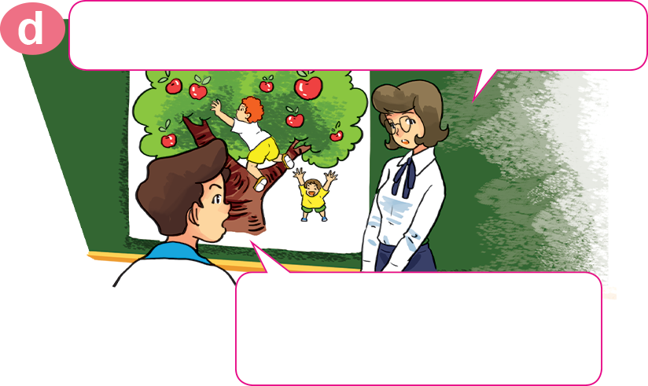
Look, listen and repeat.
Look. What are these children doing, class?
What is this boy doing?
They're looking at the apples on the tree.
He's climbing the apple tree.
Why shouldn't he climb the tree?
Should he do that?
Because he may fall
and break his leg.
No, he shouldn't.

Slide 9
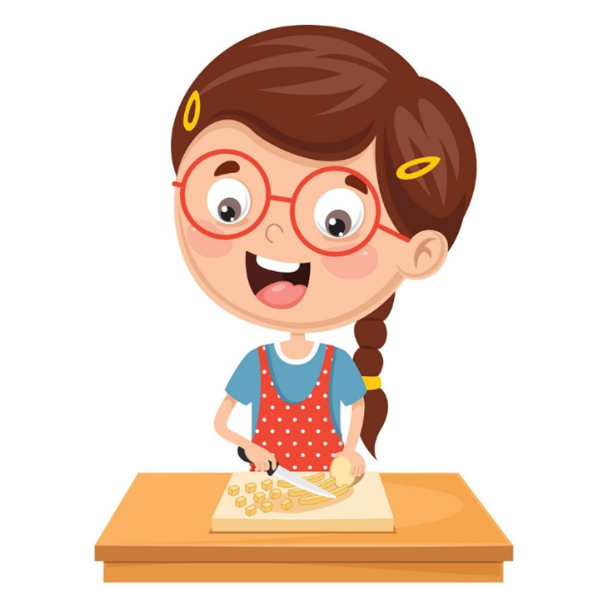
2. Point and say
play with the knife
Why shouldn't I _______________________ ?
Because you may ____________________ .
cut yourself

Slide 10
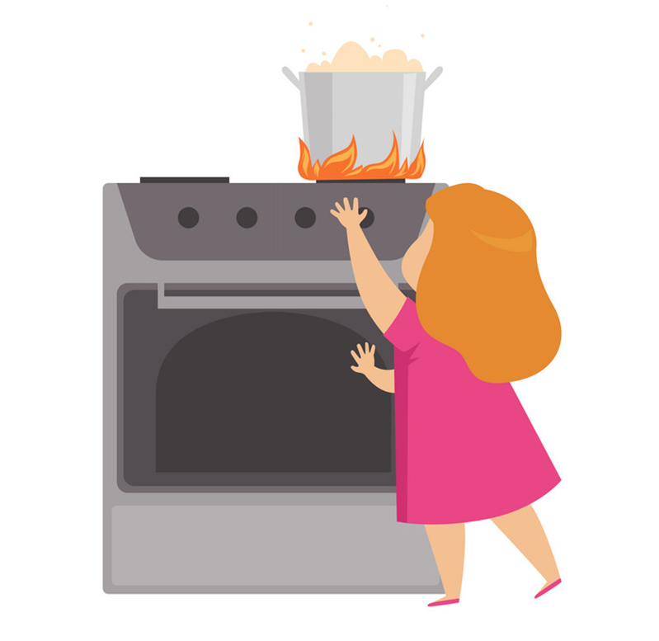
2. Point and say
play with the stove
Why shouldn't I _______________________ ?
get a burn
Because you may ____________________ .

Slide 11
2. Point and say
ride too fast
Why shouldn't I _______________________ ?
fall off your bike
Because you may ____________________ .

Slide 12
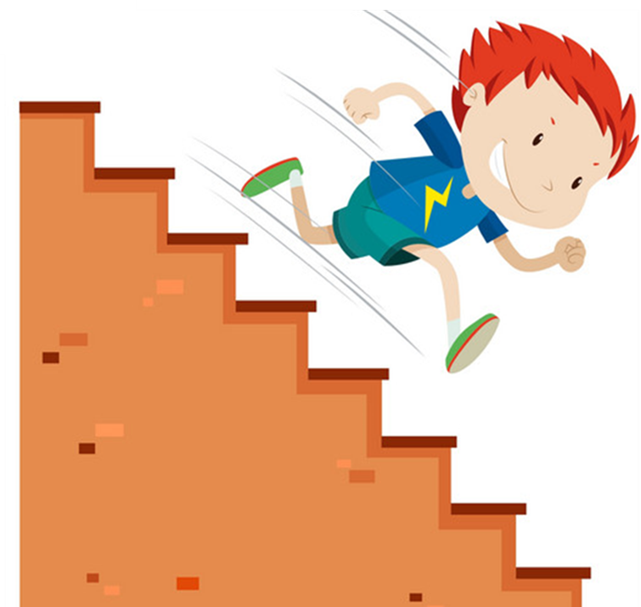
2. Point and say
run down the stairs
Why shouldn't I _______________________ ?
break your arm
Because you may ____________________ .

Slide 13
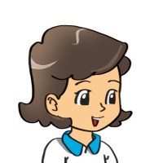
3. Let’s talk.
What is he doing?
He is _______________.
He shouldn't do that!
Why shouldn't he ________________________?
Because he may ______________.

Slide 14
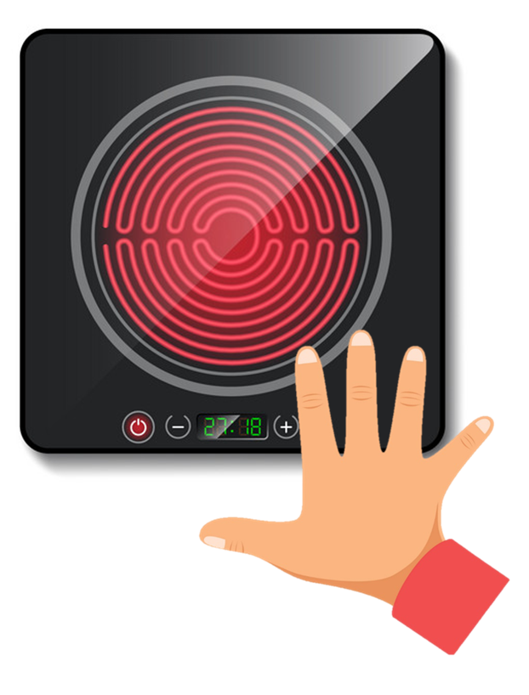
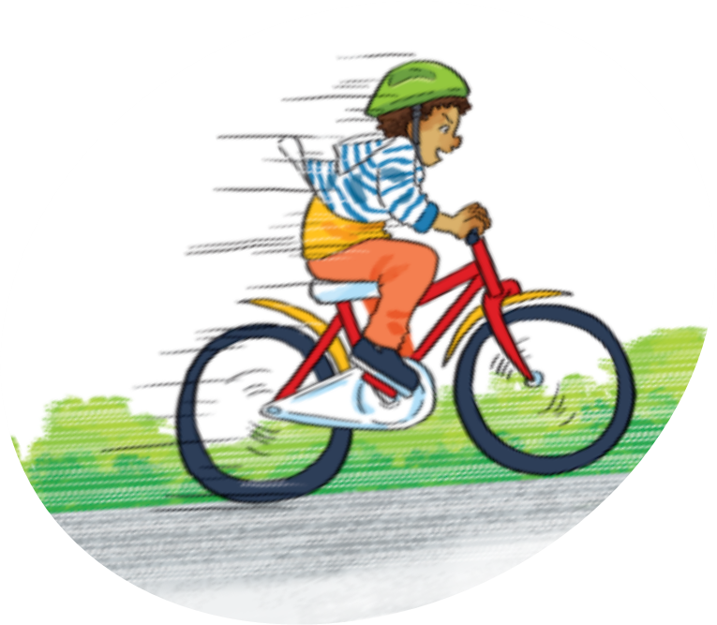
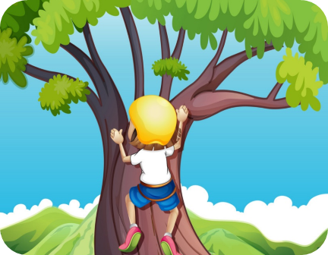
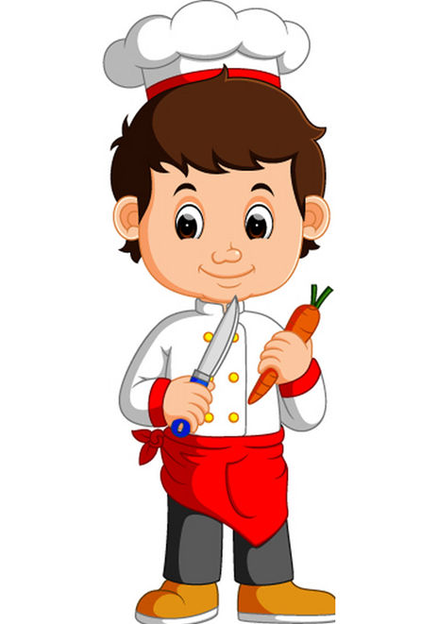
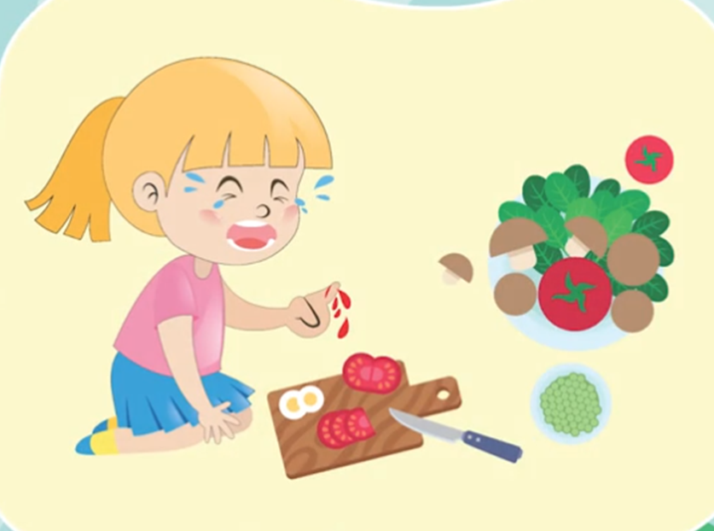
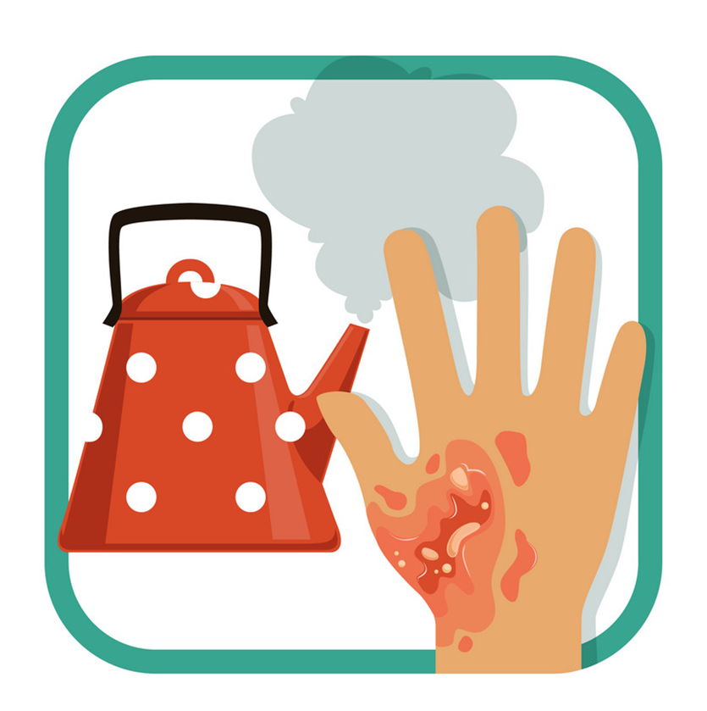
Touch the stove
Run down the stairs
Play with matches
Ride your bike
too fast
Climb a tree
Why I shouldn’t _____________?
Because you _____________.
Play with
the knife
Cut yourself
Break your arm
Break your leg
Have an accident
Get a burn

Slide 15
4. Listen and complete with one word.
1. Tony shouldn't play with the knife because it's very ________.
2. Nam shouldn't climb the ________ because he may fall and break his leg.
3. Mai shouldn't play with the stove because she may get a ________.
4. Tom shouldn't ride too fast because he may fall off his bike and break his ________.
sharp
wall
burn
arm

Slide 16
5. Read and complete.
yourself
knife
Why
Don't
see
Tom: What are you holding in your hand?
Phong: A (1) ______.
Tom: Oh, no. It's dangerous. (2) ______ play with it!
Phong: (3) ______ shouldn't I play with it?
Tom: Because you may cut (4) ________.
Phong: I can (5) ______ that. Thank you, Tom.
knife
Don't
Why
yourself
see

Slide 17
6. Let’s play

Slide 18
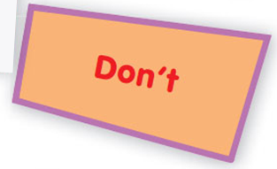
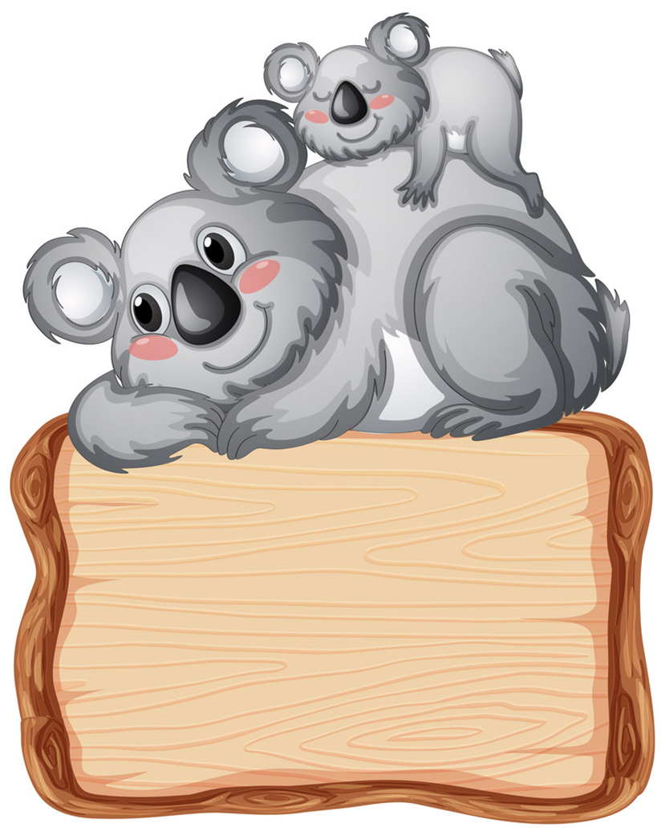
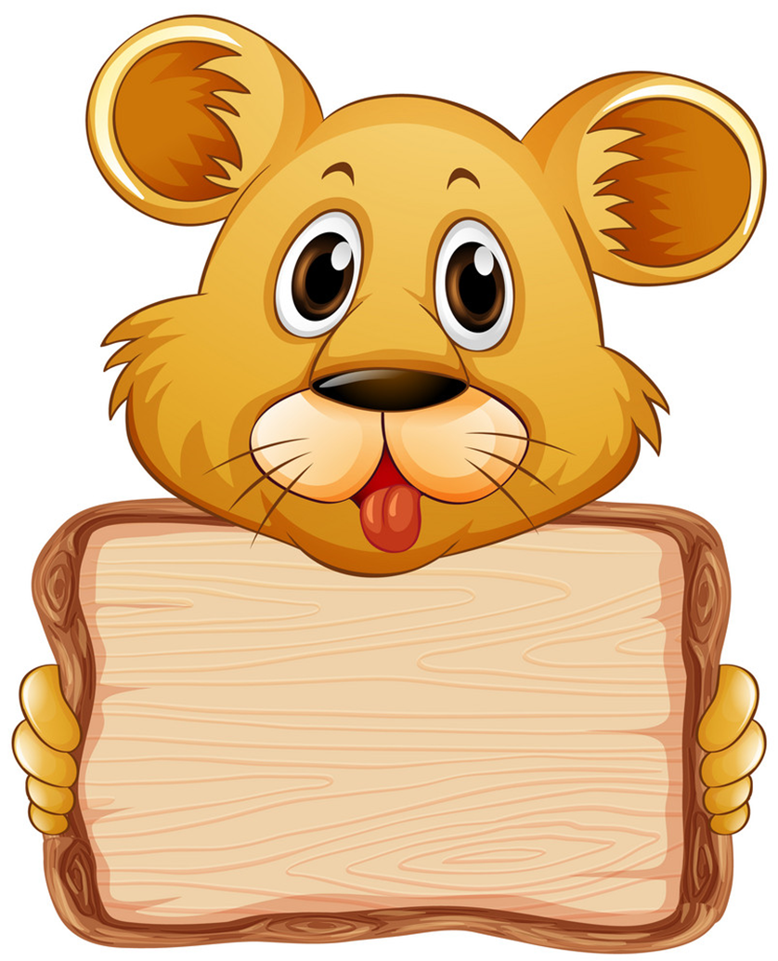
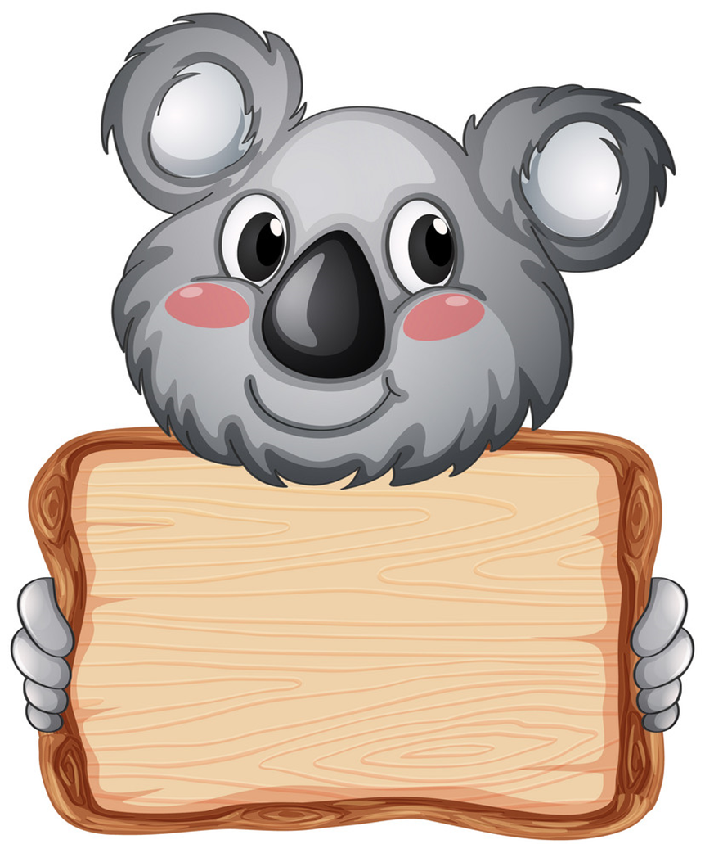
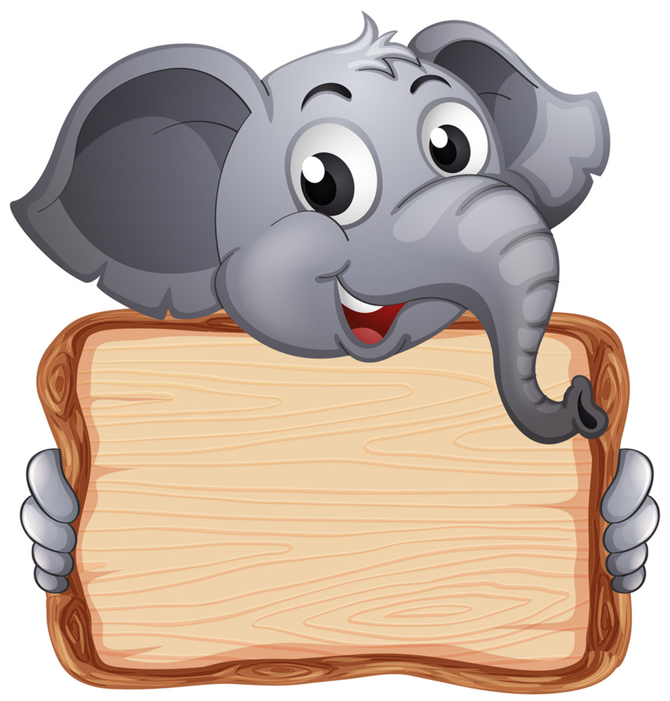
MATCHING GAME
play with
matches
You may
get a burn
Don’t
Next

Slide 19
MATCHING GAME
run down the stairs
fall off your bike
Don’t
You may
ride too fast
ride
too fast
fall off
your bike
Don’t
You may
Next

Slide 20
MATCHING GAME
get a burn
run down the stairs
break your leg
Don’t
You may
run down the stairs
break
your leg
Don’t
You may
Next

Slide 21
MATCHING GAME
fall off your bike
climb
the tree
break
your arm
You may
Don’t
climb
the tree
break
your arm
Don’t
You may
Next

Slide 22
MATCHING GAME
have a
headache
touch
the stove
listen to music too loud
Don’t
You may
listen to music too loud
You may
have a
headache
Don’t
Next

