Slide 1
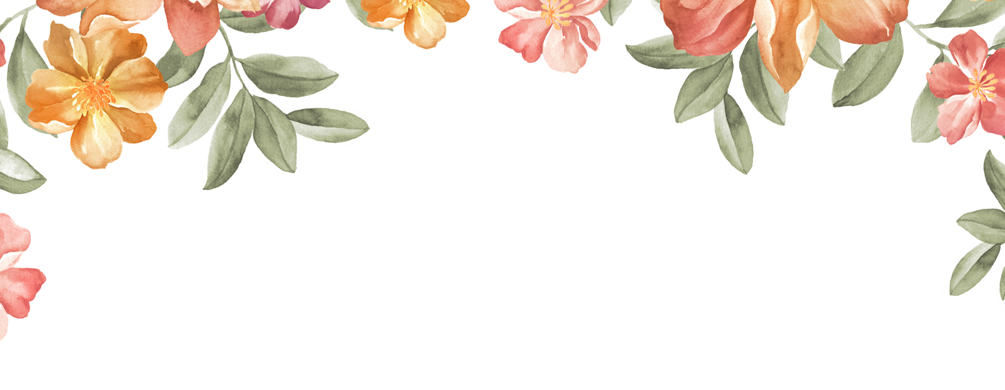




Welcome to our class
Teacher: Huynh Nhu

Slide 2

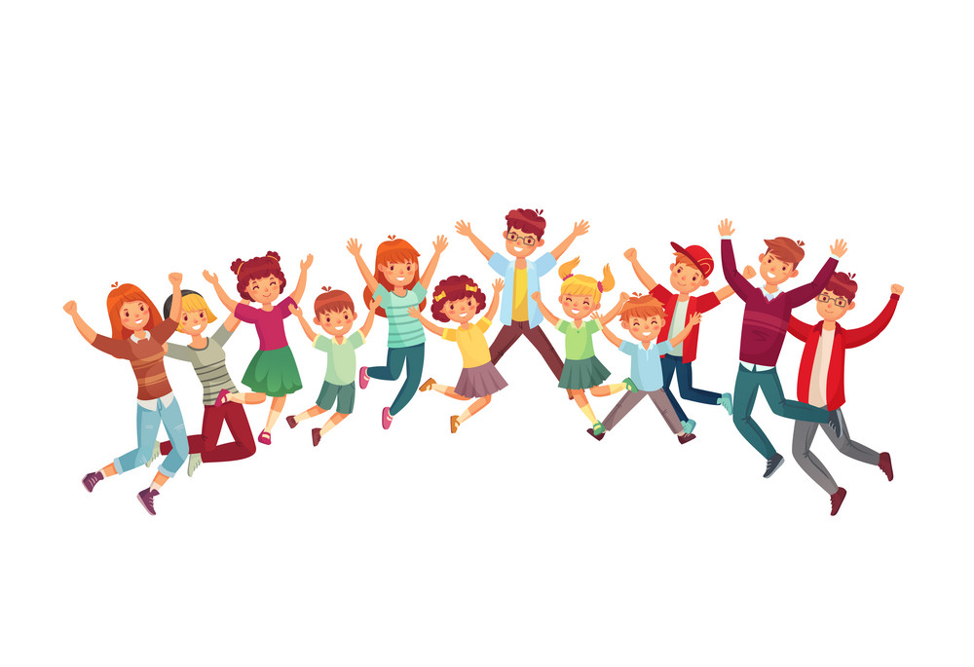
Game: “Action boys!”

Slide 3
a toothache
a sore throat
a stomach ache
a fever
a cold

Slide 4


Friday, January 22nd 2022
Unit 11: What’s the matter with you?
Lesson 3: ( Part 4,5,6,7)

Slide 5
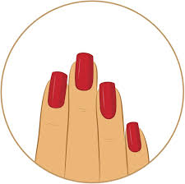
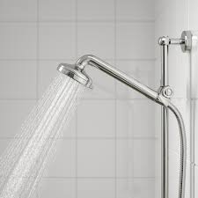

4. Read and match
Vocabularies:

Slide 6


4. Read and match
1. Wash your hands
2. Eat
3. Do
4. Brush
5. Keep your nails
6. Take
a. your teeth twice a day.
b. a shower every day.
c. short and clean.
d. healthy foods.
e. morning exercise regularly.
f. before having meals.

Slide 7

4. Read and match
1. Wash your hands before having meals.
2. Eat healthy foods.
3. Do morning exercise regularly.
4. Brush your teeth twice a day.
5. Keep your nails short and clean.
6. Take a shower every day.

Slide 8

Write your advice.
 | He/She should… | He/She shouldn’t…
1. Tony has a bad toothache.
2. Quan has a bad cold.
3. Phong has a stomach ache
4. Phong has a sore throat.

Slide 9


6. Project
Talk about two health problems and give advice.

Slide 10
1. Wash your hands before having meals.
2. Eat healthy foods.
3. Do morning exercise regularly.
4. Brush your teeth twice a day.
5. Keep your nails short and clean.
6. Take a shower every day.

Slide 11

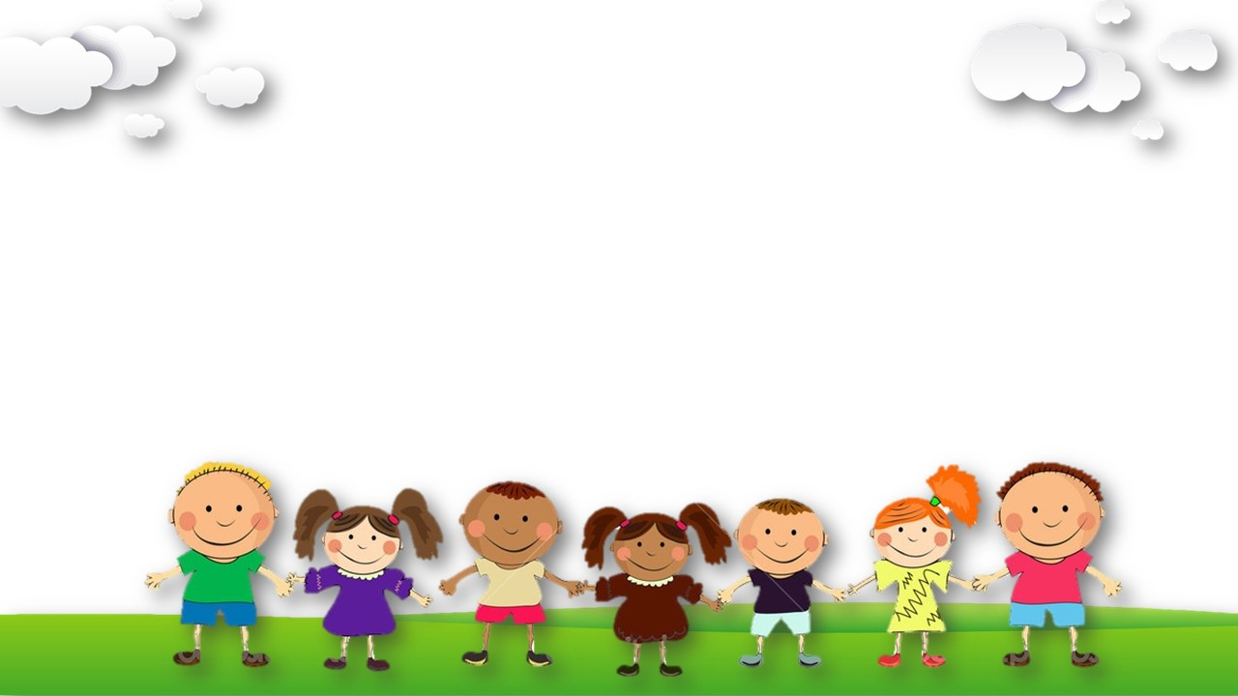
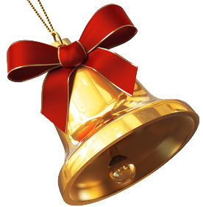


RING GOLDEN BELL

Slide 12

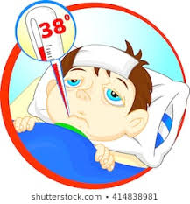
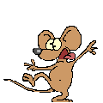
Ring golden bell
Question 1
I have ………………...
A. a sore throat
B. an earache
C. a fever
Times up
Start
Key: C
5s
1s
3s
2s
4s
0s

Slide 13
Ring golden bell
Question 2
A: I have a bad toothache
B: You should……………………..
A. go to the dentist.
B. eat a lot of sweets.
C. eat a lot of chocolate.
Times up
Start
Key: A
5s
1s
3s
2s
4s
0s

Slide 14
Ring golden bell
Question 3
Nam…..a bad cold today.
Times up
Start
Key: has
5s
1s
3s
2s
4s
0s

Slide 15
Ring golden bell
Question 4
food / should / eat / you / healthy /.
A. You should eat healthy food.
B. Should eat you food healthy.
C. Food you should eat healthy.
Times up
Start
Key: A
5s
1s
3s
2s
4s
0s

Slide 16



V. Homework
Review all the unit 11
Prepare for the next lesson
*
Prepare

Slide 17




Thank you very much
Good bye! See you again!

Slide 18
Thank you

