Slide 2
Friday, December 24${}^{th}$ 2021
Unit 10:
WHEN WILL SPORTS DAY BE ?
Lesson 2: Past: 4, 5, 6.

Slide 3
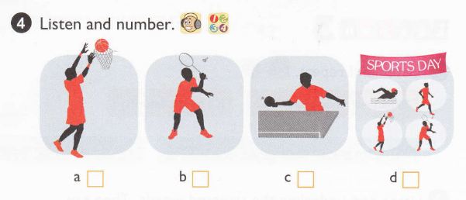
4
2
3
1

Slide 4
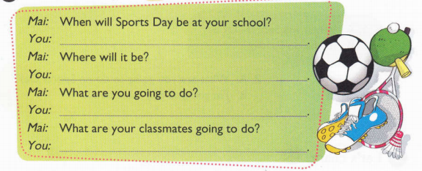
It'll be next month.
It'll be at school.
I'm going to play table tennis.
Nam, Khang and Minh are going to play in a football match. Hung and Thanh are going to play basketball. Trinh and Trang are going to play badminton...

Slide 5
